Slide 1
Georgia Quality Incentive Program
Teresa Costello
Customer Support Manager

Slide 2
Agenda
GHCA Quality Incentive Program
Program Requirements
Reports

Slide 3
Georgia Nursing Home QIP Program
Quality Incentive began in 2003
Longest running satisfaction measurement program for nursing homes
Partnership with Georgia Healthcare Association and Dept. of Community Health
Notes:
The Georgia Quality Initiative was created in 2003 and has been sustained through the cooperative efforts of the state Department of Community Health, Alzheimer’s Association, Georgia Chapter of the AARP, Georgia Office of Long Term Care Ombudsman, Georgia Medical Care Foundation, and the Georgia Health Care Association. In 2007 it became the Quality Incentive Program that you participate in today. It’s the longest running state sat measurement program for Nursing Homes. The program continues to hold the status of the nations oldest and most prominent initiative to consistently include the perceptions of nursing home residents, their families and the workers who care for them in a strategy to measure and improve overall performance.

Slide 4
Georgia QIP Requirements
Skilled Nursing Homes
Medicaid Provider
Annual Resident and Family Survey
Annual Employee Survey
Monthly Quality Profile data collection

Slide 5
Quality Incentive Reports
Each quarter NRC Health prepares a report and sends the results to the DOH
Each facility receives an individual Quarterly Report
Reports show scores and add-on incentive earned

Slide 6
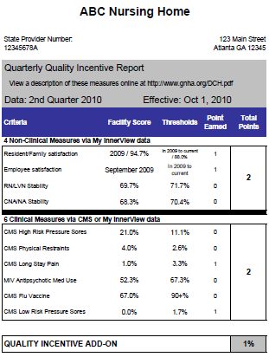
Quarterly Reports
4 non-clinical measures
6 clinical measures
Must participate in family,
resident employee surveys
Notes:
As a participant in the QIP Program each quarter you have the opportunity to earn up to a 2% add on depending on your performance. We are collecting both non-clinical and clinical data for the program. On your quarterly reports you can earn up to 4 points for the non clinical measures , and 6 points for the clinical measures.
1. In order to earn any points you must first participate in the Satisfaction Surveys- if you fail to do this it impacts your eligibility for the entire calendar year.
2. To Earn a 1% add on you must score at least 1 pt. form four non-clinical measures, one point form the 6 clinical measures and a 3rd point form either the clinical or non clinical measures
3. To earn a 2% add on you must socre at least 1 pt from the 4 non-clinical measures, 3 pts form the 6 clinical measures and the remaining 2 points from either.

Slide 7
Non-clinical data = 1 point each
Employee survey – survey from the last calendar year
Resident/family recommendation – combined score from the last calendar year
(failure to participate in the annual survey affects eligibility for entire year)
Notes:
The Non Clinical measures includes the employee satisfaction survey and the family resident satisfaction survey. We are using data from the last calendar year for the QIP. Currently we are using the 2019 Data for the 2020 QIP reports. The first requirement of the QIP program is that you participate in these surveys. The satisfaction survey is only done once per year so if you miss the survey timeline for any year it impacts you for the entire year following.

Slide 8
Non-clinical data = 1 point each
Quality Profile
Nursing Staff stability – Licensed Nurses, RNs, LPNs
Nursing Staff stability – Certified Nursing Assistants, CNAs
Notes:
The other non-clinical measures are our Nursing staff stability metrics both your licensed nurses and CNA’s. Nursing Staff stability refers to those who have been employed for one year or more.

Slide 9
Clinical Data = 1 point each
Quarterly data pulled from CMS:
% of high risk long-stay residents w pressure sores
% of long-stay residents physically restrained
% long-stay residents w moderate to severe pain*
% short-stay residents w pressure ulcers new/worsened
% residents who received influenza vaccine
% residents w one or more falls with major injury
NRC Quality metrics entered monthly will be used in the event the above CMS data is not available.
Notes:
The clinical data you see here comes from CMS each quarter – this is what we strive to use whenever possible.
If a Center does not have adequate data from CMS we have historically used the MIV Quality Profile data that is entered each month.
Because the MIV metrics do not exactly match CMS in every instance, In the past we were substituting metrics that were really apples to orange’s in some cases.
Such as substituting Acquired Catheters for short stay pressure sores new/worsened, or with weight loss/gain was substituted for long stay resident with moderate to severe pain. This again was because the MIV metrics did not match the more updated CMS metrics, because this potentially affects a large number of centeres each quarter NRC will continue to collect data from each of your centers
Some metrics will be changing beginning with Q4, (Oct – Dec 2020) the data that you will begin entering in November will be updated to more closely match CMS.

Slide 10
NRC Clinical Data = 1 point each
Entered Monthly by each Center:
% of residents w pressure sores
% of residents physically restrained
% of residents with significant weight loss/gain
% residents w pressure ulcers worsened
% residents who received influenza vaccine
% residents w one or more falls with major injury
NRC Quality metrics will be used in the event the above CMS data is not available.
Notes:
The clinical data you see here comes from CMS each quarter – this is what we strive to use whenever possible.
If a Center does not have adequate data from CMS we have historically used the MIV Quality Profile data that is entered each month.
Because the MIV metrics do not exactly match CMS in every instance, In the past we were substituting metrics that were really apples to orange’s in some cases.
Such as substituting Acquired Catheters for short stay pressure sores new/worsened, or with weight loss/gain was substituted for long stay resident with moderate to severe pain. This again was because the MIV metrics did not match the more updated CMS metrics, because this potentially affects a large number of centeres each quarter NRC will continue to collect data from each of your centers
Some metrics will be changing beginning with Q4, (Oct – Dec 2020) the data that you will begin entering in November will be updated to more closely match CMS.

Slide 11
Eligibility Requirements for Quality Data
Must have submitted as final at least two months of NRC Quality data during the reporting quarter
Data must be submitted by the 10th of the month for the previous months data
Notes:
In addition to participating in the annual surveys There are some requirements that must be followed in order to be eligible for the incentive:
For example October data will need to be submitted by November 10th

Slide 12
New data entry process effective Nov 1 2020
Beginning with October data submission November 1-10th
Email link sent to the administrator for each Center for submission
Administrator will forward the email to correct individual for submission
No more My InnerView portal submissions after Q3 (September data submission in October)

Slide 13
Timing
1st of the month (Nov 1 for October data)
Due 10th of the month
You are responsible for ensuring NRC Health is notified if there are changes in your leadership or who is submitting the data

Slide 14
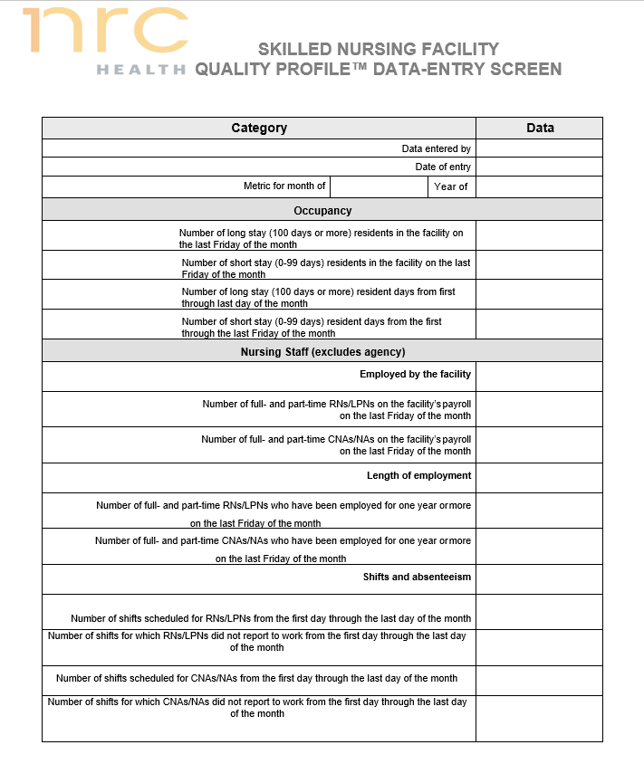
Data Entry Worksheet
Notes:
This worksheet can be found on the e-learning site under quality profile. You may find this helpful – print it off and give a copy to those staff memebers who are helping you to collect the data. Once you have this filled out it will take a very short time to enter your data

Slide 15
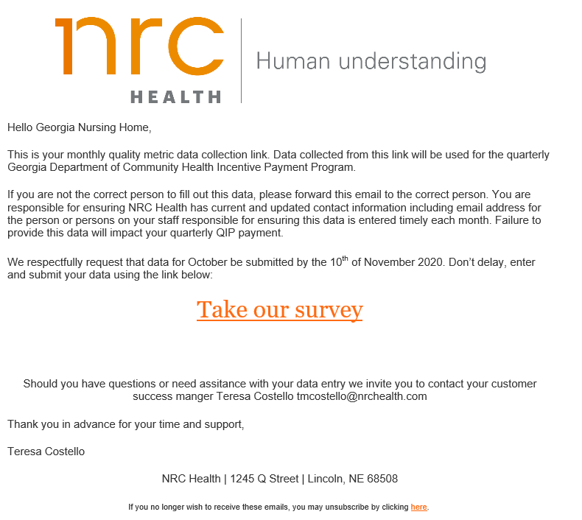
Monthly Data Entry
1st of the month
Complete by 10th

Slide 16
Quarterly Reports
Threshold for each metric will determine points earned
Family Resident Satisfaction- must be at or above combined % (Top3 Box CoreQ Recommendation) responses to recommendation to others across participating facilities
No threshold is required for Employee data

Slide 17
Thresholds
Nursing Stability
CNA Stability
Clinical Metrics
Equal to or less than the GA quarterly average of other participating facilities in the program will earn 1 point per metric
CMS Clinical metrics- must be = to or less than threshold
*Exception: Influenza vaccine must be = to or greater than threshold

Slide 18
Sample Report
This facility earned 2 points for
Non-clinical, 2 points for clinical =
1% add-on
1% add on = at least 1 point from
4 non-clinical, 1 from 6 clinical and
a 3rd point from either
2% add on = at least one point form 4
Non-clinical, 3 points from 6 clinical
and 2 points from either
Notes:
Sample quarterly report – The data collection period is for 2rd Quarter of 2010. This report was sent out late December for the payment period from Jan 1-March 31.
As reminder A facility is eligible for an award (add on) based on the following
Participation in the Family or resident satisfaction Survey for both customer and employee. If a facility fails to participate in the satisfaction survey during the fielding time, you can see that it will impact the QIP incentive for an entire year. Also please note that if a facility fails to enter QP metrics for at least two months of the quarter, they are disqualified form the QIP for that quarter.
Then to earn the 1% add on – a facility must score at least one point from the 4 non-clinical measures, and one point from the 6 clinical measures and a third point form either clinical or non-clinical measures
3. To earn the 2% add-on a facility must score at least one point from the four non-clinical measure, three points form the six clinical measures and the remaining two points form either clinical or non-clinical measures
As you can see here, The data from the most recent family resident survey combined is 94.7% AS COMPARED TO THE THRESHOLD OF 88 %. This threshold is the aggregate of all other Georgia homes. Because the score is above this number 1 point was earned for the satisfaction report. One point can be earned for participating in the employee report. While all you have to do is participate. 0 points were earned for RN Stability and CNA stability. Stability is defined as those who have been employed for one year or longer.
The clinical data in the lower portion come from CMS. This is based on quarterly data that you are reporting to CMS. CMS reports are using negative scores, unlike the MIV scores which are positive, so you want your clinical scores here to be lower than the threshold. (once exception is flue vaccine as this is measured by % of residents)

Slide 19
Reports Timing
Quarter 1: January-March Data collection
Quarterly Incentive Reports (QIP) delivered late June (end of Q2)
Impacts Incentives payments for Q3 (July 1)
Q2 reports delivered in late Sept for Q4 incentives (Oct 1)
Q3 reports delivered in late Dec for Q1 incentives (Jan 1)
Q4 reports delivered in late March for Q2 incentives (April 1)
Notes:
The timing can be a bit confusing, as we are always 2 quarters behind the date incentives are paid.
For Q1 2021 data collection we are using the Q1 NRC Data, the most recent CMS data – which is from Q4 the previous year, and the 2020 Satisfaction data which was collected in Fall of 2020, The dates are on the report, so you can always refer to this if you are confusted. Just remember the data is always 2 quarters prior to when DCH actually recognizes your incentive.

Slide 20
Teresa Costello
tmcostello@nrchealth.com
Beginning Nov 1 dedicated CS contact:
georgiahealthcaresupport@nrchealth.com
888-343-2851 option#2

