Slide 1
2021 Alabama Medicaid NRC Health Customer & Employee Survey
Teresa Costello
Customer Success Manager

Slide 2
2021 Survey
Agenda
Medicaid Program
Survey instruments
Timeline
Reports
Best Practices
Questions?

Slide 3
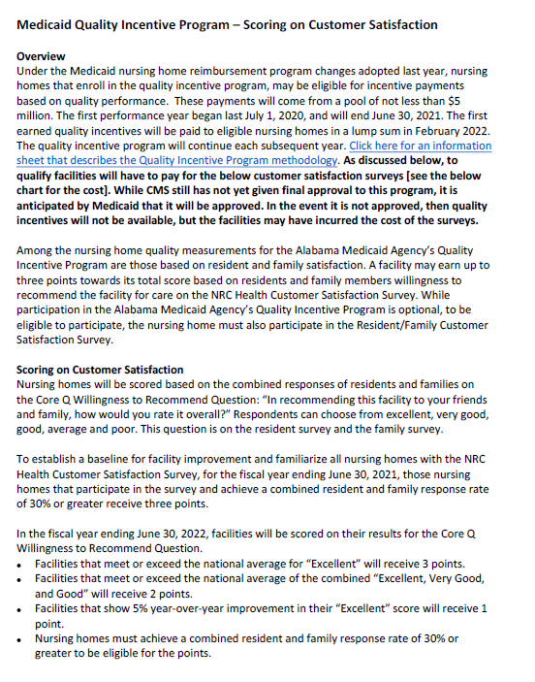
Medicaid Memo
March 1, 2021

Slide 4
Satisfaction Measures
Resident
  All Long-Stay residents that have a BIMS of 8 or above
Family
  One family member/responsible party for each resident
Employee - optional
  All full- and part-time employees should receive a survey
  All PRN staff

Slide 5
2021 Incentive
All Medicaid participating facilities will have the opportunity to earn 3-points toward their annual incentive
The 2021 Incentive will be based on the following:
  Facilities must participate in the annual family/resident survey process
  Achieve a 30% Combined Resident/Family response rate
Any facility that meets the requirements above will earn 3-incentive points
2022 Incentive will be a metric based system

Slide 6
Incentive Points
Year 1 (2021)
Year 2 (2022)
The first-year incentive will be based on meeting the following participation requirements:
  Facilities must participate in the annual resident/family survey
  Facilities must have a minimum combined Resident/Family response rate of 30%
  If facilities meet the above requirements they will receive 3-points toward their annual incentive
Metric-Based incentive program CoreQ (Willingness to Recommend):
  Facilities must have a minimum combined Resident/Family response rate of 30% to be eligible
  3-Points: Meet or Exceed National Average for TopBox “Excellent” score
  2-Points: Meet or Exceed National Average for Top3Box “Excellent, Very Good, Good” score.
  1-Points: Improve TopBox “Excellent” score by 5-points from previous year.

Slide 7
Behavioral Based Surveys

Slide 8

Survey Questions – Family and Resident
Satisfaction Based
Behavioral Based
Rate this facility on Management’s responsiveness to your suggestions and concerns?
Excellent
Good
Fair
Poor
Are your concerns responded to in a timely manner?
No
Yes, somewhat
Yes, mostly
Yes, definitely
Notes:
We are transitioning to a shorter behavioral based survey.
Behavioral based surveys use a different scale that is more actionable.
If you look at this example you can see that with a satisfaction bases survey we are asking for a rating. A rating is good, but usually only provides feedback based on the respondents most recent interaction or experience. A Behavioral based survey provides information on how often a certain behavior is happening, giving you more insight into how to improve.
These are going to be short surveys, not like the long surveys we did 2 years ago,
There will be 17 questions on the family and resident surveys
12 questions on the employee survey
They will be all the same scale – with a couple of exceptions …………..

Slide 9
Net Promoter Score (NPS)
How likely would you be to recommend this facility to your family and friends?
0 Not at all likely
1/2/3/4/5/6/7/8/9/
10 Extremely likely
Notes:
One new question will be the NPS score.
This question will replace the recommendation question on the survey.

Slide 10
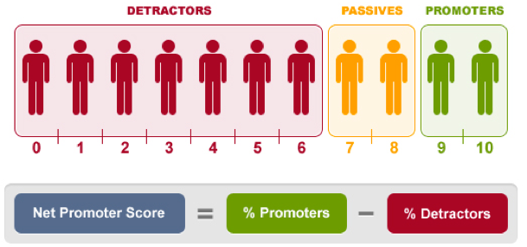
NPS Scoring
Notes:
NPS is a simple singular metric that can be tracked and help focus on the goal of converting non-promoters to promoters, it is widely used in virtually all industries. It changes the focus from satisfaction which can be fleeting to Loyalty.
Based on their response each customer can be categorized into one of 3 groups
Promoters 9-10 = loyal and enthusiastic likely to remain over time and generally more pleasant to interact with
Passives 7-8 =this group is satisfied, their like hood for refer to others is lower than that of promoters. They may defect
Detractors 0-6= they are unhappy and can account for the majority of negative word of mouth The criticisms diminish a company’s reputation
NPS is calculated by subtracting % detractors from % promotors.

Slide 11
AHCA CoreQ
The questions below are part of a national initiative to measure the quality of skilled nursing care centers:
In recommending this facility to your friends and family, how would you rate it overall?
Overall how would you rate the staff?
How would you rate the care you receive?
Poor, Average, Good, Very Good, Excellent
Notes:
We will be asking the AHCA CoreQ questions on the survey as well. The results of these questions can be uploaded into Trend Tracker in order to satisfy AHCA’s Quality Initiative to have members fielding these questions and using this as a national benchmark for all nursing homes regardless of the survey vendor they work with.
The recommendation question will also be used as the measure for the QIP reports next year.
These questions will be on a scale of Poor, Average Good Very Good and Excellent and they will appear on the survey in their own section: Read screen

Slide 12
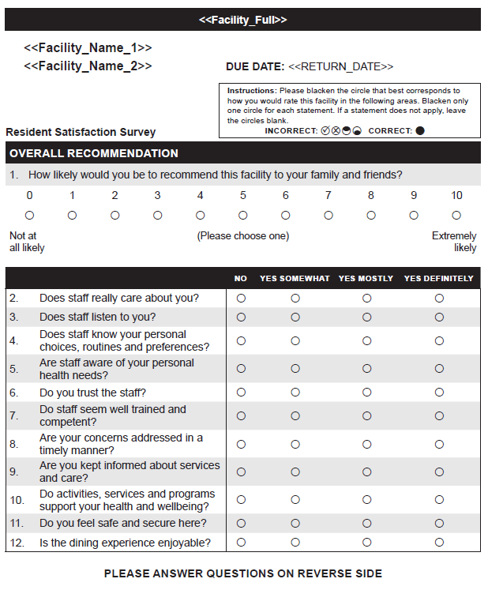
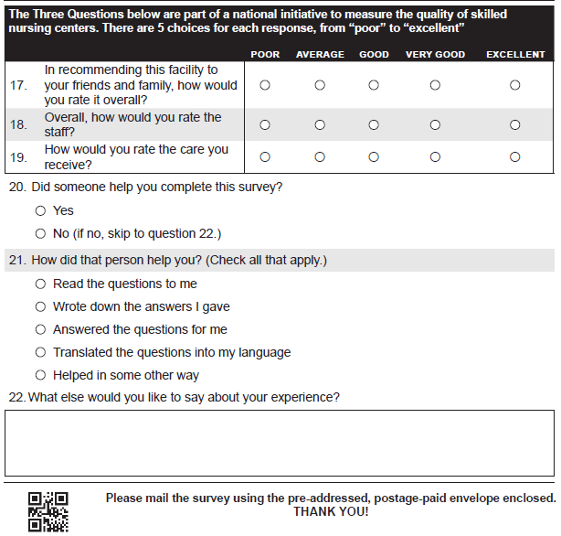
Resident & Family Surveys
Shorter Questionnaire
NPS – Likely to recommend
Quality of Care
Quality of Service
Safety
CoreQ
Open Ended
Notes:
17 Questions

Slide 13
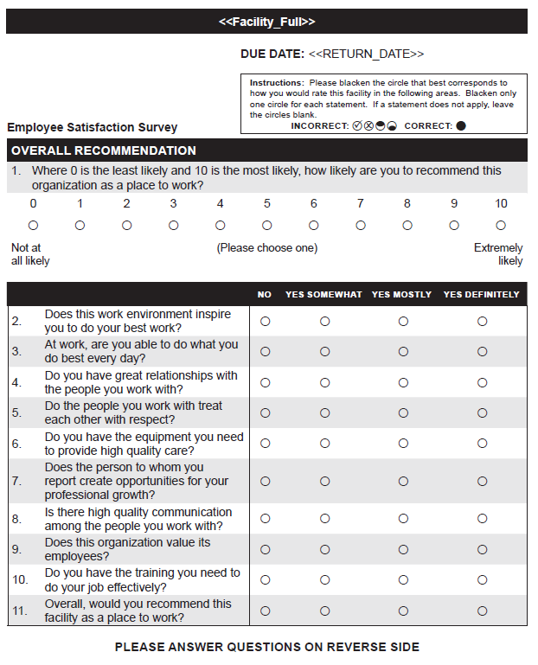
Employee Survey
Questionnaire
NPS Likely to Recommend
Work Environment
Training
Supervision
Commitment
Open End
Notes:
12 Questions

Slide 14
Methodology
Resident – paper with web option
Family – paper with web option
Employee – paper with web option

Slide 15
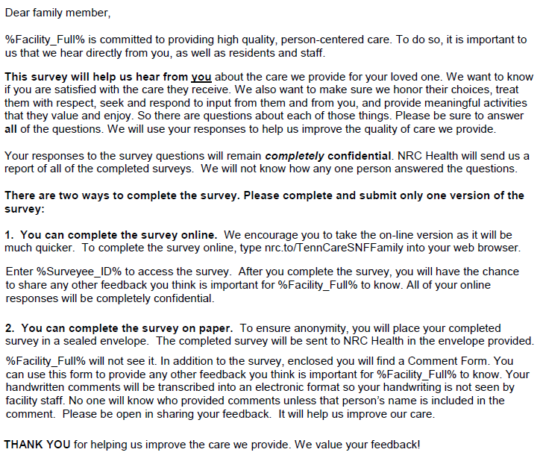
Web Option
nrc.to/SNFFamily
nrc.to/SNFResident
Enter code on cover letter as
instructed

Slide 16
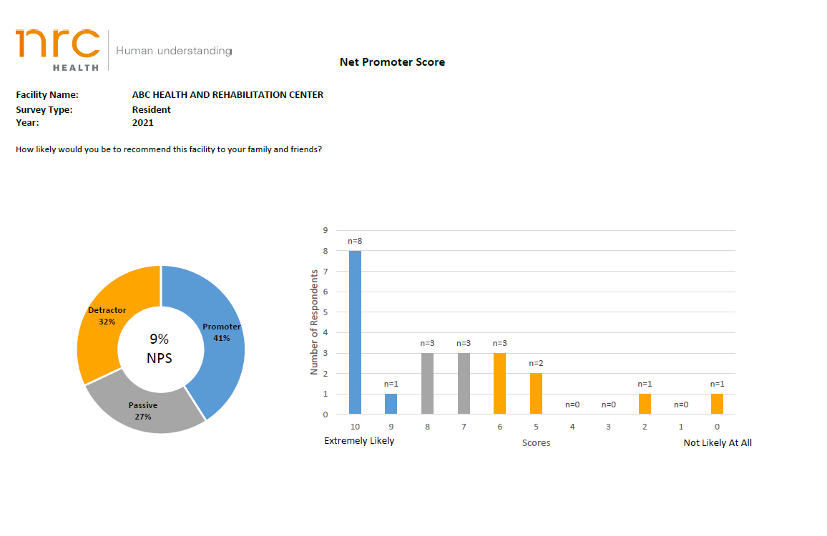
Reports
My InnerView portal has
been sunset
Reports will be in a new format and will be emailed to the administrator going forward

Slide 17
2021 Point In Time Survey Initiative Details

Slide 18
What is important to Customers & Employees
Belief action will be taken
Convenience
Post-Survey Follow Up
Communication is the most critical step to the success of our survey and response rate
Notes:
As we prepare for the survey – we want to keep in mind what is most important to our customers (residents and families) and employees.
Good Communication is the most important to all your stakeholders. They want to know that their responses are confidential – that their name will not be associates with their Reponses.
They want to know that you will use the data for improvement and that you take their feedback seriously.
It should be easy and convenient for them to complete the survey.
Most importantly- they want you to follow-up with them and report back the results of the survey and what you are going to do next.

Slide 19
Leadership
A high response rate helps to ensure the survey results are representative of the survey population
Higher response rates are correlated with higher scores
Influenced by the visible support of facility leadership
Notes:
One of the primary requirements of the Medicaid Agency is to have a response rate of 30% or more combined family and resident. A high survey response rate helps to ensure that the survey results are representative of the survey population. Research shows that facilities with higher response rates also have higher scores. A high response rate is influenced by the visible support and encouragement facility leaders exhibit during the survey process.
The employee engagement survey run is particularly important because there is a correlation between Employee satisfaction and Resident/Family Satisfaction
- A word of caution here- don’t get carried away with response rates making them the most important goal- too much pressure on your residents/families or staff to complete a survey can backfire on you. Be thoughtful about how you go about this.

Slide 20

Best Practices For Increased Participation
Site Champion
  Drives the process
Set Goals
Implementation Plan
  Communication
  Delegates
  Schedules
Notes:
Appointing a site (survey) champion is a recommended best practice.
This person will be in charge of the survey process. You will decide who is the most appropriate person for this important role. It can be the admin, don, SS, Activities Dir or anyone who you decide would excel at making sure your survey is a success. If you have an achiever on your staff this is a great opportunity to let them shine in managing the survey process. It does not have to be a person in a leadership role, but they do need to have the full support of leadership.
Another best practice is to set goals for your survey. A SMART goal is specific, measurable, results focused, and timebound. Goals should be simple and clear. It can be anything that is important to your organization or center.
The site champion will be in charge of putting together an implementation plan for your survey. Make sure you include a communication plan, a schedule and who is going to do what.

Slide 21
2021
Timeline
March 31
April 9
April 12
April 30
May 28
July 10
Submit Survey Registration Form
Submit data file
Notify Stakeholders
NRC Health Mails Surveys
Final Due date for surveys
Reports available
July 13
  Post-survey Webinars

Slide 22
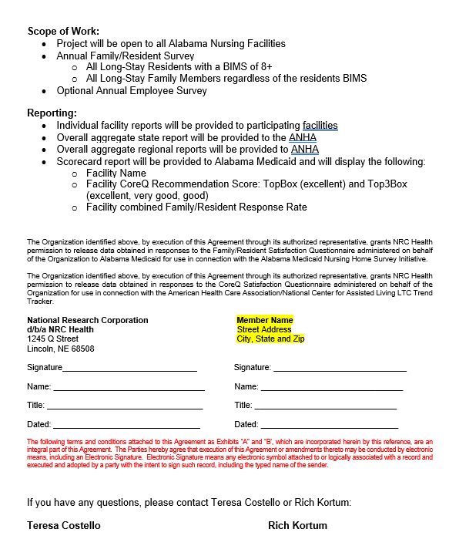
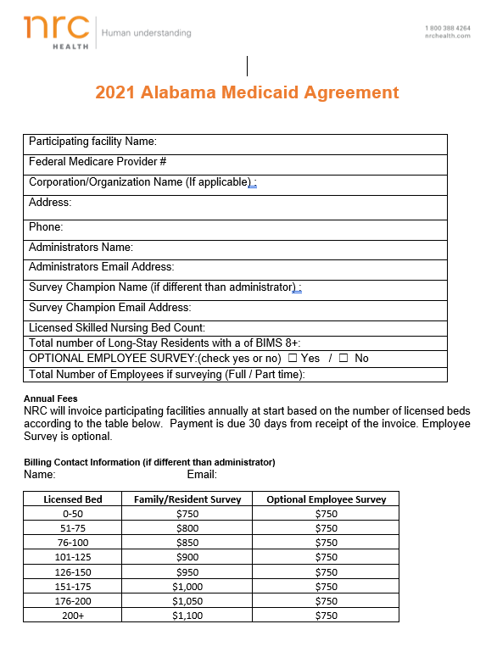
Agreement with NRC Health
https://nrchealth.com/wp-content/uploads/2021/02/2021-AL-Medicaid-Facility-Agreement_NRC-Health-Form.pdf
DUE MARCH 31

Slide 23
Ordering Surveys
Resident Surveys -will arrive bulk anonymous
Employee Surveys (optional) –will arrive bulk anonymous
Family Surveys -will be mailed
All surveys, bulk and mail will be ordered using a data file template

Slide 24
Ordering Resident and Family Surveys
  All Long-Stay residents that have a BIMS of 8 or above
  All family members of residents regardless of BIMS*
  *One family member for each resident
Notes:
This project requires that you offer a survey to all cognitive long stay residents who have a BIMS score of 8 or above
All family member/personal representatives should receive a family survey- If you have previously participated in the ANHA survey you know this is different than in past years.
Instead of ordering family surveys for non-cognitive residents only – you are ordering surveys for every residents family or representative.
For example, if you have 100 residents and of those 100-60 are cognitive (BIMS of 8+) You will order 60 resident surveys and 100 family surveys

Slide 25
Ordering Employee Surveys
Optional
Every employee both full and part-time should receive a survey including PRN staff
No limitations based on bed size
Notes:
Every employee will be offered a survey
You will order a survey for all employees- both full time and part time. This includes PRN staff.

Slide 26
Reminder
Ordering correct number of surveys is critical to having sufficient data for Medicaid
Facilities who do not have at least a 30% response rate for family and resident combined will not qualify for any points

Slide 27
Submit data file
HIPAA requires that all files containing personal health information (PHI) be submitted via a secure link (on the data file)
Important: Do not email data files
Notes:
We will place your survey order based on what you submit on your data file.
The next important date on our timeline is the first step in getting an accurate data file submitted. As you may remember we must comply with HIPAA requirements because family and resident names are considered PHI – and they must be submitted using a secure link. Do not send data files using email as this is a HIPAA violation.
We will be using a new data file specific to this Alabama project. If you have an old MIV data file in your folders somewhere – DO NOT USE IT. We will not accept it
We will also be using a different secure data exchange to submit your file -

Slide 28
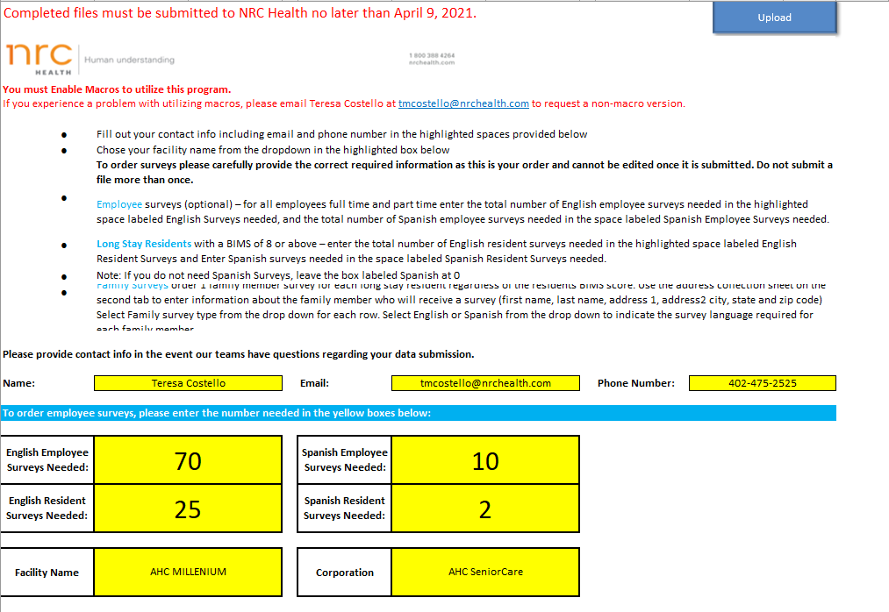
No later than April 9 : Submit data file
Notes:
You will provide all of the survey information needed to order your surveys on the data file. I will be sending you the data file template along with some other supporting documents.
You must fill this out correctly so that we can provide the surveys. Do not leave any of the yellow boxes blank – I recorded a detailed video tutorial of the instructions which I will send to you – please watch this before you begin filling out your file.
1. You will use the drop down to choose your facility name
To order employee surveys fill out the total number of employees in the yellow highlighted cell– include both full and part time as well as PRN employees.
Fill out the number of surveys needed for long stay residents with a BIMS of 8 and above,

Slide 29
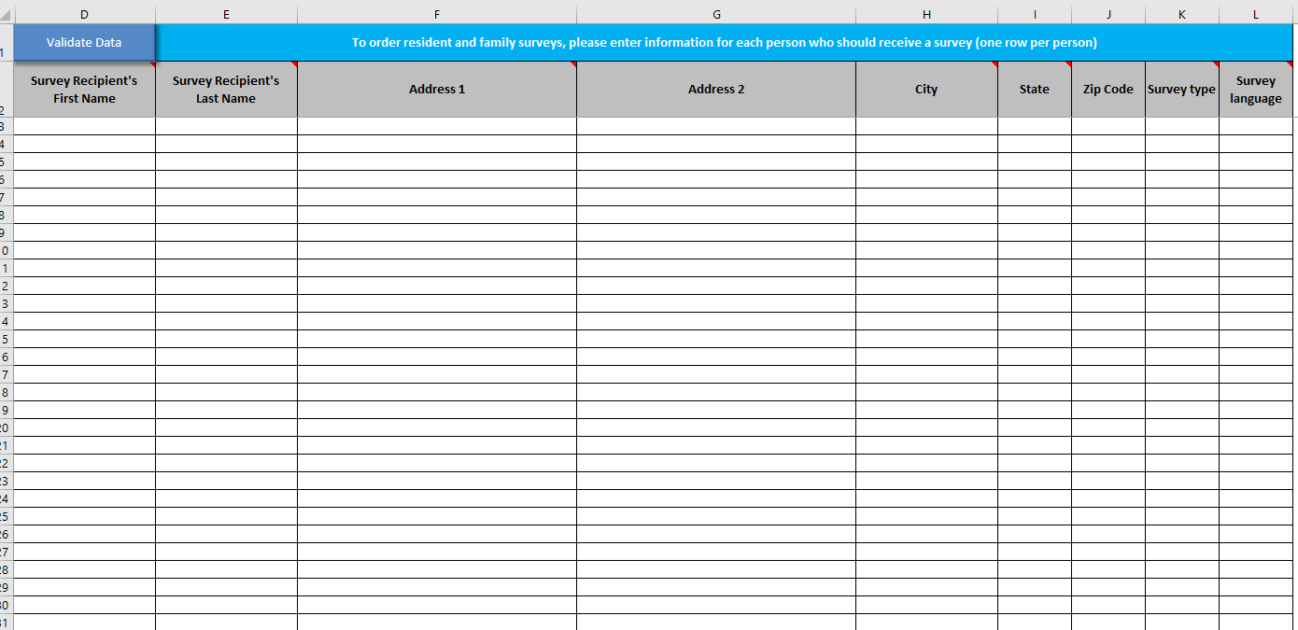
Address Collection Sheet – 2nd Tab
Notes:
For family surveys you will fill out the spreadsheet below. Fill out all the columns completely. the first and last name, and then the address (use the address 2 only if you have an apartment number or other information needed) City, State Use the drop down to fill in the state-then the Zip.
Do not leave any blank rows between names, or any blank columns with the exception of the address 2 column.

Slide 30
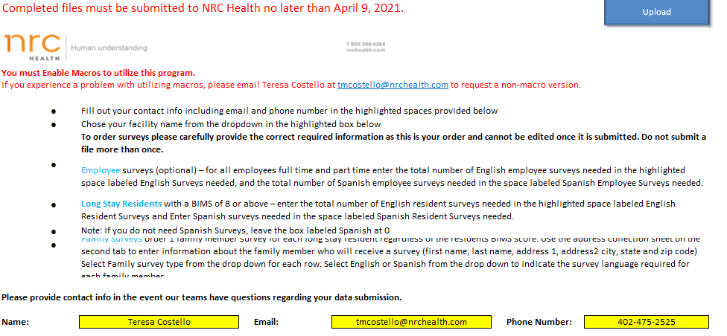
Preparing your data file
Save file as:
AL_FACILITY NAME_data_MM_DD_YYYY.xlsm
Example:
AL__COLONIAL HAVEN_data_4_1_21.xlsm
Save as Macro Enabled Worksheet
Then: Click the link in the header of the
Data file to upload your file

Slide 31
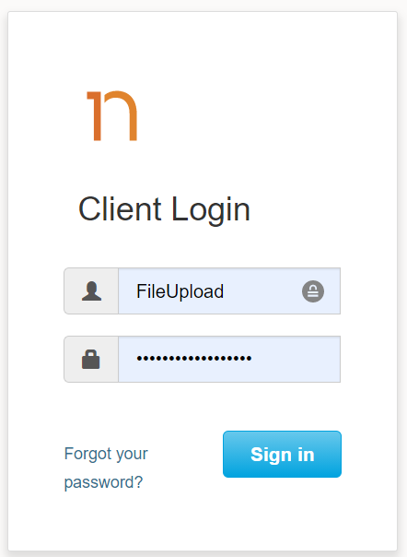
File Upload
https://nrchealth-dataexchange.nrch.us/login
User Name:
FileUpload
Password: titan7#Francophone

Slide 32
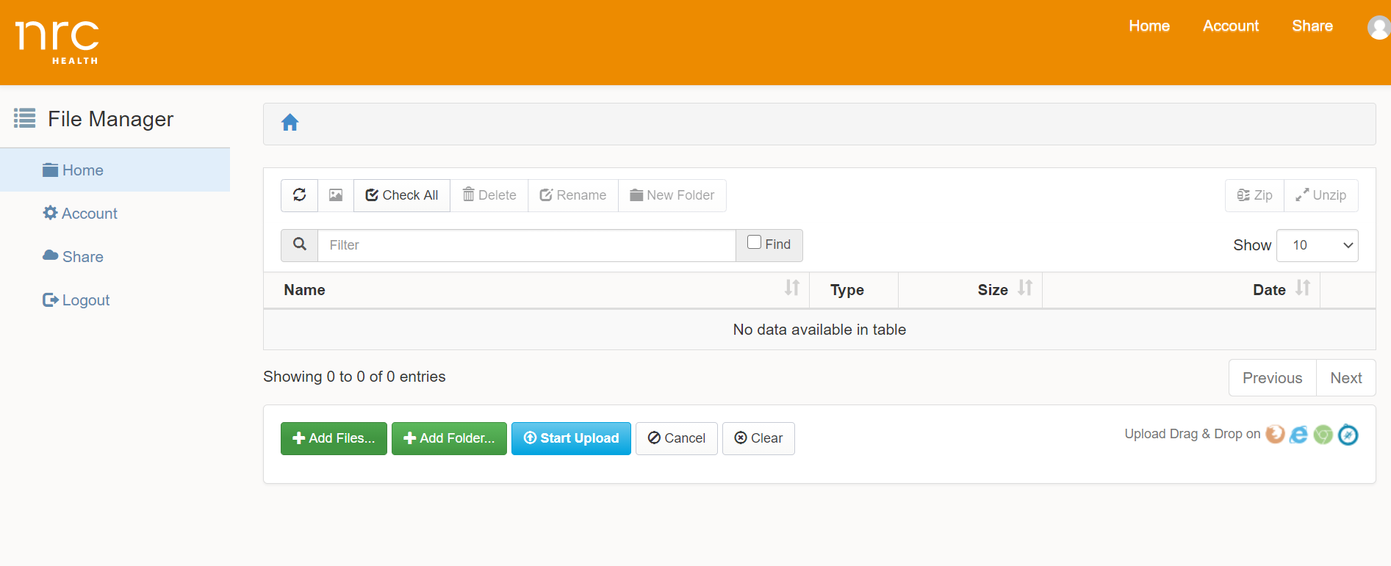
Browse and select your file

Slide 33
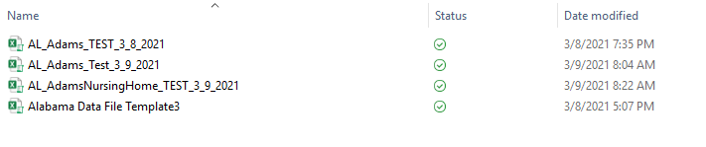
Browse and click on your file

Slide 34
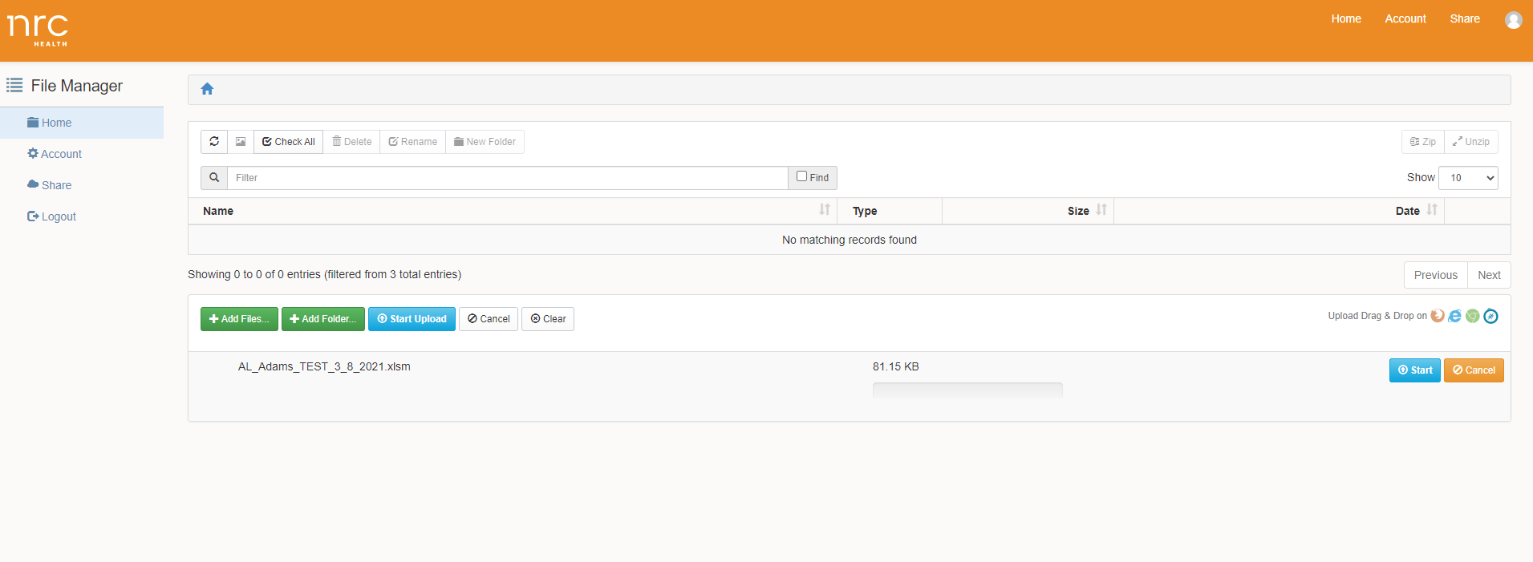
See your file

Slide 35
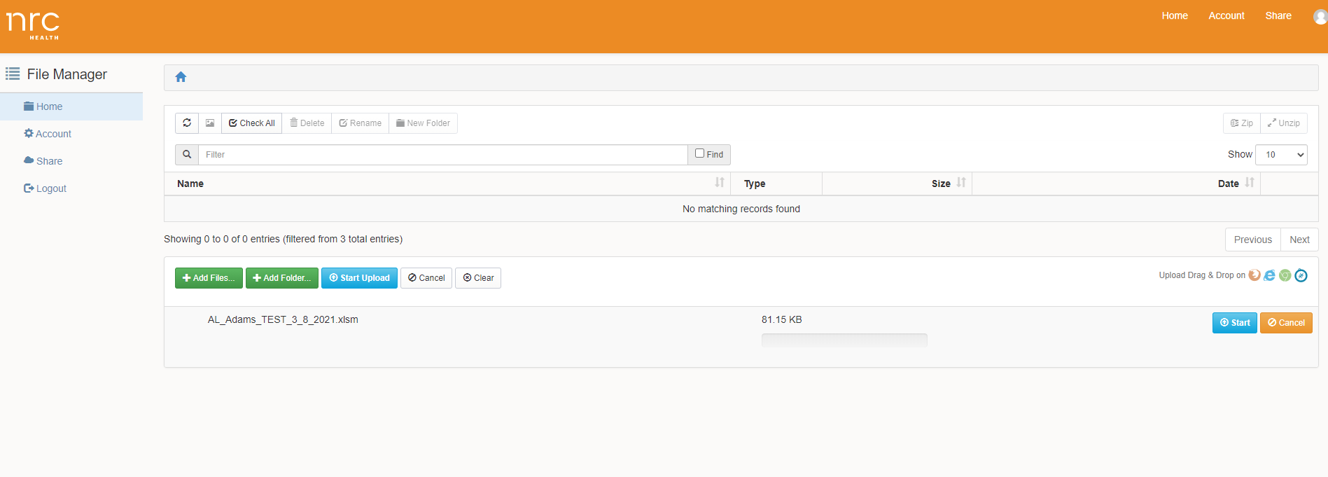
Start Upload

Slide 36
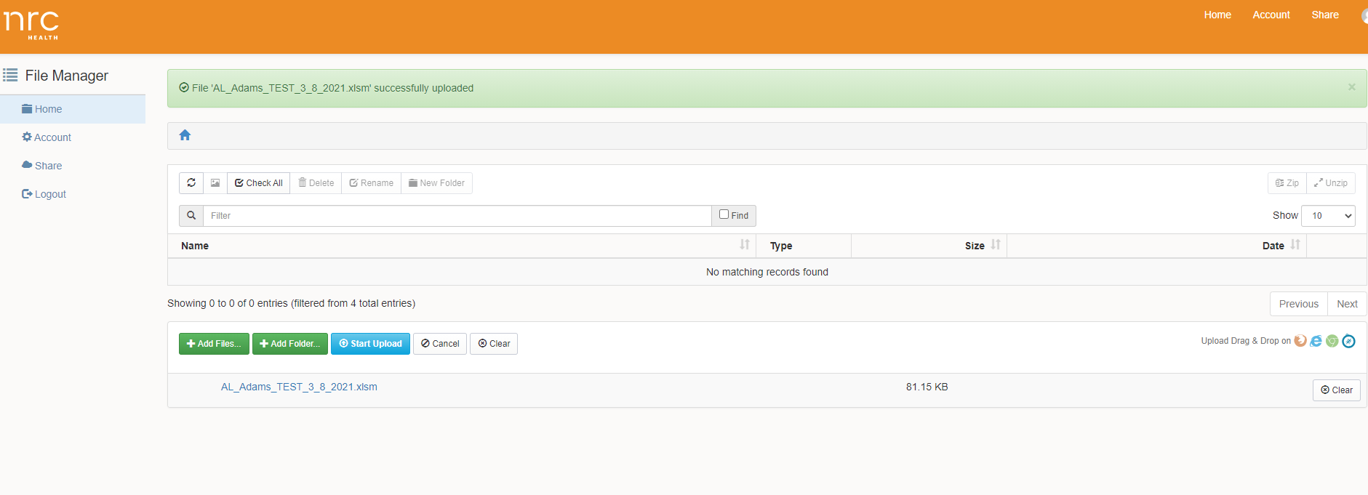
File successful uploaded!

Slide 37

Residents Who Require Assistance
Survey Helpers
Facility staff with permission of the resident or family member
Staff who does not provide direct care
Activities/Social Services/etc.
Notes:
Some surveyable residents will require assistance in completing the survey due to physical limitations or mild-to-moderate cognitive impairment.
Individuals recommended to provide incidental assistance to residents with their surveys include family members, volunteers, or (if a family member or volunteer is not available) facility staff with the permission of the resident or resident’s family or guardian.

Slide 38
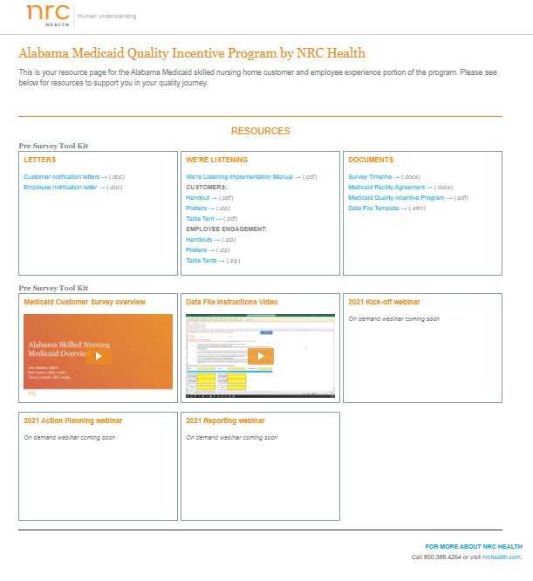
https://go.nrchealth.com/l/279972/2021-03-03/lw28r
Alabama Nursing Home
QIP Web Page
Resources
Data File Template
Data File Instructional Video
Notification letters
Marketing Materials
Webinar Recordings

Slide 39
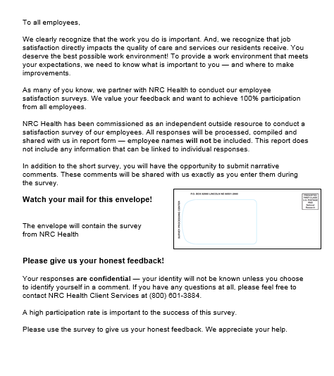
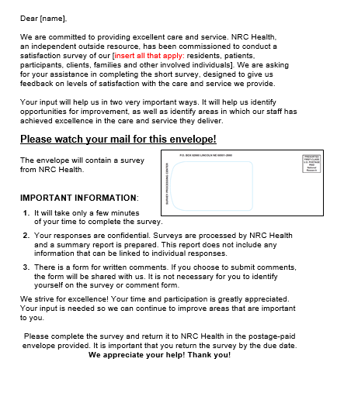
Notification Letters

Slide 40
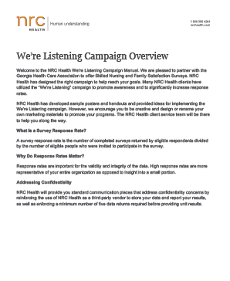



April 12: Communication
Mail or distribute notification letters to family, residents and employees
Implementation Manual to help
Notes:
After your surveys are ordered you will want to communicate that the survey is coming, there is a variety of ways you can do this. Use the notification letter templates and other collateral that is available to you. You can use the “We’re Listening” materials downloadable from the MIV elearning site.
Make sure you are beginning this communication at least two weeks before the surveys will arrive. We recommend beginning this around Jan 7th

Slide 41





We're Listening Materials
Notes:
All the marketing materials will be sent to you in a follow-up email. These examples of hand-outs/flyers/posters/table tents and other items that will be included in a zipped folder. These can be included in pay stub envelops, billings etc..

Slide 42

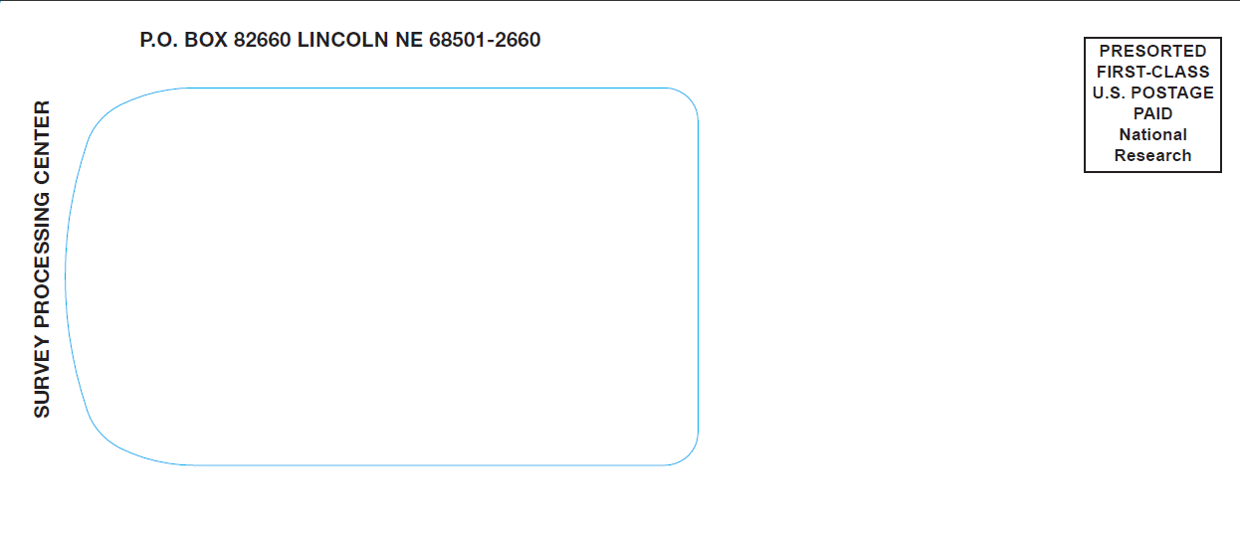
April 30: Family Surveys mail
Family Surveys will mail via US Post Office. Survey packets will come to the attention of each person in the mail

Slide 43

April 30: Surveys Shipping
Resident and Employee Surveys will ship
together in one package via UPS
Addressed
Attn: Administrator

Slide 44
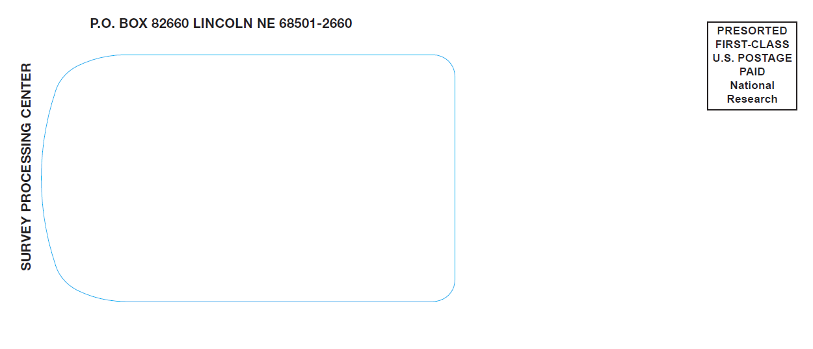
Distribution of Surveys
Distribute surveys to residents and employees
Notes:
The packages will contain bundles of each resident and employee surveys. Each Survey Packet contains a cover letter, the survey and the postage paid return envelope. You are to distribute the surveys to residents and employees as soon as you receive them.

Slide 45

Best Practices
Use and refer often to the “We’re Listening” materials
Provide sealed collection boxes for completed surveys
Maintain confidentiality

Slide 46
May 21: Mail Completed Surveys
DO
  Ship completed surveys back (one package)
  Return unused and unopened surveys
DO NOT
  Open surveys
  Keep unused surveys

Slide 47

No later than May 28: Due date for surveys
Final date for NRC Health to accept surveys
Surveys must be received
at NRC Health by this date
New return address for
NRC Health
Notes:
May 28th is a hard date for NRC to accept surveys. They must arrive at our processing center by this date in order to be counted for the QIP.
This is not the date posted by USPS, it’s the date it arrives – so make sure you are mailing these a week or so ahead of May 28th.

Slide 48
July 10: Reports available
Reports will be emailed to the administrator of each facility
Reporting Review – How to view your results
Tuesday July 13, 1:30 pm CT

Slide 49
2021
Timeline
March 31
April 9
April 12
April 30
May 28
July 10
Submit Survey Registration Form
Submit data file
Notify Stakeholders
NRC Health Mails Surveys
Final Due date for surveys
Reports available
July 13
  Post-survey Webinars

Slide 50
NRC Health Resources
Alabama Medicaid Program Resources Webpage:
Access to NRC Health’s Customer Support Team
Reports
  Facility level results
Benchmarking Capabilities
  State / National
Best Practice Documents
Action Planning Sessions
-Tuesday August 10, 1:30 pm

Slide 51

Questions?
Teresa Costello
Customer Success Manager
  Email: tmcostello@nrchealth.com
Customer Support
Email: customersupport@nrchealth.com
Phone: 888.343.2851

