Slide 1

August 2022
NRC Health
Connections
Gathering Insights – Inspiring Understanding

Slide 2

Recording Link

Slide 3


Regional Summit
Register at go.nrchealth.com/summit22_MN
IN-PERSON EVENT November 3, 2022 | Minneapolis, Minnesota W MINNEAPOLIS - THE FOSHAY

Slide 4

Regional Summit
Register at go.nrchealth.com/summit22_MA
IN-PERSON EVENT November 15, 2022 | Boston, MA W BOSTON

Slide 5
Housekeeping
Recording the session to share via brief sent by email
Get ready to discuss, discuss, discuss
Let’s update our names, Alissa Wood- NRC Health

Slide 6
Objectives
Share best practices for addressing disruptive patient/visitor behavior
Discuss intervention processes
Share policies and SOPs

Slide 7
Disruptive Behavior
The Joint Commission International (JACHO) defines disruptive behavior as threatening, inappropriate behavior, which has a deconstructive effect on the culture of safety.

Slide 8
These behaviors lead to
Stress
Job dissatisfaction
Compromised patient safety
Decreased quality of care
Increased errors
https://www.ncbi.nlm.nih.gov/pmc/articles/PMC8775368/#:~:text=Aside%20from%20these%20negative%20consequences,%2C26%2C27%2C28%2C

Slide 9
The World Health Organization found in February 2022 that up to 38% of healthcare workers around the world suffered physical violence at some point in their careers.

Slide 10
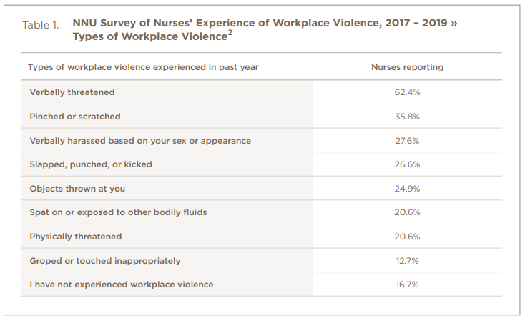
Types of Behavior
https://www.nationalnursesunited.org/sites/default/files/nnu/documents/0221_HS_WPV_InjuryToNone_Brief.pdf

Slide 11
Discussion
Describe your policies for addressing patient/visitors who demonstrate disruptive behaviors.
What training do you offer staff to de-escalate the disruptive behaviors?
  How do you encourage staff to be empathic and set boundaries?
  What guidelines or criteria do you have for staff to escalate?
How do you help employees heal from those situations?

Slide 12
Discussion Highlights
Let staff know that disruptive behaviors are unacceptable. Commitment to patient experience does not mean staff should be subjected to disrespect or violence. Safety for everyone is priority.
Empathic communication is key while delivering care to patients who are upset or disruptive. It can help de-escalate the situation and avoid escalation in the first place.
A helpful tool to inform staff is to flag a patient’s chart if they have displayed serious disruptive behaviors in the past.
De-escalation teams or codes can be called to provide another layer of support for frontline staff.
Staff training in de-escalation techniques is a common and recommended strategy to help frontline staff address disruptive behaviors.
Limiting the number of visitors is a policy example that can help mitigate instances of disruptive behaviors.
To help staff heal from interactions involving disruptive behaviors, remind them of your employee assistance program (EAP) and other resources. Involve chaplains on a regular basis and increase support after sentinel events.

Slide 13
Resource
Empathic communication & Recovery series
Injury to None
Workplace Health and Safety Article

Slide 14


Contact Information
Toya Gorley
Improvement Advisor
tgorley@nrchealth.com
Alissa Wood
Collaboratives Manager
awood@nrchealth.com

Slide 15
What’s Next
Date | Event/Resource | Where to Locate
9/01 | New Huddle video release | Real-time Resources
9/01 | Discharge Process Improvement Resource Release | Real-time Resources
9/13 | Connections Call | Improving the Discharge Process | Register
9/27 | Connections Call | Navigating Healthcare’s Shifting Staffing Landscape | Register
Monthly | Patient No Longer Podcast | Subscribe

Slide 16
Thank You

