Slide 1

September 2022
NRC Health
Connections
Gathering Insights – Inspiring Understanding
Notes:
Toya

Slide 2

Recording link: https://player.vimeo.com/video/751714324?h=5fd17c4d07

Slide 3
Housekeeping items
We are recording today’s session; recording will be sent out with a summary of key takeaways
Please share. Our hope is to learn from each other.
Update your name and organization
  Toya Gorley | NRC Health
Feel free to unmute and turn on your camera
Notes:
Dan

Slide 4


Regional Summit
Register at go.nrchealth.com/summit22_MN
IN-PERSON EVENT November 3, 2022 | Minneapolis, Minnesota W MINNEAPOLIS - THE FOSHAY
Notes:
Toya

Slide 5

Regional Summit
Register at go.nrchealth.com/summit22_MA
IN-PERSON EVENT November 15, 2022 | Boston, MA W BOSTON
Notes:
Toya

Slide 6
Objectives
Share innovative ideas to make a discharge process more effective
Discover the loyalty impact of an effective discharge process
Share practices to improve the discharge process
Notes:
Dan

Slide 7
Definition
The discharge process involves actions and communication to help patients successfully transition from their hospital stay to home or another facility.

Slide 8
Start the process early
Only 18.4% of consumers say they strongly agree that when they receive care, their doctors, nurses, and caregivers know their expectations before they come in.
Expectations = agenda, goals, priorities, barriers.

Slide 9
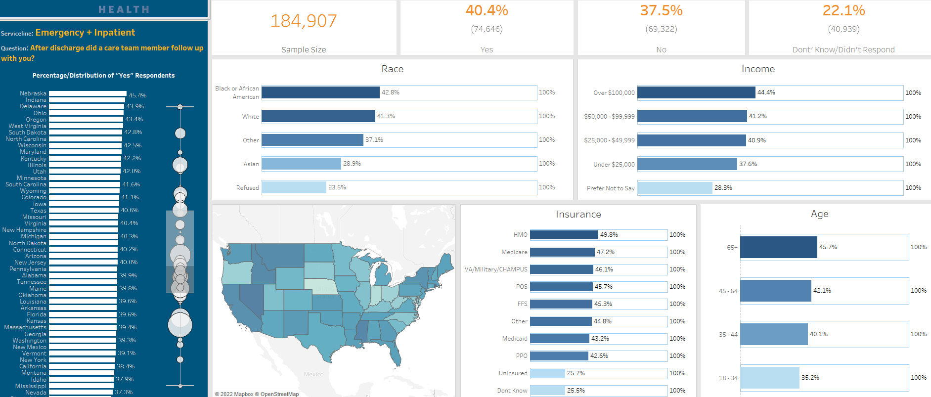
Follow-Up Inequities

Slide 10
Long term impact
58% of people discharged from the inpatient or ED setting say they are more likely to return to that organization if they receive a follow-up call.
70% of 18–44-year-olds with children!

Slide 11
Discussion questions
How do you account for patient preferences and/or address barriers to frictionless transitions?
How do you identify and involve a patient’s advocate (family member or friend) in discharge planning, especially if they are not able to be present in person?
What is the role of patient education in your discharge process?
How do you handle following-up with all patients after discharge to ensure they have everything they need?

Slide 12
Discussion Highlights
Pharmacists included in patient education conversations at discharge, especially when patients are prescribed new meds.
Rounding teams consisting of PT/OT, Case Manager, nurses and providers collaborate with patients to identify preferences. This team makes recommendations based on patient needs and preferences.
At admission, ask patient/parent, “How do you like to learn? Auditory, visual or written?” Make sure question is asked so the person doesn’t feel “less than”.
Use Teach back along with a discharge folder.
Use handouts that list frequently asked questions, Nurses highlight and make sure patients understand.
A hospital to home program is implemented where nurse practitioner conducts a telehealth visit with patients within seven (7) days of discharge.

Slide 13

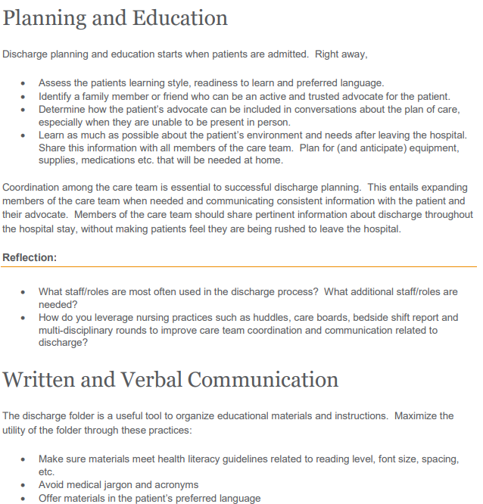
Discharge Process Improvement Resource
Link to improvement Resource:
https://nrchealth.com/wp-content/uploads/2022/08/DischargeProcess_ImprovementResource.pdf
Intent for use:
Highlight practices that work in many organizations
Encourage customization to create a process that all can own
Complement the Huddle Video
* Please note, If you are logged into Real-time, click on the image to navigate to the resource or landing page.

Slide 14

The Huddle
* Please note, If you are logged into Real-time, click on the image to navigate to the resource or landing page. .

Slide 15
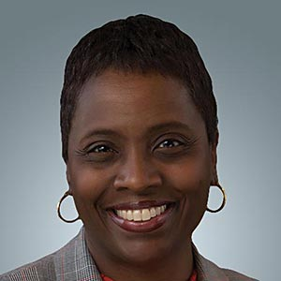
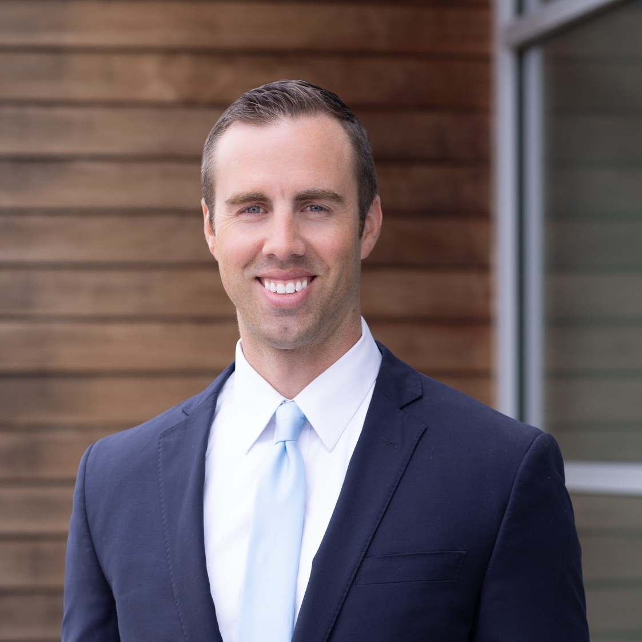
Contact Information
Toya Gorley
Improvement Advisor
tgorley@nrchealth.com
Dan Halverson
Solutions Expert
dhalverson@nrchealth.com

Slide 16
What’s Next
Date | Event/Resource | Where to Locate
9/27 | Connections Call | Navigating Healthcare’s Shifting Staffing Landscape | Register
10/01 | New Huddle video release | Real-time Resources
10/01 | Leader Rounding Improvement Resource Release | Real-time Resources
10/11 | Connections Call | Setting the Tone for Patient Experience Through Leader Rounding | Register
Monthly | Patient No Longer Podcast | Subscribe

Slide 17
Thank You
Notes:
This wraps up our call today.
I want to thank Toya and each of you for your time and engagement today
We hope to see you next month as we have a discussion on Improving the discharge process
Thank you again and Have a good day!

