Slide 1

Building on the Positives
Amanda Montalbano, MD MPH FAAP
Medical Director
Patient & Family Engagement
Children’s Mercy Kansas City
Mandy Riemer, MSW
Patient Experience Specialist
Patient & Family Engagement
Children’s Mercy Kansas City
Katie Taff, MBA MHA CPXP
Director
Patient & Family Engagement
Children’s Mercy Kansas City

Slide 2
Disclosures
Dr. Montalbano owns Excel in Academic Transfer, LLC
No other relevant disclosures

Slide 3
Learning Objectives
Design a recognition program that will resonate with your teams and engage other leaders in the celebration.
Discover how to leverage the NRC Real-Time and Transparency suite of tools to develop a recognition program.
Construct metrics to monitor the impact of the recognition program.

Slide 4
Practice Poll | Role
What is your role within your organization?
Patient Experience Leader
Patient Experience Team Member
Physician/Advance Practice Provider
Patient or Family Member
Other

Slide 5
Recognition
Variable Across Industries
  Often peer to peer nominations
  Minimal utilization of feedback direct from customer
Heath Care
  Usually based on quality metrics, productivity, revenue generation
  Providers:
    Recognizing their sense of calling
      High life meaning (OR 5.14)
      Commitment to direct patient care (OR 2.50)
Notes:
Why does recognition matter? → increased engagement
For several years, employee engagement has been a hot topic in the executive suite because there is mounting evidence that employee engagement correlates to individual, group, and organizational performance in the areas of productivity, retention, turnover, customer service, and loyalty
Recognition was a stronger motivator than a 5% salary bonus
Increased Efficiency
Innovative Work
Improved Team Dynamic
Sense of calling was strongly positively associated with
high life meaning (odds ratio [OR] 5.14, 95% confidence interval [95% CI] 2.87–9.19) and
commitment to direct patient care (OR 2.50, 95% CI 1.53–4.07).

Slide 6
Effects in Healthcare
Impact on Patient Safety
  Top 25%ile Engagement → 41% fewer safety events
Impact on Quality of Care
  Disengagement → lower standards of care
Impact on Patient Experience
  Strong correlation between
    Engagement/Satisfaction/Would Recommend
Notes:
Important Effects in Healthcare
Specifically with respect to health care institutions, the same analysis found that units in the upper quartile in engagement had a median 41% fewer patient safety incidents than units in the bottom quartile
a population of 225 hospital doctors and general practitioners, 82 of whom reported recent incidents where they considered that symptoms of stress had negatively affected their patient care. Half of these effects concerned lowered standards of care;
1. Firth-Cozens J, Greenhalgh J. Doctors’ perceptions of the links between stress and lowered clinical care. Soc Sci Med. 1997;44(7):1017-1022. doi:https://doi.org/10.1016/S0277-9536(96)00227-4
Patient Experience: Cleveland clinics investment in employee engagement showed almost 1.0 positive correlation btw improved employee engagement/satisfaction/WR

Slide 7
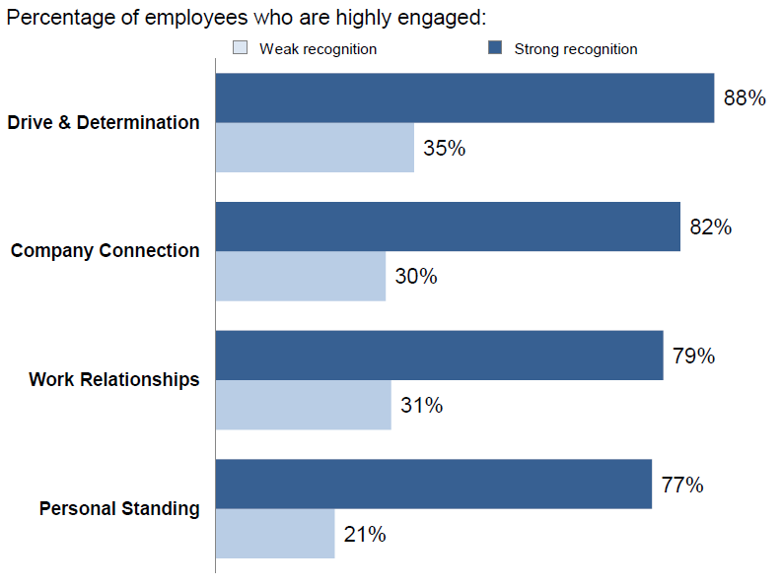
Engagement & Recognition
Notes:
Regardless of Type of recognition if they had strongly agreed they had received recognition (8-10) → lead to improved engagement
When you collapse this down those who strongly agreed they had received recognition were 3x more likely to be highly engaged

Slide 8
Types of Recognition
Ongoing Effort
  Informal
  Casual
  Small Note, Email, Sincere ‘Thank You’
Above and Beyond Performance
  Formal
  Tied to Significant Achievement
  Announcement to Team/Company
  Physical Award Item
Notes:
What is the basis and on what frequency: too frequent can seem disingenuous and costly, too rare and some can feel slighted (that will never be me). In general ABP should be less frequent (monthly/quarterly/yearly), while (OGE) multiple times a month/monthly) best comes from the direct manager/team member.

Slide 9
Data Source
NRC Real-Time
  Short surveys, real-time feedback
  By-provider results available for clinic
NRC Transparency
  Automated StarCards to providers monthly
  Star rating of providers over the last 12 months

Slide 10
Poll | Data Sources
Which questions could be leveraged for a recognition program?
*Please pick all that apply
      Rating of provider
      Rating of visit/facility
      Timeliness of care
      Trust
      Listened to
      Input and Say
      Knew Medical History
      Good Communication
      Comments
      Other quantitative question(s)

Slide 11
Provider Recognition Program
All billing providers are eligible
  Inclusive of physicians, nurse practitioners, psychologists, mental health therapists, audiologists, speech/physical/occupational therapists
Three domains
  Capitalize on small wins
  Continuous patient experience excellence
  Sustained effort resulting in improved scores
Notes:
Established 2018, launched 2019

Slide 12

Top Box Rockstar

Slide 13
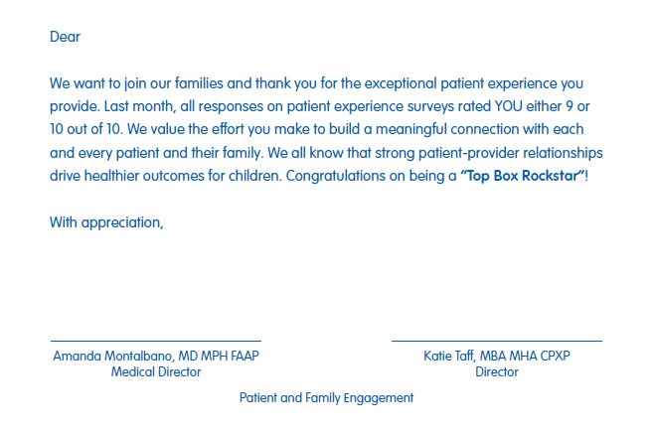
Top Box Rockstar

Slide 14
Identify Rockstars with Transparency
Navigate to Reviews
Uncheck all boxes in
  Status
  Profile Type
  Has Comments
  Has Response
Set Advanced Filters to "Created Date"
Check "5" rating box
Export the list to CSV
Repeat to create 1-4 ratings CSV file
Remove duplicates
Use NPI to cross-reference both files
Notes:
You may need to describe these last 2 steps in more detail

Slide 15
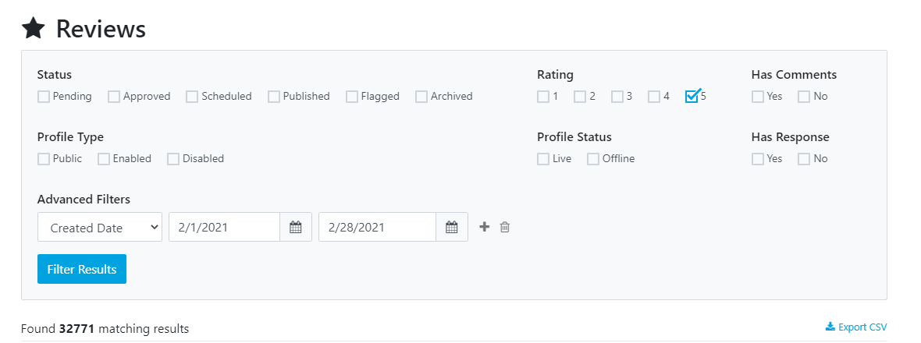
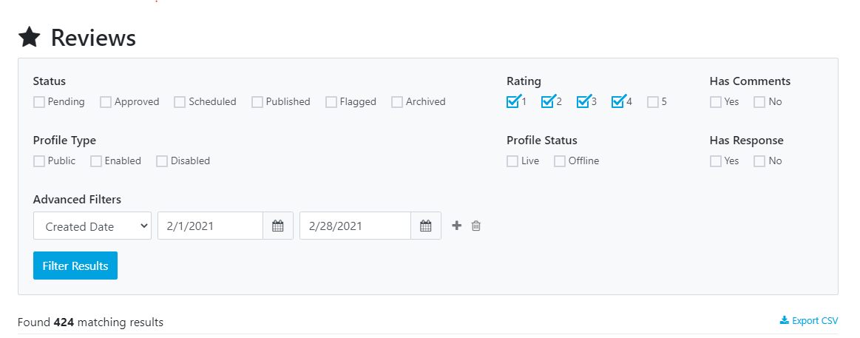

Slide 16
Dear Division Director,
Thank you for all your calm presence in this stressful time. Our care teams are rising to the challenge of CoVid-19; however, we know we will be faced with very frightened patients and families in the coming weeks. So to share a bit of sunshine in a dark time, I send you the RockStar cards for providers who received ALL 9’s or 10’s on their “rate your provider” question for the month of February.
We know our patient experience scores are going to reflect the fear and anxiety of our patients and families. Our systems will be taxed, and monitoring metrics will seem low on our priorities. I have included some scripting to help support all members of our care teams to mitigate these effects.
“Thank you for coming in today, I know just coming into the [hospital/clinic] was stressful”
“We care about the health of our community and have had to make some changes in our processes, thank you for being patient with us during this time.”
“How else can I help you today?”
“What other questions do you have?”
“If you have questions after you leave, please call [clinic number/nurse advice line]. We are getting a high number of calls right now, I apologize if you have to wait for a return call.”
“If you or anyone else has questions about the CoVid-19 outbreak, please go to our webpage.”

Slide 17
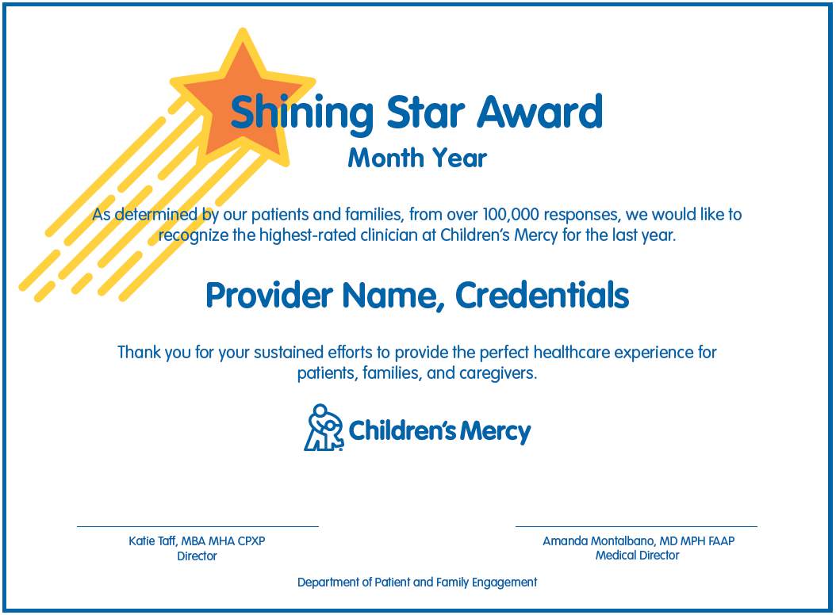

Shining Star
Notes:
The award recognizes the top-rated provider for the last 12 months – essentially the top provider for the year gets to be celebrated every month!
That provider is celebrated in front of their local care team and hospital leadership is invited as well to show gratitude for our care providers that have consistently connected with patients and families. --- You might want to include the top portion of our script? ----

Slide 18
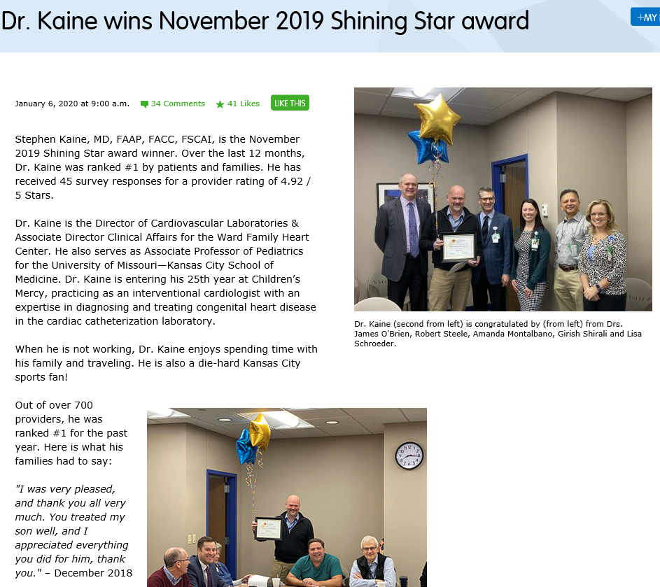
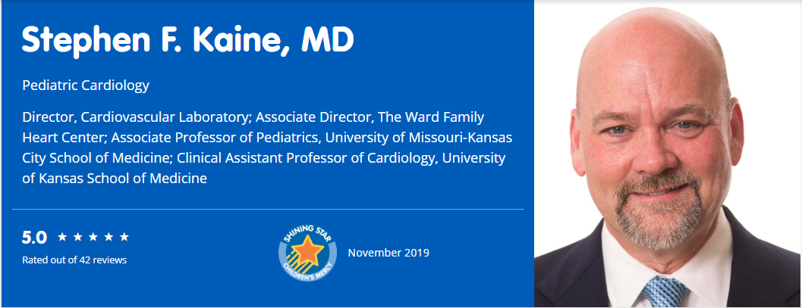
Notes:
The winner receives a certificate, a lapel pin and recognition from our CEO, as well as an opportunity to have a small-group meeting with our CEO and other SS winners. The award is also displayed on their external website profile.

Slide 19
Identify Shining Stars with Transparency
Navigate to "Profiles"
Profile Type
  Check "Enabled"
Profile Status
  Check "Live"
Filter by "Rating" to view highest-rated provider
In the case of a tie
  Award goes to the provider with the highest number of ratings
If the highest-rated provider has already been recognized in the past 36 months, move to the next provider

Slide 20
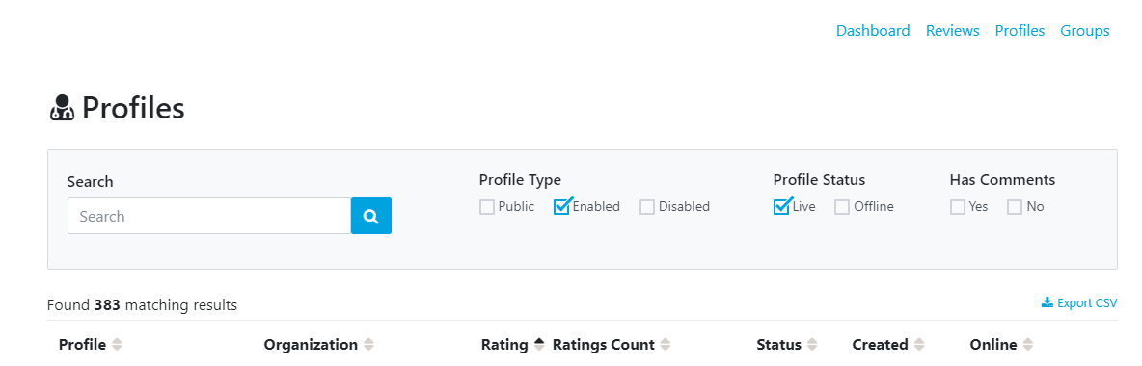

Slide 21
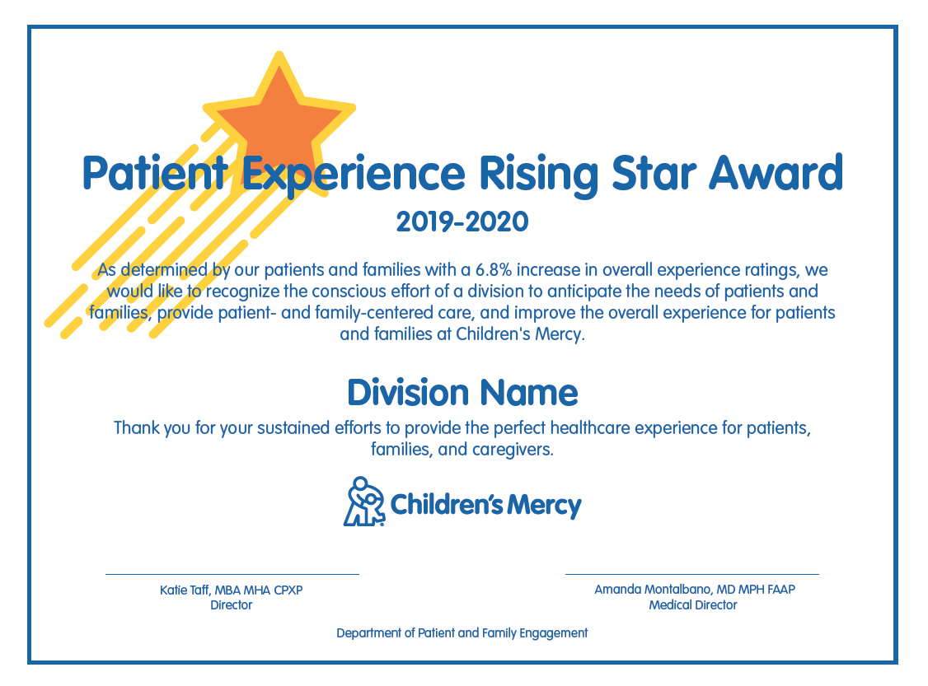
Rising Star
Notes:
We also wanted to recognize the divisions and providers who have garnered the largest improvements in their ratings over the course of the year. While we previously had branded this our Crusader award, we have decided to rebrand the award as "Rising Star"

Slide 22
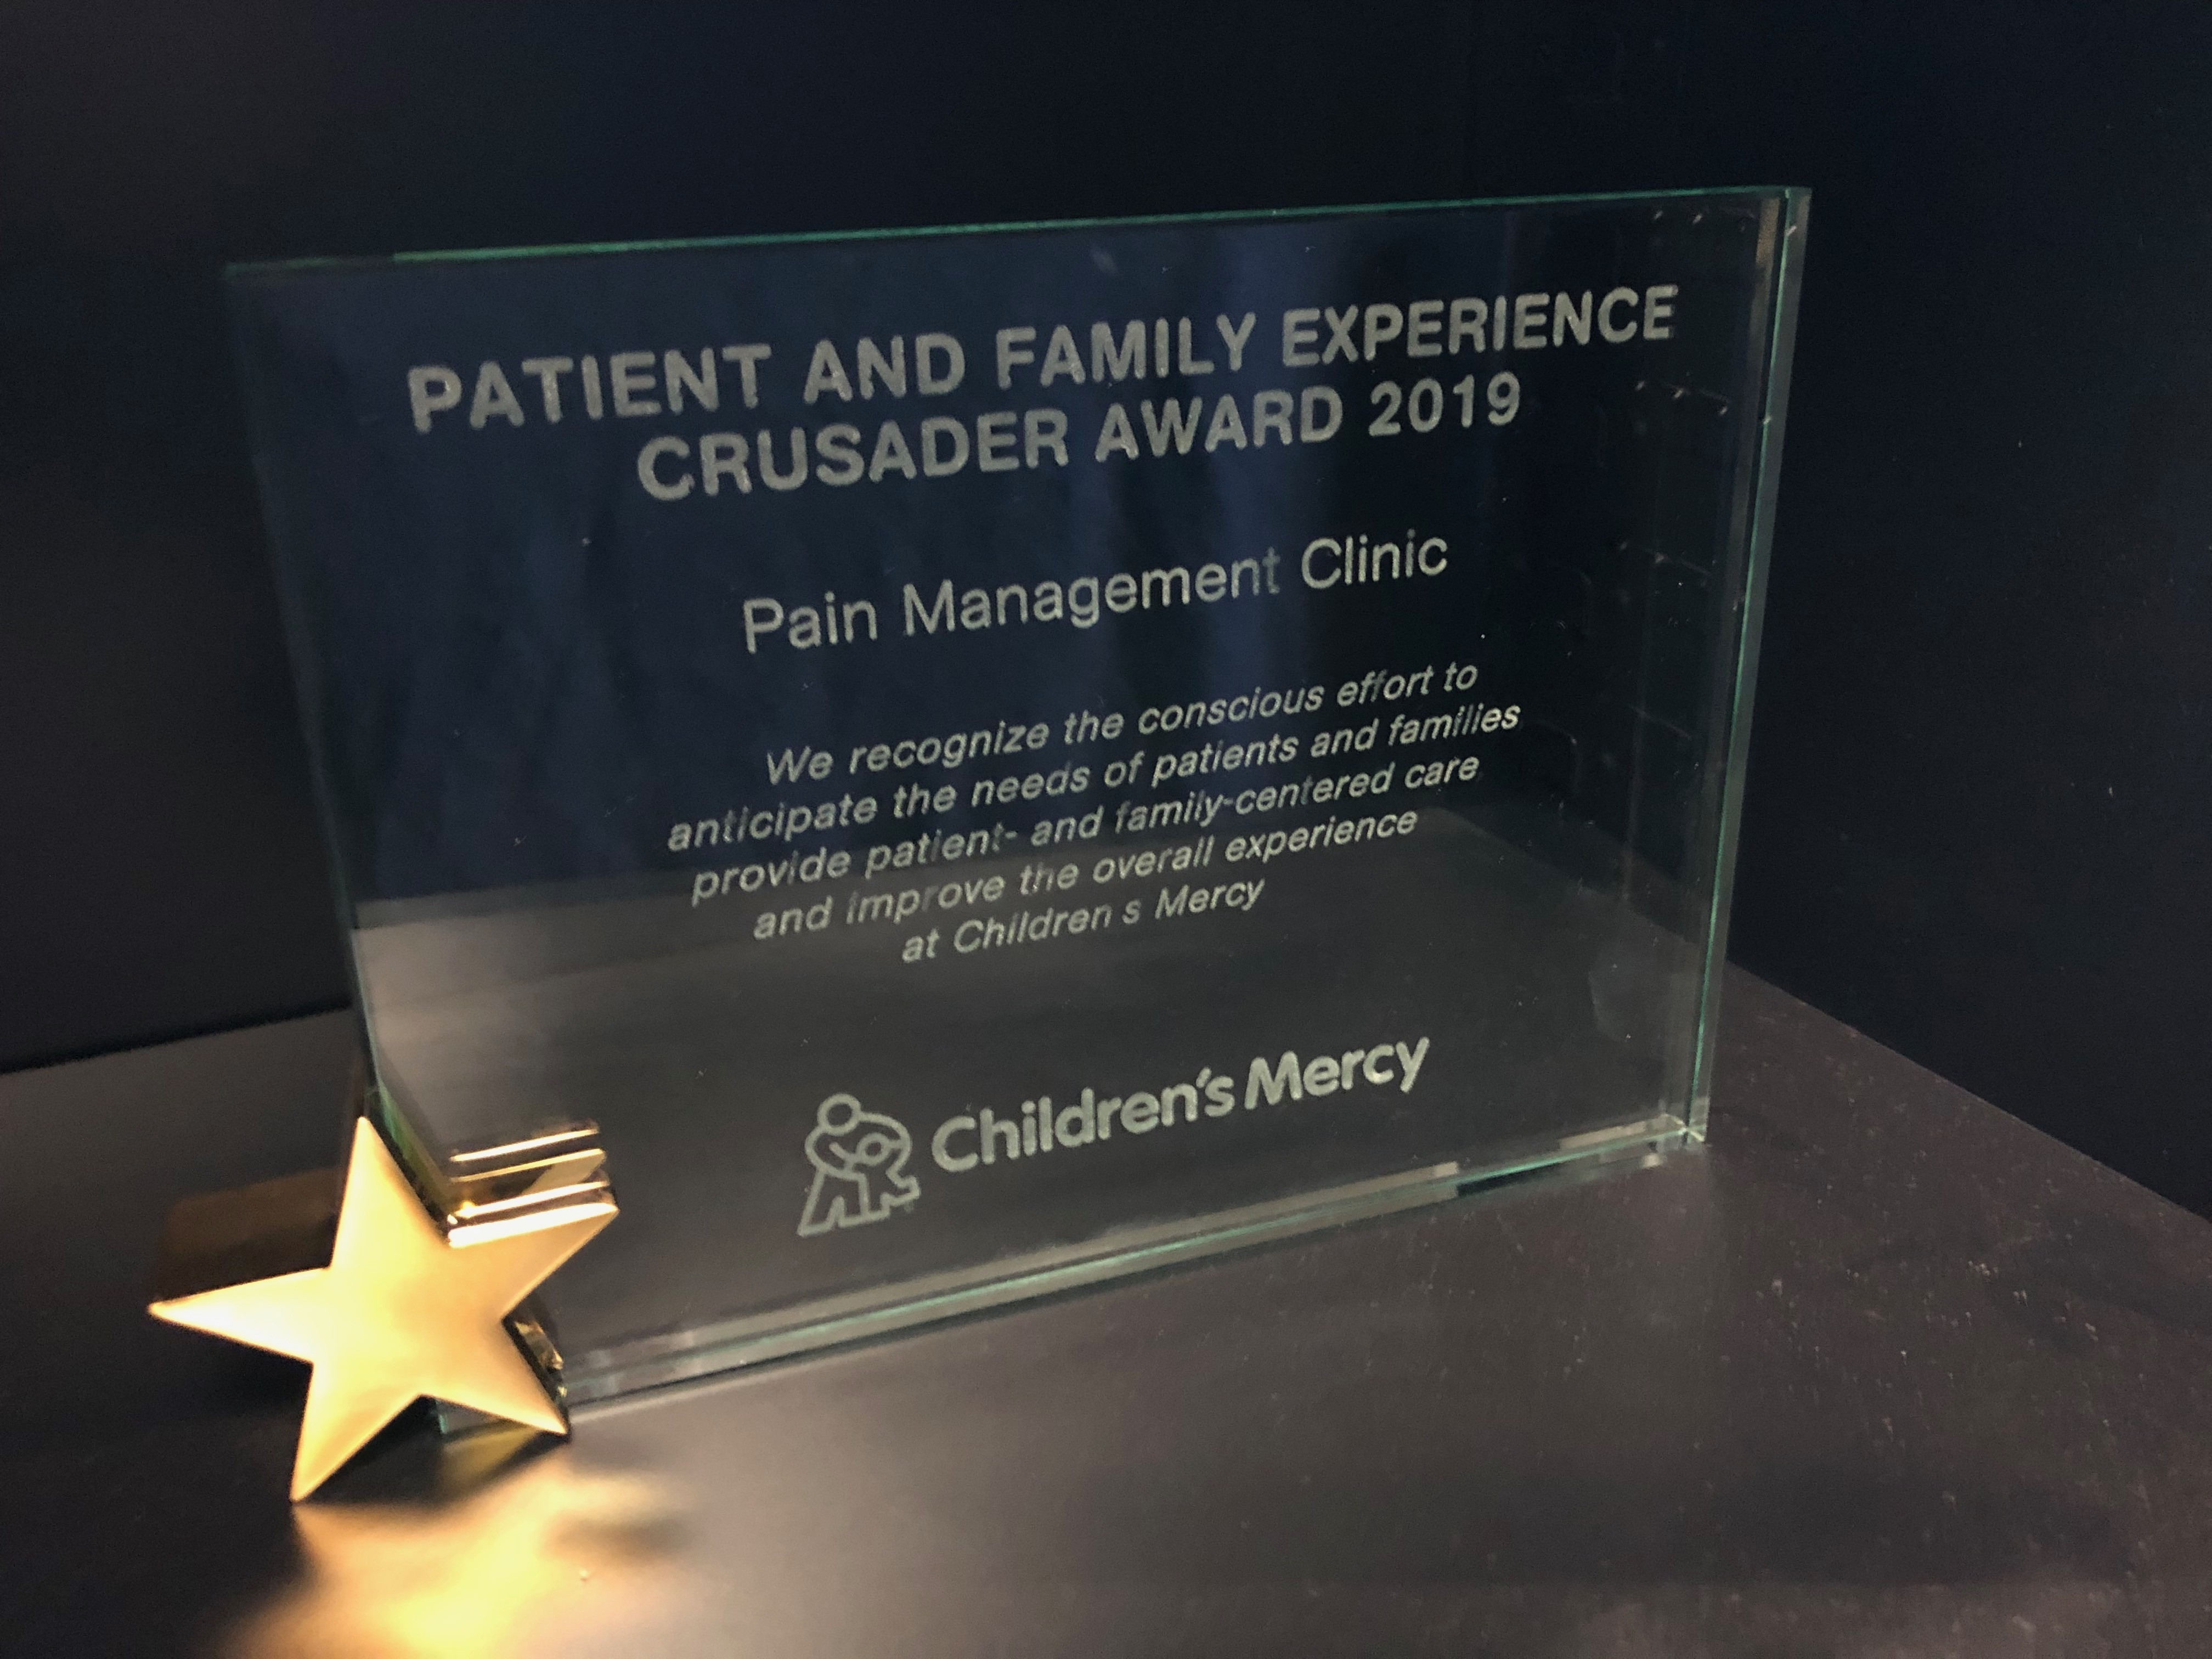

Slide 23
Identify Rising Stars with Real-Time
Set award timeframe
Pull division and provider results
  For current timeframe
  For previous timeframe
Calculate delta from current time period to previous
Identify award winners from largest delta
Division/Team award: find a natural break point in n-size
  Large Division > 1,400 returns annually (19)
  Small Division < 1,400 returns annually (26)

Slide 24
Group Work
Build a Recognition Program
Who will you recognize?
How will you define award winners?
What will the recognition be?
When (& how often) will you give it?
Who does it come from?
Notes:
Play fun music,

Slide 25
Share Out
Award Name
Eligible Recipients
Data Source
Winner Definition
Frequency
Who/How/What Delivered
Notes:
share out if able...via chat or raise hand?

Slide 26
Poll | Cost
How much does a three-part recognition program like the one just described cost per year for the organization?
        $1,100
        $2,200
        $7,800
        $12,400

Slide 27
Budget Outline
Recognition Program & Item | Annual Cost
Top Box Rockstars (~220 monthly) Cards & Envelopes | $1,350
Shining Star (1 monthly) Monthly Certificate & Frame Balloons Lapel Pins & Post Cards | $250 $100 $100
Rising Stars (2 division, 1 individual annually) Trophies Balloons & Treats | $200 $150
Total | $2,150

Slide 28
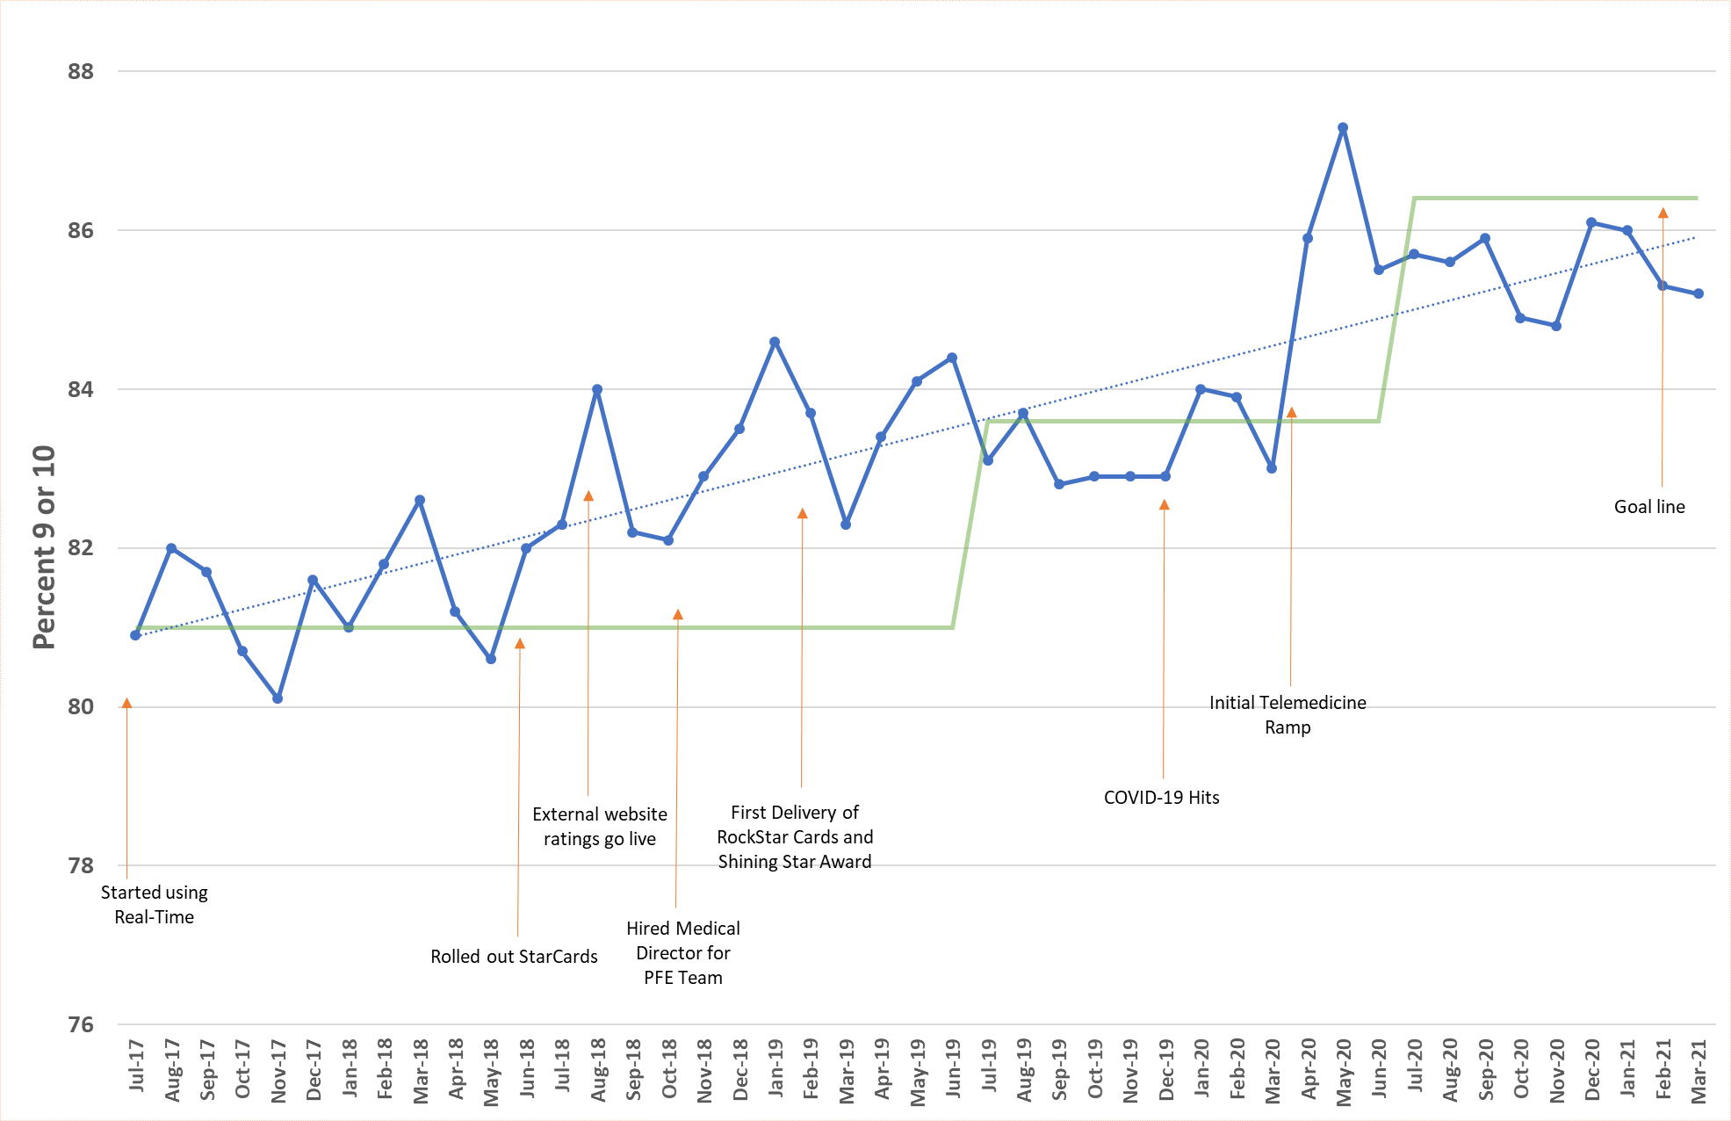
Outcomes:
Provider rating
Notes:
Katie to update

Slide 29
Measure the Impact
Provider Ratings
Improvements in other Survey Metrics
Employee Engagement
  Provider Engagement
Provider Burnout
Engagements with PX Content

Slide 30
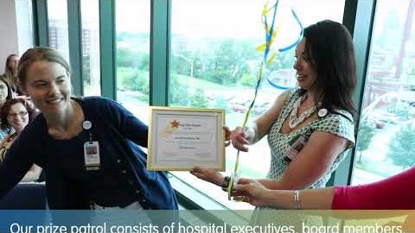
Shining Stars

Slide 31
“I don’t know that I will
cherish anything more.”
– Children’s Mercy Cardiologist
2019 Patient Experience Rising Star
Notes:
PK on pursuit of perfect patient experience
Patient family engagement starts with organizational culture and leadership.”
- Paul Kempinski, Children’s Mercy President & CEO

Slide 32
Take Home Points
Remember WHY this matters
WHAT are your data sources?
WHO is your target group for recognition?
HOW will you recognize them within your budget?

