Slide 1

Community Insights

Slide 2
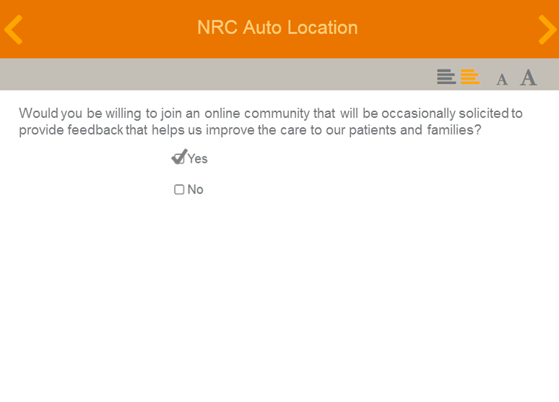
Building a trusted patient panel
EFFICIENCY
Over 2,500 patients joining on average annually.
NRC Auto Location
Thank you for providing feedback on your recent experience with us. Would you being willing to join our online patient community and provide periodic feedback that will help us continue improving the care we deliver to patients?
Yes I would like to be a part of the patient feedback community!
No thanks, not at this time.
PATIENT RECEIVES & FILLS OUT EMAIL REAL-TIME SURVEY
PATIENT’S VOLUNTARILY JOIN PATIENT INSIGHTS
CONDUCT RESEARCH WITH COMMUNITY
Done via email for all Real-Time care settings
Those declining to opt-in will not be asked to join again for six months
Tap into a proprietary panel to inform strategic decisions and initiatives.
Notes:
All web surveys through the NRC Health real-time platform for patient experience surveys will have the option of adding an additional question at the end of all question pods that reads: “Thank you for providing feedback on your recent care experience with us. Your feedback is instrumental in ensuring we deliver on our mission of providing world-class experiences to all of our patients. We would love for you to join our patient community and continuing giving periodic feedback to ensure we are delivering on our care promise. Yes I would like to be a part of the patient feedback community!; No thanks, not at this time.” Those who opt-in will be redirected to a preferences profile study. This study will ask them their preferences in regards to how often they want to be reached out to and what health topics are of interest to them.

Slide 3
Keeping the customer front and center
EFFICIENCY
TIMELINESS
CONFIDENCE
ENGAGEMENT
Automatically recruit to continuously build a large, trusted, patient panel
Engage with your patient panel to quickly inform current strategic initiatives
Validate your strategic decisions with the voice that matters – your patients
Build deeper relationships with your patients and community
Notes:
Driving customer engagement is key to ensuring all the decisions you make have the customer’s best interests and preferences in mind. NRC Health makes engaging them fast and simple. We automatically recruit and build a trusted community panel and manage engagement activities to obtain and report feedback, getting the insights you need, whenever you need them. Whether validating a design for a patient experience improvement initiative, designing online appointment scheduling, offering new care services, or redesigning your website, you’ll have more confidence with feedback from your trusted community.

Slide 4
Managing the process
EFFICIENCY
01
IDENTIFY TOPIC
Identify a topic – any topic – and let us know
Or, choose from a library of templated studies
Identify appropriate outreach audience
Create email templates and survey themes (colors, logos),
Send test links, and launching/closing studies.
02
GATHER DETAILS
Schedule and opportunities for incentive and follow-up approved
Sign off and agree upon study questions before study kick-off.
Receive a test email to approve of any outreach to patients
03
APPROVE & LAUNCH
Notes:
Take advantage of the efficiency and expertise of a completed managed process by NRC Health.

Slide 5
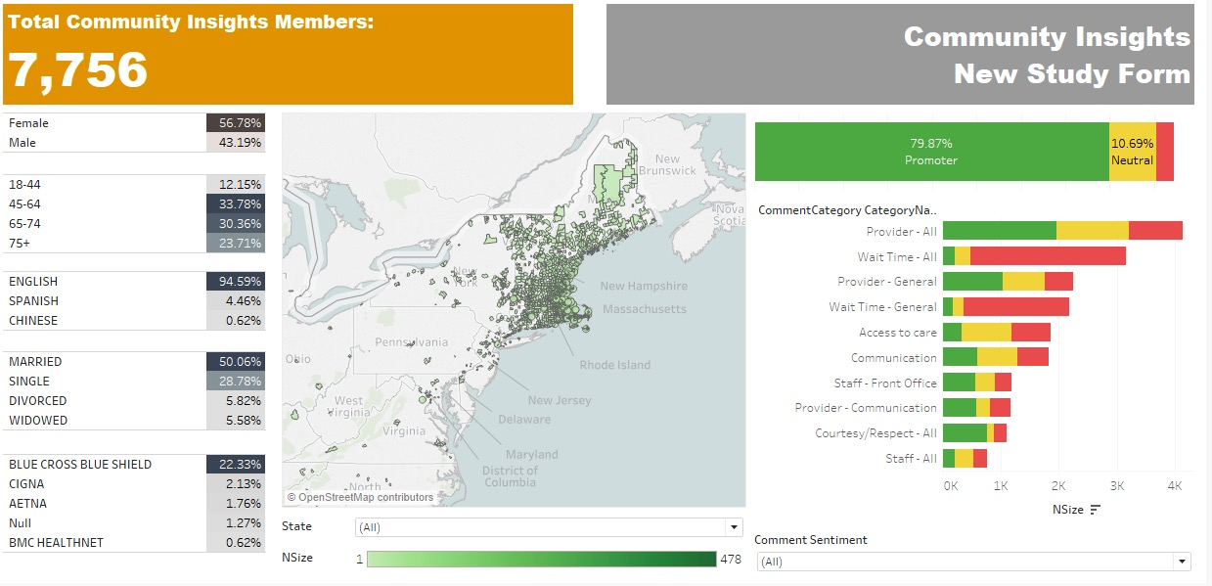
Up-to-the-minute info on your panel community
TIMELINESS
Notes:
Know in real-time the make-up of your patient panel: number of panelists, demographics, Net-Promotor Score, sentiment analysis, and more.

Slide 6
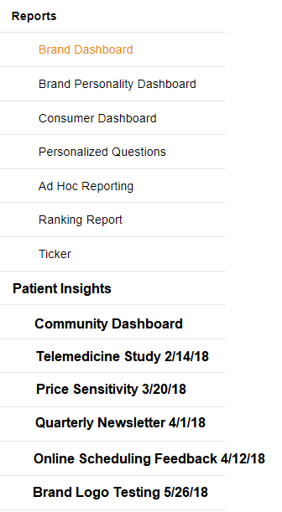

Knowing what you need to know, fast
TIMELINESS
Quick turnaround (~2 weeks)
Personalized Summary Report lives within your NRC Health Platform
POSSIBLE COMMUNITY INSIGHTS TOPICS
Logo testing Mission, vision, values testing Tagline testing Website testing Demographic Exploration Patient Personalization Wait Times Improvement Initiatives Telemedicine Price Sensitivity Brand pulsing Innovation services testing Scheduling Preferences Patient Population Segmentation Patient Portal Improvement
PROCESS IMPROVEMENT
ONLINE SCHEDULING
NPS HYPER-TARGETING
TELEMEDICINE OFFERING

Slide 7
CASE STUDY:
Telemedicine Exploration
CONFIDENCE
Health system was in beginning stages of launching telemedicine services. They needed feedback around awareness of the service, likelihood of usage, price sensitivity, and naming preference.
Q. Are patients willing to pay out of pocket for telemedicine?
Q. How much will they pay?
Q. What name make the most sense for this type of service?
A. Nearly 1/3 of patients (29%) would be interested in paying for telemedicine services.
A. Patients are willing to pay the same as what their co-pay ($20-$30) is for normal telemedicine services and up to double their co-pay (~$50) for a second opinion or specialty visit.
A. Patients like the use of virtual care, instead of tele, in the naming convention. “Tele- sounds antiquated and implies (TO ME) telephone only. I assume this virtual contact may be via skype or other face-to-face software.”
Notes:
ABC Health engaged their patient panel on telemedicine pricing. They found patients willing to pay 2X co-pay for specialty telemedicine.

Slide 8
CASE STUDY:
Birth Center Concept Test
ENGAGEMENT
To compete with an independent midwife group, health system tested birth center concept in a young, vibrant, gentrifying neighborhood around existing hospital.
Q. Do women want alternative maternity services?
Q. Will they use our birth center?
Q. Who is our target user?
A. Yes. In fact, 72% would consider partnering with a midwife.
A. Yes – but only if it has a NICU and is connected to the hospital.
A.
Focused on mental wellbeing in pregnancy
Open to holistic care
Skews older
Notes:
ABC Health considered midwife services to compete and engaged with their panel to confirm market desire and must-have services.

