Slide 1
All Aboard: Launching Pediatric Experience Behaviors through Onboarding and Beyond
Anna Ahrens, MA, CCLS
Director, Transformation and Experience
Mary Bridge Children’s Hospital and Health Network
Tacoma, Washington

Slide 2
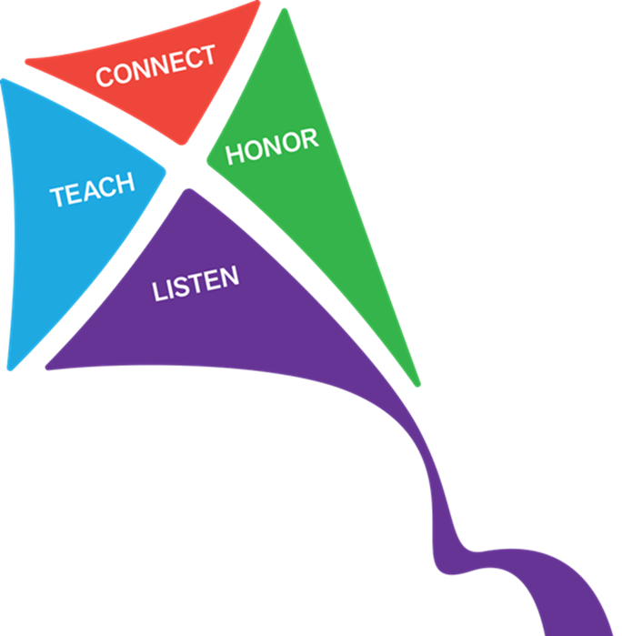
Agenda
About Mary Bridge Children’s
Creating Care Promises
Engaging patients, families, and staff
Incorporating Care Promises into culture and daily work

Slide 3
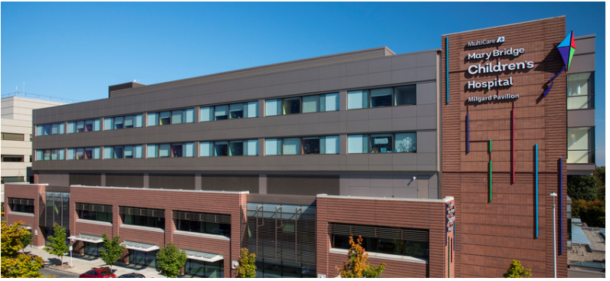
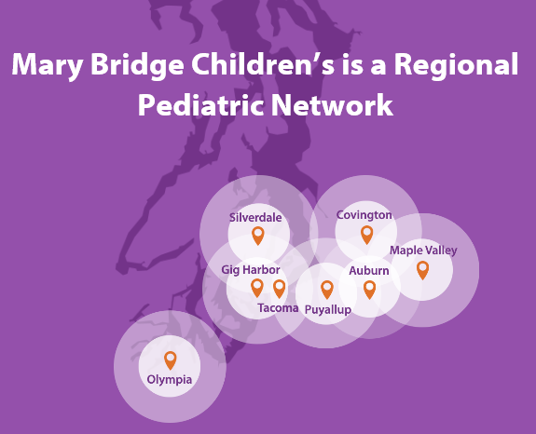
Mary Bridge Children’s Hospital and Health Network

Slide 4
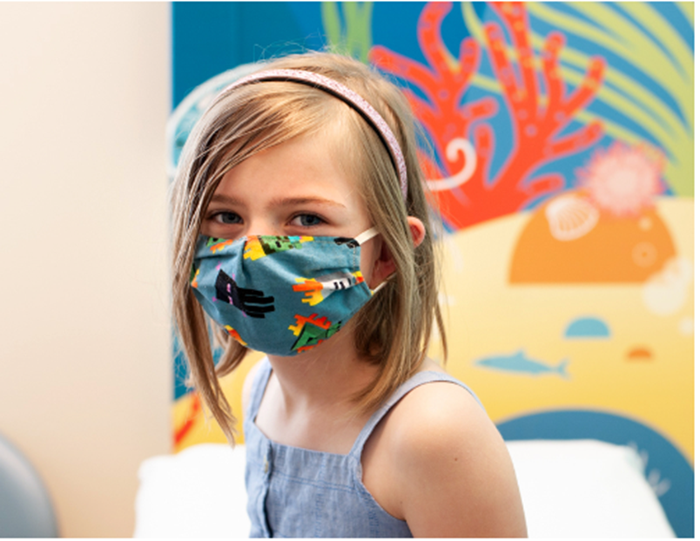
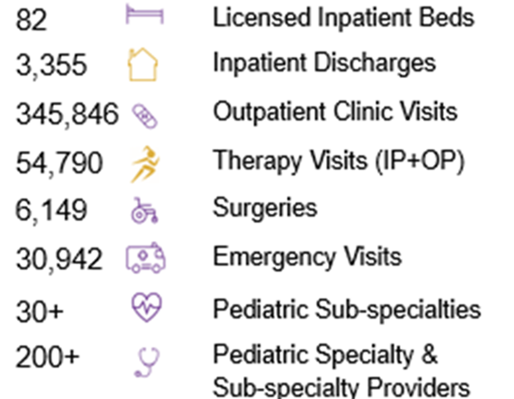
Dedicated to Caring for Kids

Slide 5

An Exciting New Era for Mary Bridge Patients, Families, Providers and our Staff

Slide 6
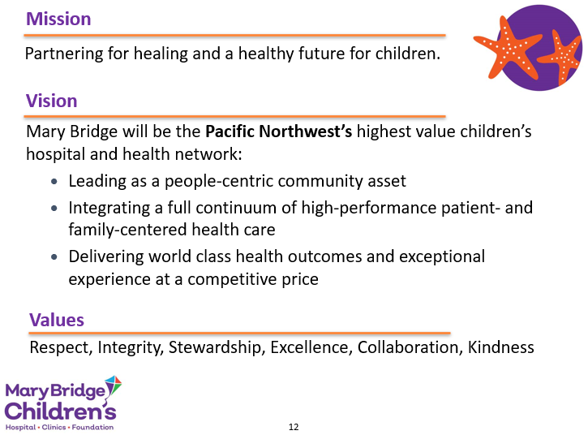


Slide 7
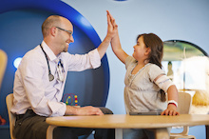
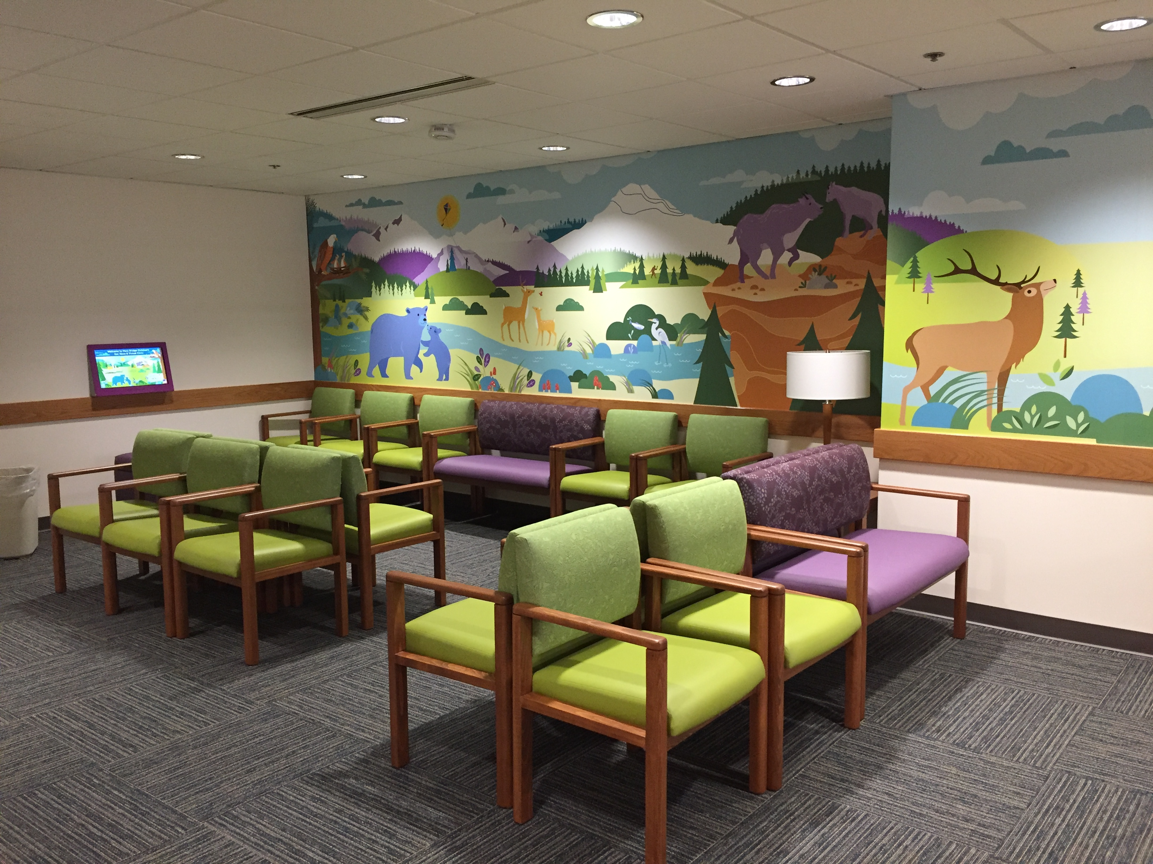
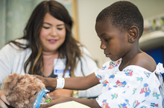
The Mary Bridge Experience
Patient
Experience
Healing
Environment
Child Life &
Family-Centered Care
Notes:
Anna

Slide 8

Tactics to Great Communication and Partnership
AIDET®
  (Acknowledge, Introduce, Duration, Explanations, and Thank You)
Bedside Report (Inpatient)
Hourly Rounding® (Inpatient)
White Boards (Inpatient)
Close the Gap (Outpatient)
Room and Round (Outpatient)
Mary Bridge
Care Promises
Notes:
Anna
These are Patient experience standards that already exist at MHS. We will not discuss these in great details today. These actions help to inform families, minimize anxiety, and engage them in improving care. AIDET and rounding are used across all areas, where some of these best practices are targeted towards certain areas and disciplines. One key strategy currently is leaders rounding with patients. We are able to get key information from parents, so we can make real time improvements.
You are all familiar with AIDET as a way of introducing ourselves to families and explaining care.
Some of these standards are specific to units, such as Bedside Shift report in the Inpatient setting, while others are practiced everywhere, such as patient rounding.
Today, we will be teaching you our new Mary Bridge behaviors: Care Promises. Our Care Promises are set up to interconnect with all these tactics and not be something new. They are a Mary Bridge extension of our MHS values.

Slide 9
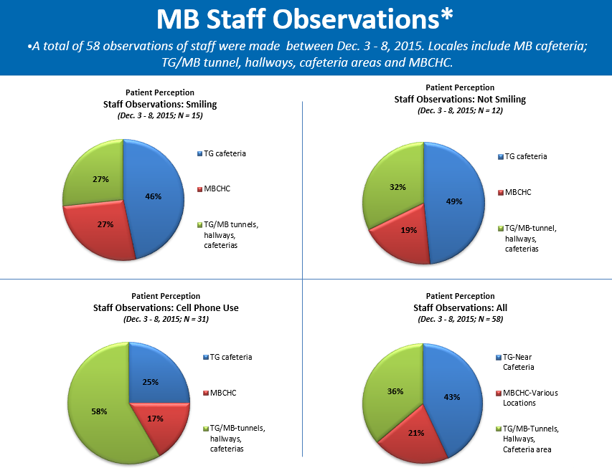
Engaging the Team in Creating Care Promises
Needs assessment launched to staff and families
Interdisciplinary team
Families identified priority behaviors
Created videos with kids teaching staff

Slide 10
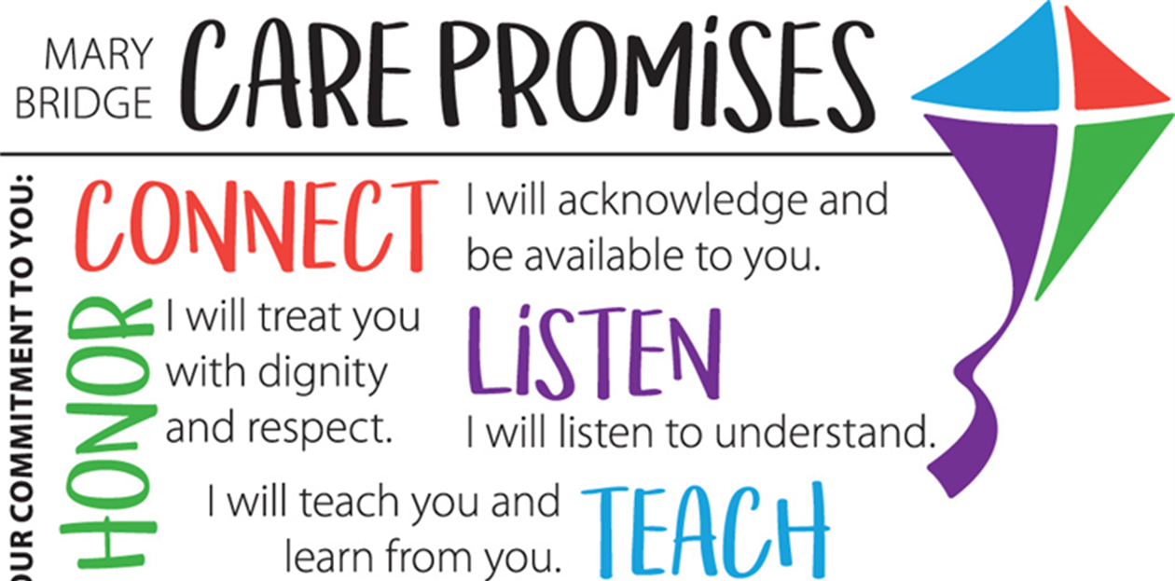
Engaging the Team in Creating Care Promises

Slide 11
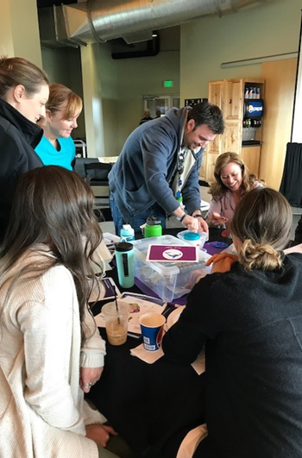
Launched First Pediatric Onboarding
Launched at Cheney Baseball Stadium!
Onboarding Learning Objectives:
Launched with leader onboarding
Condensed trainings offered for providers
Care promise presenters
Interactive and fun!
Journal gift
Theme: Imagine the Possibilities
  Remember what is means
  to be part of Mary Bridge
  Learn the rich history
  Understand the journey in becoming a High Reliability Organization
  Learn and practice experience behaviors:
  Care Promises

Slide 12
Pediatric Patients Teaching Staff…
Video link: Teach video

Slide 13
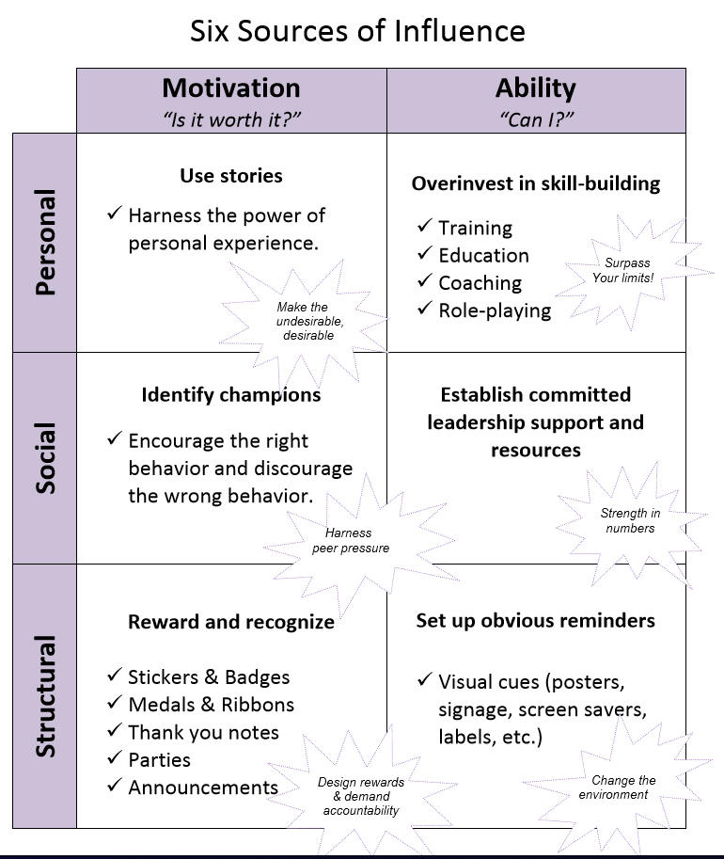
Incorporating Care Promises into Culture
Takes more than training to create cultural behavioral change
Engaging and empowering leaders
Care promise of the quarter
Recognition
Visual cues
Tools: reflection and observation/coaching

Slide 14
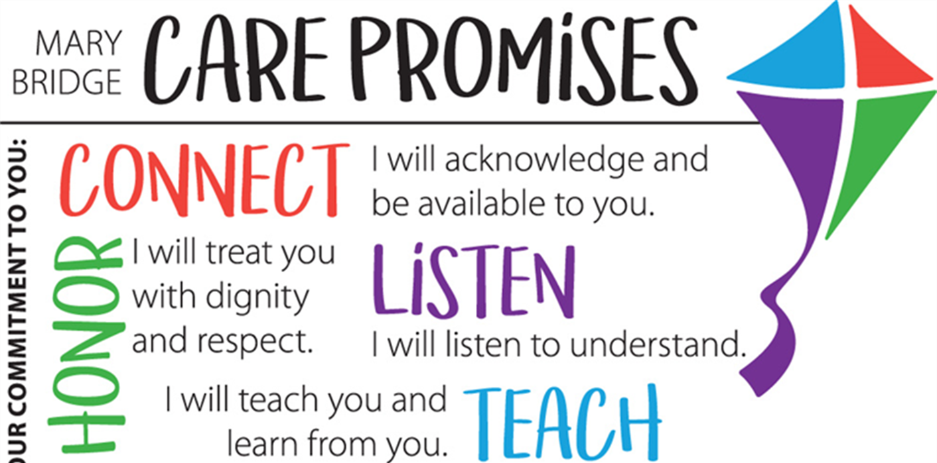
Care Promises and Onboarding Today
Laying foundation has led to endless possibilities…
Care Promises in the arrival and back-office spaces
Onboarding: Virtual and family story
Empowering leaders to customize, but not change branding
Promoting positive experiences through COVID

Slide 15

Care Promises Today: Put Your Game Face On
February 2021 Clinic Staff Meeting
Child Life Presentation:
Say Hello with a SMILE
Get down on the child’s level
Introduce yourself to both the caregiver and child
Confirm who is with child “Who did you bring with you today?”
Address patient by name

Slide 16

Care Promises Today: Making the Connection
Shoes & Shirt Trick
  Wow! You have cool shoes.”
  Or “What’s on your shirt?”
Use open ended questions. Try “What have you been up to today” vs. “How are you today?”

Slide 17
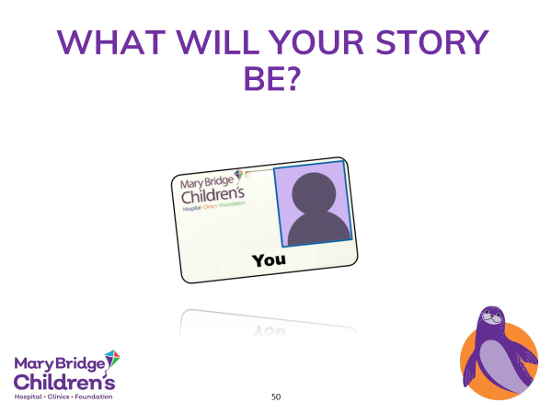
Wrap Up
Creating: Combination of lean tools and engagement
Engaging patients and families
Next endeavor: emotional safety

