Slide 1

August 2022
NRC Health
Connections
Gathering Insights – Inspiring Understanding

Slide 2


Regional Summit
Register at go.nrchealth.com/summit22_MN
IN-PERSON EVENT November 3, 2022 | Minneapolis, Minnesota W MINNEAPOLIS - THE FOSHAY

Slide 3
Recording Link and Roadmap
Key sections of the Connections Session are listed below, with the associated time within the video recording
Slide Time
Nurse Leader Rounding (NLR) Definition 7 03:20
Nurse Leader Rounding Impact 8,9 05:59
Discussion 11 08:46
Improvement Resource 15,16 52:22
The Huddle 17 53:33
Upcoming Events 18 54:24

Slide 4
Objectives
Review the importance of nurse-leader rounding
Discuss ways to sustain nurse-leader rounding efforts

Slide 5


28TH ANNUAL NRC HEALTH SYMPOSIUM
Human Understanding—
Connecting through stories
AUGUST 21–23, 2022 | SEATTLE, WA
Join us for a groundbreaking healthcare transformation event!
nrchealth.com/symp22
Notes:
As far as upcoming events:
NRC Health is hosting our annual symposium in Seattle this year.
We would love for you to join us. Please go to the link and check out the agenda and speakers today.
New this year, In addition to the conference sessions, we have added an executive track and a governance track.
NRC Health’s Toya Gorley will be presenting at a pre-conference workshop titled: Making Best Practices and Promising Innovations Stick, where participants will hear 10 tactics that are necessary to make best practices and promising innovations stick. The workshop will take place Sunday, August 21 1-4pm.
We hope to see you there!

Slide 6

Regional Summit
Register at go.nrchealth.com/summit22_MA
IN-PERSON EVENT November 15, 2022 | Boston, MA W BOSTON

Slide 7
Nurse Leader Rounding
An evidenced-based best practice in which unit/department-level nurse leaders visit patients to:
Demonstrate strong, visible leadership
Ensure that patients’ needs are met, and patients feel comfortable and safe
Address concerns, complaints, or disappointments
Observe and address issues with the room/space/environment
Mange-up staff and solicit recognition/praise that can be shared with staff

Slide 8
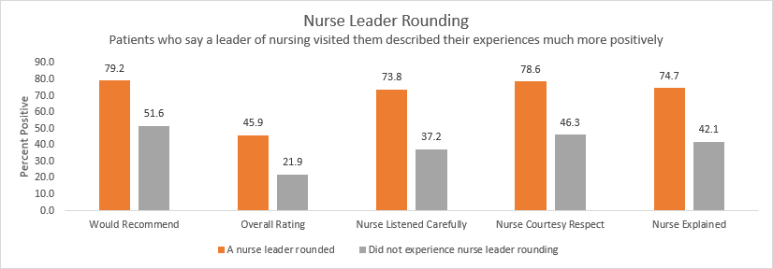
Nurse Leader Rounding positively impacts several dimension of care
Limited to Inpatient data July 1 2021- June 30 2022

Slide 9
Patients who said a nurse leader visited them during their stay were 1.5 times as likely to be promoters compared to patients who said they were not visited by a nurse leader.
Limited to Inpatient data July 1 2021- June 30 2022

Slide 10
Poll
Do you have a nurse leader rounding program right now?
Poll Results:
Yes = 78%
No = 22%

Slide 11
Discussion
Describe your nurse leader program.
How have you adapted the practice to accommodate what is happening in your organization today?
How have you used technology to enhance the process?
How do you ensure that rounding is happening and that it is impactful?

Slide 12
Discussion Highlights
Be flexible with the target number of patients to visit each day. While the goal should be 100%, do what is realistic based on the challenges of the day
Invite clinical and non-clinical leaders to round
Rounding technology can be used and takes on many forms, including partnering with a vendor or leveraging existing technologies such as Microsoft Documents or Survey Monkey
Training is important to ensure rounding happens effectively
Recognizing staff is a critical part of the rounding process

Slide 13
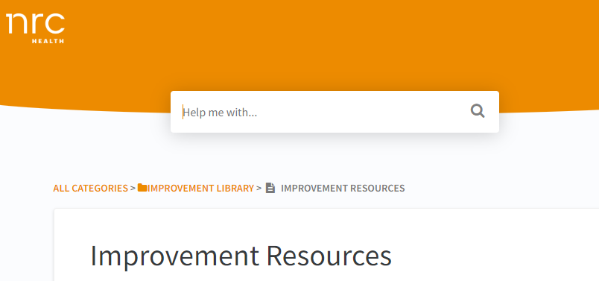
Improvement Resource
Improvement Resource documents highlight evidence-based best practices, explain why they're important, share research to validate the practice, and provide suggestions for implementing and sustaining the practice.
* Please note, If you are logged into Real-time, click on the image to navigate to the resource or landing page.

Slide 14

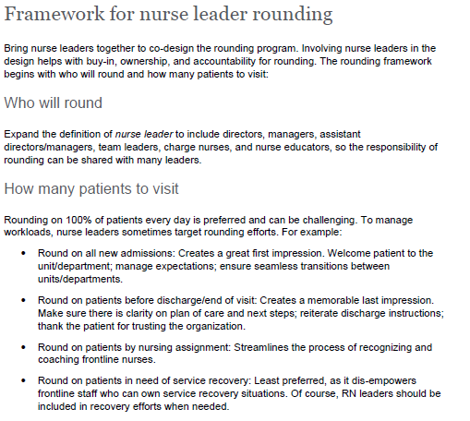
Nurse Leader Rounding Improvement Resource
Intent for use:
Engage nurse leaders to develop a rounding program that they can embrace.
Encourage creativity and flexibility
Highlight practices that work in many organizations
Compliment the Huddle Video
* Please note, If you are logged into Real-time, click on the image to navigate to the resource or landing page.

Slide 15

The Huddle
* Please note, If you are logged into Real-time, click on the image to navigate to the resource or landing page. .

Slide 16
What’s Next
Date | Event/Resource | Where to Locate
8/30 | Connections Call | Addressing Disruptive Patient/Visitor Behavior | Register
9/01 | New Huddle video release | Real-time Resources
9/01 | Discharge Process Improvement Resource Release | Real-time Resources
9/13 | Connections Call | Improving the Discharge Process | Register
9/27 | Connections Call | Navigating Healthcare’s Shifting Staffing Landscape | Register
Monthly | Patient No Longer Podcast | Subscribe

Slide 17
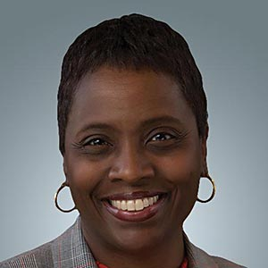

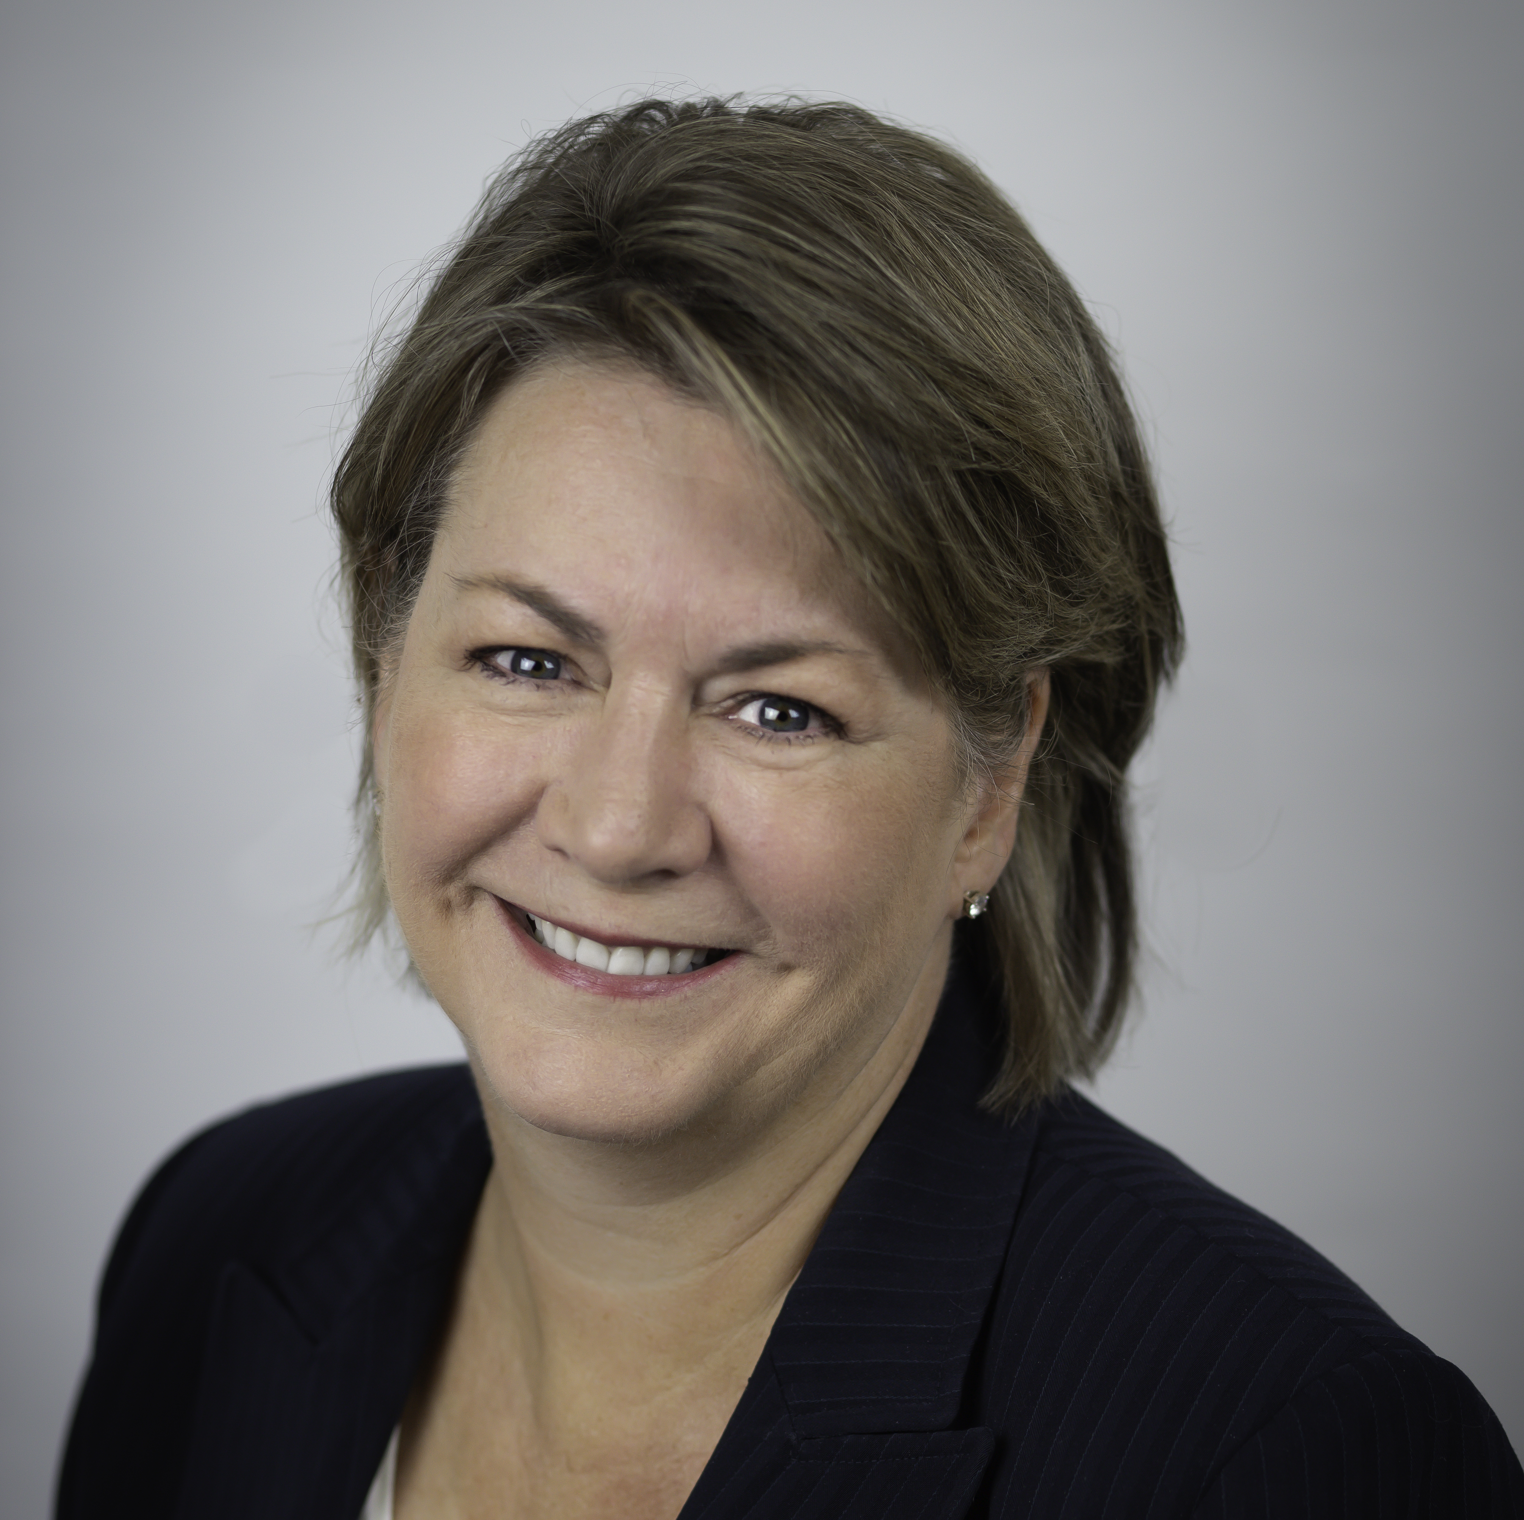
Contact Information
Toya Gorley
Improvement Advisor
tgorley@nrchealth.com
Alissa Wood
Collaboratives Manager
awood@nrchealth.com
Jill Ellis
Solutions Expert, Magnet and Nursing Leadership
jellis@nrchealth.com

