Slide 1
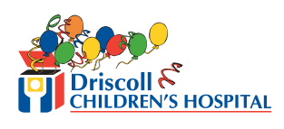
“This partnership with NRC Health, for me, personally, has shown me a much richer view of medicine.”
—Dr. Jon Roberts, Director of Pediatric Pulmonology, Driscoll Children’s Hospital

Slide 2
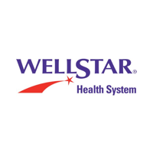
“At WellStar, a team of us chose NRC to be our partner in this new way of surveying. We know there are other options out there. NRC Health provides a customized approach. We don’t want to treat all of our patients the same way. You want to partner with someone who can provide the service that you want, but it is about the experience. It’s about the connection you make with people, and the quality.”
—Pat McNulty-Collins, AVP Patient Experience,
WellStar Health System

Slide 3
“We’ve been partners with NRC Health for over a decade. NRC Health has been a partner in helping us understand how changes are affecting our consumers and how we can be responsive to their needs amidst all of the change.”
—Aubrey Hinkson, AVP of Marketing, Augusta University Health

Slide 4
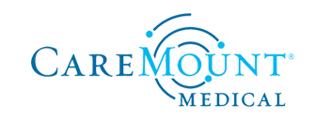
“NRC Health has been exceptional in meeting us where we were and taking us where we needed to be.”
—Jason Ruda, Director of Patient Experience, CareMount Medical

Slide 5
“I value our partnership with NRC, as the resources we utilize are easy for us to use and are pretty intuitive. Having strong resources that are easy for people to use makes the partnership much stronger.”
—Jason Shenefield, COO, Phelps County Regional Medical Center

Slide 6
“Working with NRC is very different from with other vendors in overall responsiveness and level of customer service.
The ability to really go above and beyond to partner with us, to assess what it is that we as an organization are trying to do, and then make suggestions and tailor what it is that is being offered to us based on those needs, has been really helpful for us in driving our mission forward to take great care of our patients.”
—Brandie Manuel, Chief Patient Care Officer, Jefferson Healthcare

Slide 7
“NRC has been a partner for us since 2010. They listen to us. They are very responsive to Children’s of Alabama.”
—Lori Moler, VP Customer Service, Children’s of Alabama

Slide 8
“NRC Health is always very helpful. If we need any additional information, they’re great partners to be around. They have most of the pediatric benchmarks, which was why we originally migrated to NRC Health from another vendor. We’re very happy.
We’re going into our fifth year with NRC Health, and we couldn’t be happier.”
—Lisa Schiller, Director of Patient Experience, Children’s Hospital Los Angeles

Slide 9
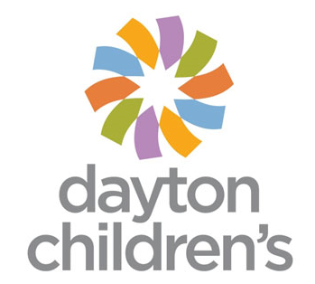
“The deliberate thought of the experts at NRC has been so helpful to us. NRC is a vehicle for bringing people together; with the pediatric collaborative, and with the national conferences, it’s a way to talk to other people who have the same issues, the same questions that we do.”
—Cindy Burger, VP and CXO, Dayton Children’s

Slide 10
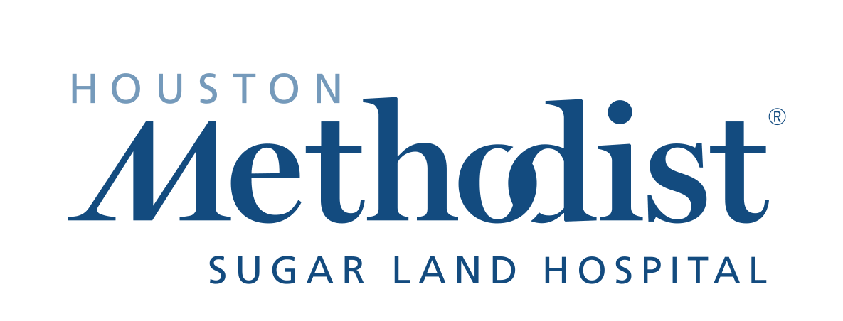
“The feedback you get on NRC’s real-time surveys, I think, is incredible. It’s much more robust than what we see through the traditional long-form surveys.
I think that’s powerful for us as healthcare providers, in terms of changing how we look at things.”
—Chris Siebenaler, Senior Vice President and CEO, Houston Methodist Sugarland Hospital

Slide 11
“NRC Health’s Real-time has surpassed our expectations, it’s so much better. The different ways that throughout the organization we can partner with NRC Health, and the different things that they can do, really help bring it all together so that there’s one direction.
They are providing us with so much more than we expected.”
—Barbara Burnes, Director of Workforce Development and Service Excellence, Floyd Medical Center

Slide 12
“I would say that NRC Health is helping OU Medicine interact with patients. I think the Real-time tool really is challenging us to look at patient experience in a different way. I think it’s pushing us to reach further and dig deeper and really figure out what that patient experience means.”
—Theresa Steckel, VP of Patient Experience, OU Medicine

Slide 13
“As far as being responsive goes, we’ve been saying in pediatrics for many years that our families, our parents that are 25 and 35 years old, do not want to fill out a 60-question survey. We have to have a better way to get their feedback in real time.
NRC Health was so responsive and created a product especially important in pediatrics. Now we hear from our families quickly, and we’re getting so many more comments and insights from them.”
—Cindy Burger, VP and CXO, Dayton Children’s

Slide 14
“We are using consumer insights to build brand loyalty. Ad testing from NRC Health is part of how we collect insight. It’s not a matter of ‘Do we have the time?’ or ‘Do we have the resources?’ It’s just a part of what we do—making sure that those consumer insights we yield are driving the creative strategy.”
—Aubrey Hinkson, AVP of Marketing, Augusta University Health

Slide 15
“Columbus Community Hospital is privileged to have a wonderful board of directors. They have learned so much from The Governance Institute.
It’s hard to be a community member and suddenly join a hospital board. There are regulations; there’s patient experience, so many things to think about. There’s ‘Do we build, or don’t we build?’ and there are financial pieces. For them to have a clear understanding of their role as board members, The Governance Institute has been wonderful. It’s been very, very helpful to them.”
—Dorothy Bybee, VP of Patient Care Services and CNO, Columbus Community Hospital

