Slide 4
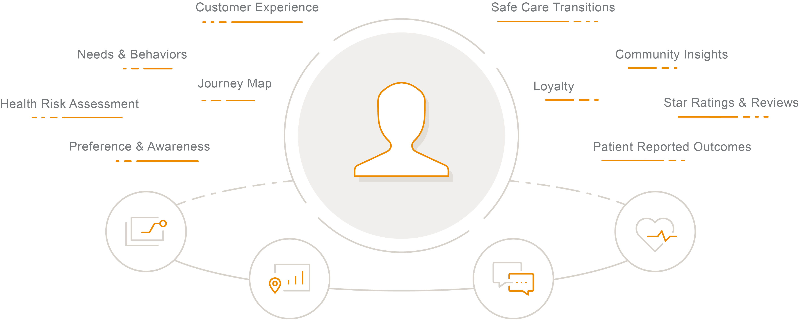
NRC Health Customer Intelligence Platform
Notes:
Achieve customer obsession
Rooted in human understanding, NRC Health’s Customer Intelligence Platform is the only enterprise solution that gives healthcare providers the insight and inspiration for innovation to drive strategic direction, market development, customer experience, and quality outcomes.
Gain a complete understanding of your customers – not as an episode, but as an ongoing relationship.

Slide 5
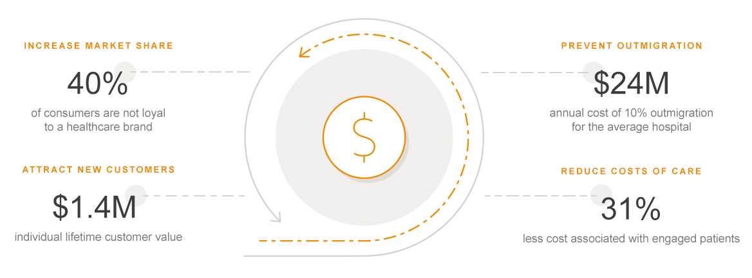
Realize the economics of experience
Notes:
Realize the economics of experience
Thriving in a consumer-driven healthcare economy requires a revolutionary approach to care and service delivery. To grow and retain market share, a complete picture of evolving preferences, needs, and behaviors of your consumers is critical.
NRC Health gives you the in-depth customer intelligence necessary to transform. We deliver the right insight, at the right time, to exceed expectations of today’s consumer. You’ll be poised to succeed at every stage of the customer journey, from strategy and marketing to customer experience and outcomes.

Slide 6





Our solutions
Strategy and Governance
Guide organizational direction with a consumer-driven strategy.
Attract and Acquire
Identify and attract customers in the communities your serve.
Loyalty and Retention
Prevent outmigration with personalized care experiences and services
Quality and Outcomes
Align quality views to co-produce positive health outcomes.
Service Culture
Empower a customer-centric culture and return joy to practice.

Slide 7
Our Experience
37+
Years Advancing Healthcare
9,000
Healthcare Organizations
75%
of the 200 Largest Health Systems
25M+
Consumer Voices Heard Annually

Slide 8
Upcoming events
EVENT TYPE | EVENT TYPE | EVENT TYPE | EVENT TYPE
Event Name | Event Name | Event Name | Event Name
Date Time Location | Date Time Location | Date Time Location | Date Time Location
For more information on NRC Health events, visit nrchealth.com/events.

Slide 9

Your NRC Health team
We’re committed to empowering human understanding at [Organization Name].
TEAM MEMBERS
Sally Doe
Real-time Implementation Specialist
sdoe@nrchealth.com
First name Last name
Job title
email@nrchealth.com
First name Last name
Job title
email@nrchealth.com
First name Last name
Job title
email@nrchealth.com
First name Last name
Job title
email@nrchealth.com
First name Last name
Job title
email@nrchealth.com
First name Last name
Job title
email@nrchealth.com
First name Last name
Job title
email@nrchealth.com

Slide 11

The economics of
Healthcare Loyalty
What every healthcare executive needs to know.

Slide 12

Survey, or…
Build Relationships
Distinguish your customer experiences with Human Understanding.
12

Slide 13
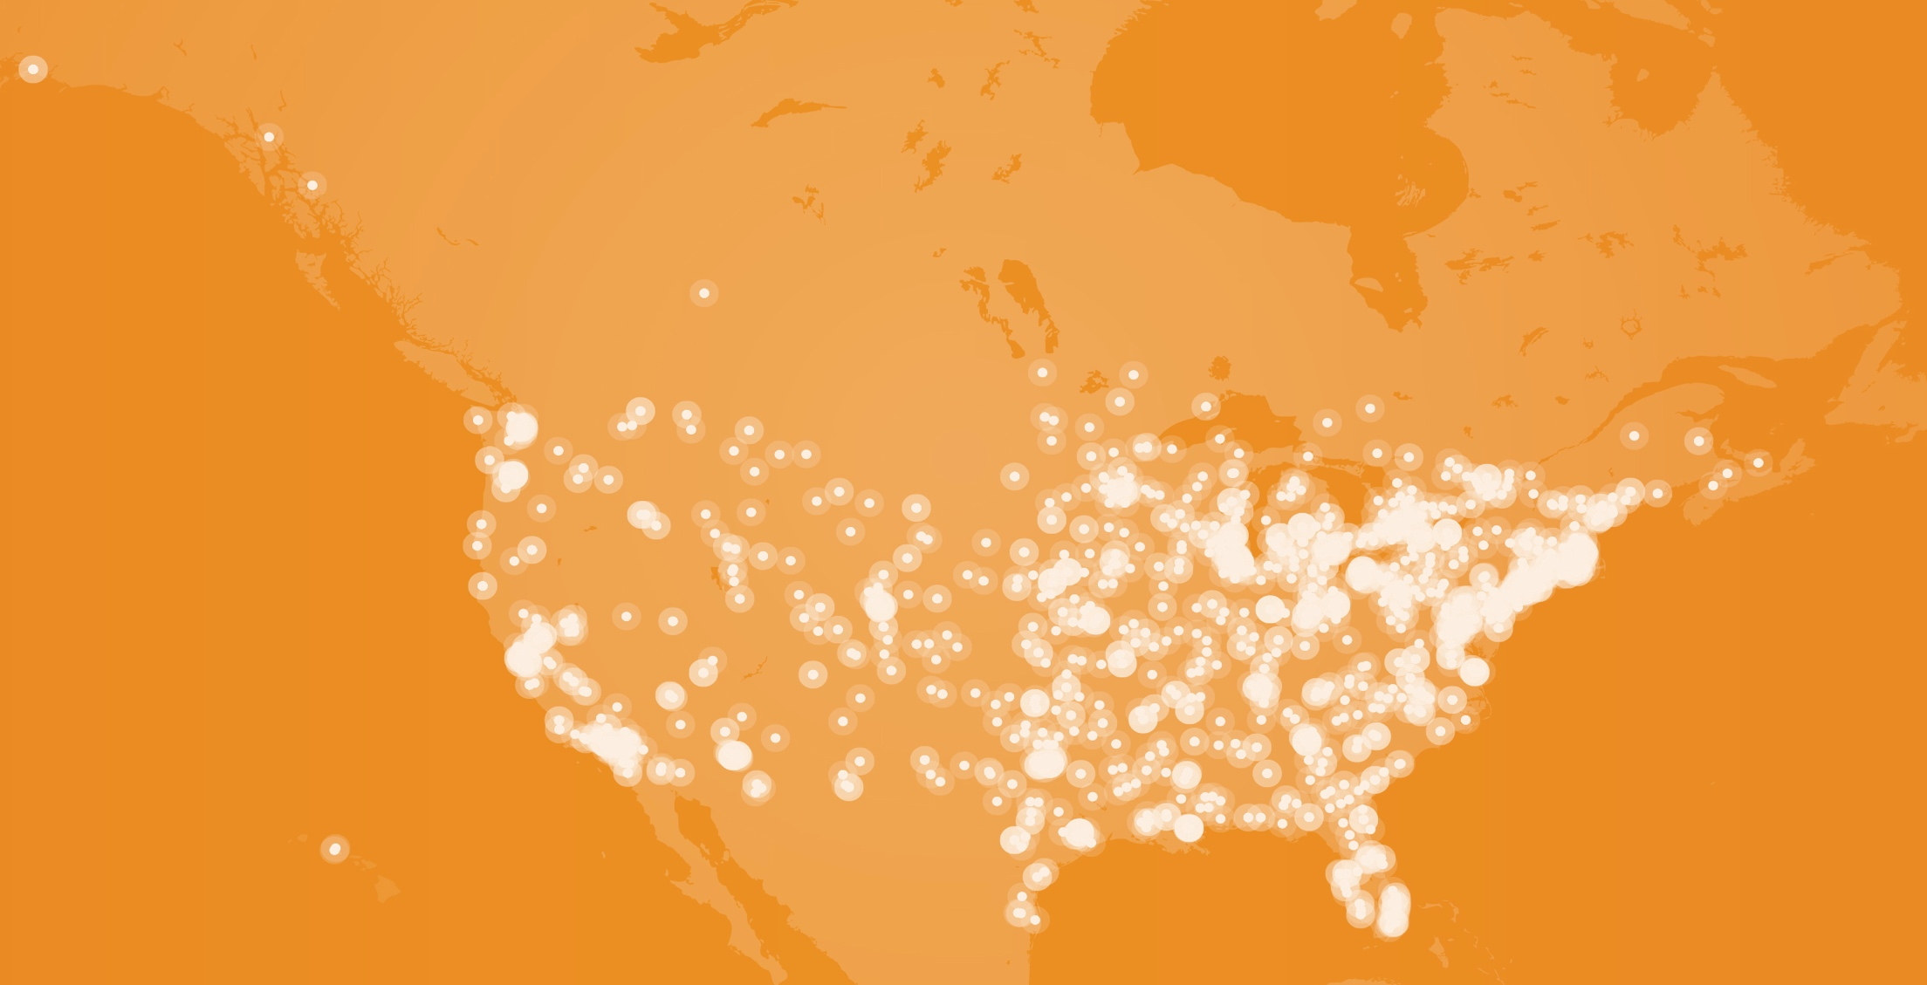
Join the network.
We serve 75% of the top 200 US health systems.
13

Slide 14

Loyalty, Quantified.
Do you know how loyal your customers are?
14

Slide 16

Notes:
Image option: Collective patient voices used to drive decisions

Slide 17


Slide 18


Slide 19


Slide 20


