Slide 1

Thursday February 21, 2019
Monthly Insights:
Disrupters in Healthcare
Market Insights

Slide 2


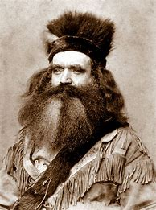

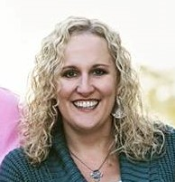







Meet the Market Insights Team
Allison Thomas
Director, Customer Success
Michelle Ostia, Customer Success Manager
Ryan Donohue,
Corporate Director of Program Development
Marty Hager, Customer Success Manager
Alison Mumaugh,
Customer Success Manager
Ryan Hatt,
Customer Success Manager
Shannon McCann, Customer Success Associate
Jo McElwain, Customer Success Manager
John Palmer, Strategic Analyst
Sara Nelson, Customer Success Manager
Jillian Fast, Customer Success Associate
Zach Zobel,
Product Manager

Slide 3
Webinar Agenda
Consumerism in Healthcare
Disrupter Profiles
The Consumer Perception
What this means for Healthcare

Slide 4
Consumerism: Healthcare’s Biggest Challenge
US Healthcare has been under intense scrutiny since 2010
The discussion has largely cast the industry in a negative light
The popular view, the political view and the patient view are
in agreement: Healthcare has failed
Where do we focus? Who is our most critical audience?

Slide 5


Slide 6


Slide 7
Consumerism: Healthcare’s Biggest Challenge
Think of consumers and patients as two sides of the same coin
“Consumerism” isn’t some abstract concept or trend – and it cannot
be managed through a strategic plan
Consumerism represents how people think and feel about us
Don’t lose the emotion of the issue – it’s at the heart of consumerism

Slide 8

“1 in 7 Americans – including 8 million children – does not have even basic healthcare coverage.” - Dave Reichert
“US life expectancy has – for the first time since the 1960s – gone down.” – The Atlantic
“Nine in 10 doctors would not recommend their profession to others” – MedCityNews
“It’s as rare as affordable healthcare.” – Big Sean (popular rapper)
“America's health care system is neither healthy, caring, nor a system.” - Walter Cronkite
“I wish I had healthcare but I just don’t.” – Consumer from Castle Rock, CO
“If you don’t think healthcare is about power, you haven’t been paying attention.” - Don Berwick
“[Consumers] think the US medical system is more about its profits than its purpose.” - Paul Keckley
“The reality of [intensive care] is we are as apt to harm as we are to heal.” - Atul Gawande
“If we don’t do better, health costs will squeeze out spending on all other government costs.” - Bill Gates
“The ballooning costs of health care act as a hungry tapeworm on the American economy.” – Warren Buffett
Notes:
Tapeworms can cause you to feel ill and lose your appetite, often due to irritation of the bowel. In some cases it can even induce vomiting.

Slide 9
Is healthcare moving in the wrong direction?
37%
32%
31%
Moving in the right direction
Not moving in the right direction
Don’t know/
Not sure
Source: NRC Health’s Market Insights consumer survey, nationwide, November-December 2018, n size = 44,159

Slide 10




Consumer Unrest = Competitive Opportunity

Slide 11

Disrupter Players

Slide 12

“Customer obsession” led path from selling books to…everything
Who can transform healthcare? Consumers #1 is Amazon
Entering healthcare: alongside Berkshire Hathaway and JP Morgan they represent nearly 1.2 million covered lives
Vast majority of consumers trust Amazon – but will it translate?

Slide 13

Walmart has the largest retail footprint in the US
Consumers know who Walmart is and where Walmart is
Flu shot (or other routine care) at Walmart? 51% would use!
MRI (or other test/imaging service) at Walmart? 38% would use!
Reasons for use: convenience and affordability were #1 and #2
Walmart virtual visit $4 for employees

Slide 14

Apple
The world’s largest IT company by revenue, strong reputation & customer service
Has a history of disruption (iTunes, iPhones)
Showing interest in healthcare
Tracking health stats through the HealthKit platform
Access medical records with smartphone

Slide 15
Consumer Perception – Disruption Awareness
Which of the following companies do you think will enter the healthcare industry in the near future?
24%
Amazon
10%
Walmart
4%
Apple
39%
I don’t know

Slide 16
Consumer Perception – Predicted Utilization
How likely would you be to utilize providers that were not traditionally involved in healthcare (e.g., Walmart, Amazon, Apple, Berkshire Hathaway)?
24%
Likely
32%
Neutral
44%
Unlikely

Slide 17
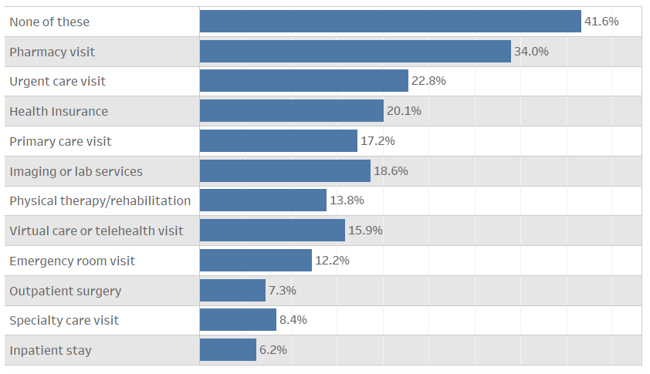
Consumer Perception – Predicted Utilization
Which services would you consider using through a healthcare provider that was not traditionally involved in healthcare?

Slide 18
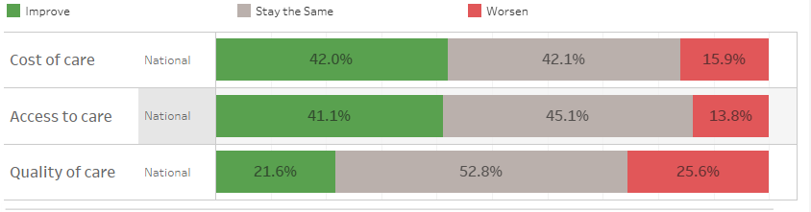
Consumer Perception – Impact on Healthcare
If companies that were not traditionally involved in healthcare began providing healthcare services, how do you think the following aspects of the healthcare industry would change?

Slide 19
Consumer Perception – Cost Factor for Coverage
If costs stayed the same, would you switch to non-traditional healthcare coverage?
65%
Would Keep Current Coverage
24%
Don’t Know
11%
Would Switch

Slide 20
Consumer Perception – Cost Factor for Primary Care
If you had to choose between keeping your doctor or keeping down costs, which would you choose?
45%
Would Keep Current Doctor
35%
Would Switch to Save Money
20%
Don’t Know

Slide 21
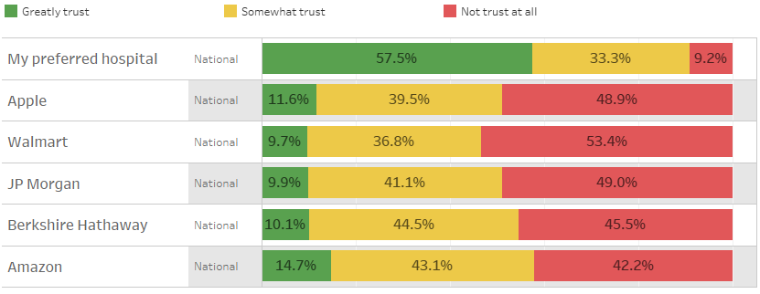
Consumer Perception – Trust Level
To what extent would you trust the following companies in providing healthcare services to you or your family?

Slide 22
Consumer view of Amazon Triad’s chances
Will the Amazon triad lower cost and improve care?
13%
32%
39%
Very confident
Somewhat confident
Not confident at all
Source: NRC Health’s Market Insights consumer survey, nationwide, November-December 2018, n size = 44,159

Slide 23
Is local healthcare moving in the right direction?
49%
22%
29%
Moving in the right direction
(National: 37%)
Not moving in the right direction
(National: 32%)
Don’t know/
Not sure
(National: 31%)
Source: NRC Health’s Market Insights consumer survey, nationwide, November-December 2018, n size = 44,159

Slide 24
Conclusion
Consumers will be the judge on disrupters
It will take some time for disrupters to truly enter the market
Hospitals need to:
Continue to compete for attention & loyalty
Continue to build a trusting relationship with consumers
Adapt to new ever changing expectations of Access

