Slide 1
2023 PEDIATRIC COLLABORATIVE
Hit a Grand Slam: Support Employee Well-being
& Deliver A Better Family Experience
Toya Gorley, Improvement Advisor, NRC Health

Slide 2



Notes:
I show up every day because…

Slide 3
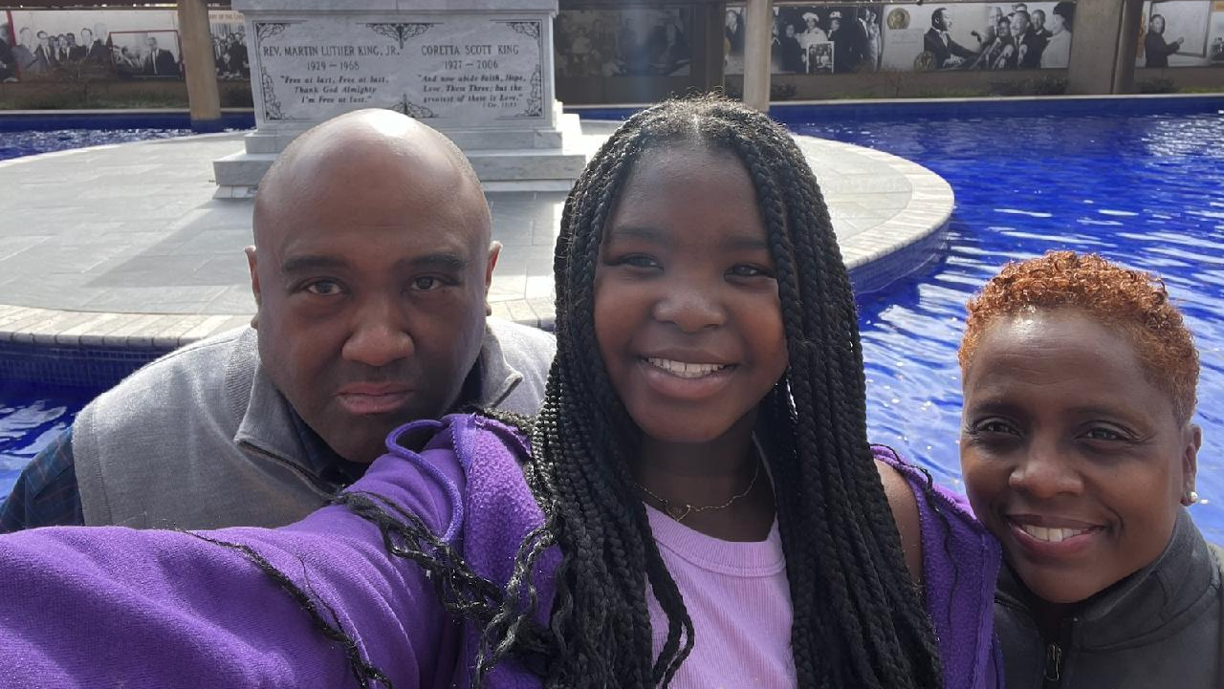

Slide 4
The Backdrop for our Conversation

Slide 5


Slide 6
Shifting employment landscape
The Great Resignation
Quiet Quitting
Presenteeism
Resenteeism

Slide 7
We are hearing
LEADERSHIP
“I would like a manager that is actually present and available. There have been no meetings with staff for 5 months.”
COMMUNICATION
“More upfront and transparent communication with upper management; we cannot plan, implement and provide feedback for things we do not know about. Emails are not always sufficient.”
STAFFING/WORKLOAD
“Minimal staffing and increased workloads make it difficult to have a work/life balance and provide safe patient centered care.”
APPRECIATION
“The lack of value being placed on our staff members who have broad backgrounds and diverse experiences does not seem to align with our hospital's values nor with DEI initiatives.”

Slide 8


Slide 9
Comprehensive strategy to address well-being
Programmatic Tactics
Feel cared about
Feel valued
Strategic Tactics
PROGRAMMATIC
TACTICS
STRATEGIC
TACTICS
    Shared responsibility between employee and organization
    Organization supports the whole employee
    Ask employees and tailor offerings to individuals and teams whenever possible

Slide 10
Our conversation
Programmatic Tactics |  | Strategic Tactics
Employees feel cared about and cared for |  | Employees feel informed, valued and able to do meaningful work
On-the-job well-being and relief | Encourage a culture of vulnerability | Two-way, transparent, 24/7 communication | Culture – Way of doing things | Compensation, advancement and workload
Review programmatic and strategic tactics
Share what is working
Challenge conventional thinking
Decide what you will do to affect change

Slide 11
Programmatic Tactics

Slide 12
Programmatic Tactics
Employees feel cared about and cared for
On-the-job support and relief
Healthy foods on all shifts and to take home Help with errands and child/adult care PTO and cash funds Encourage use of off-stage areas for breaks Adjust schedules to accommodate time off Opportunities to build comradery / fun at work Pet, music, aroma, massage therapy for employees Gratitude, recognition and praise
Notes:
handout

Slide 13
What are you doing?
What’s missing?
Which one of these does your organization do well?
How do you know?

Slide 14
Workforce engagement surveys
Explain your process.
How does the process support your well-being strategy?

Slide 15
Successful WFE processes
Remember the survey is meant to give a voice and facilitate listening
Use short pulse surveys to check-in
Survey when times are hard
Do something with the feedback.
  Don’t rely too heavily on “best practices”
  Own problems at your level
  Escalate to other leaders as needed
Communicate what you can and can’t do
Don’t overthink the action plan – thank, own, address, communicate

Slide 16

Does your organization have a culture of vulnerability?
https://www.youtube.com/watch?v=kse7UE82UFU

Slide 17
Reflect and share
Does your organization have a culture of vulnerability?
How do you help care providers heal?
Notes:
Table discussion

Slide 18
Programmatic Tactics
Employees feel cared about and cared for
Encourage a culture of vulnerability
Wellness programs – healthy eating, fitness, smoking cessation Employee assistance programs (EAP) Code Lavender Schwartz Rounds and other opportunities to debrief challenging situations Resilience and gratitude programs Leveraging spiritual care Peer mentor programs
Notes:
https://www.theschwartzcenter.org/programs/schwartz-rounds/t

Slide 19
Practice Empathy as a Team
Harvard Business Review, Christine Porath and Adrienne Boissy
Complete Me
Raising Your Hand
The Pause
  Complete any of these sentences
    Compassion is hardest when…
    I made a difference yesterday when I…
    I show up every day because…
  Invite colleagues to raise hands to show personal, emotional connection to a situation.
  Created by Jonathan Bartels to foster meaning
  A brief spoken recognition followed by 15 to 30 seconds of silence at the bedside to honor the passing of a patient.
  Can be used for any traumatic experience.

Slide 20

What does your organization do to facilitate a sense of belonging?

Slide 21
Strategic Tactics

Slide 22
Strategic Tactics
Employees feel informed, valued and able to do meaningful work
Two-way, transparent, 24/7 communication
Townhalls Fireside chats “Food with…” Leader rounding Video messages from leaders Solicit ideas to address common concerns / innovation Communicate what is being done and what can’t be done Communicating about the “elephants in the room”

Slide 23
Leader rounding
Effective and consistent?
Describe your leader rounding program.
What challenges did you overcome (do you need to overcome)?
What’s the first step to get started?

Slide 24
Successful leader rounding
Focus on connecting with the person, communicating important information, facilitating service recovery, and recognition.
Prioritize employees – get to know them.
Block time to round – consider a centralized approach
  Allow for flexible protected time
Don’t rely too heavily on rounding tool or script – be conversational, sincere and authentic
Connect with employees when you’re not formally rounding

Slide 25
Strategic Activities
Employees feel informed, valued and able to do meaningful work
Culture – Way of doing things
Decrease or eliminate meetings Develop strong, empathic leaders Limit number of “initiatives” Eliminate “initiatives” or workflows that are not working or not necessary Obtain staff input for projects and improvements. Use PI resources to streamline processes De-emphasize PX metrics. Play up qualitative feedback. Focus on back-to-basics best practices Create structures for accountability Require collaboration with other departments

Slide 26

Are patient/family experience leaders asking too much?

Slide 27
Focus on high impact, high value practices
Drivers of passives and detractors (0-8)
Provider emotional support (61%)
Care team involves friends and family (57%)
Provider involves friends and family (55%)
Qualitative analysis
Created a Pediatric Collaborative Cohort
Analyzed comment categories – across all care settings
Found probability of being a passive or detractor
Correlated negative comments to NPS
Notes:
inpatient, med practice, outpatient, ED and telemedicine.

Slide 28
Reflect and share
What are you currently doing to influence emotional support and involving family/friends?
What one or two practices can you prioritize?
What is one practice care providers can stop in order to focus on the one or two you will prioritize?
Notes:
Table discussion

Slide 29
Strategic Activities
Employees feel informed, valued and able to do meaningful work
Compensation, advancement and workload
Competitive wages Attractive benefits packages Clear career paths Frequent, meaningful performance feedback Creative schedules, job-share Virtual work/work from home opportunities

Slide 30
Two more issues that impact well-being

Slide 31

Traveling staff
Workplace violence

Slide 32
Reflect and share
Check in.
What is your organization doing to address these two issues?
What’s one thing you would advise others to do?
Notes:
Table discussion

Slide 33
Wrap-up

Slide 34
Comprehensive strategy to address well-being
Shared responsibility between employee and organization Organization supports the whole employee Ask employees and tailor offerings to individuals and teams whenever possible
Programmatic Tactics |  | Strategic Tactics
Employees feel cared about and cared for |  | Employees feel informed, included, valued and able to do meaningful work
On-the-job well-being and relief | Encourage a Culture of Vulnerability | Two-way, transparent, 24/7 communication | Culture – Way of doing things | Compensation, advancement and workload
Healthy foods on all shifts and to take home Help with errands and child/adult care PTO and cash funds Encourage use of off-stage areas for breaks Adjust schedules to accommodate time off Opportunities to build comradery/fun at work Pet, music, aroma, massage therapy Gratitude, recognition and praise | Wellness programs – healthy eating, fitness, smoking cessation, mindfulness Employee assistance programs (EAP) Code Lavender Schwartz Rounds and other opportunities to debrief challenging situations Resilience and gratitude programs Leveraging spiritual care Peer mentor programs | Townhalls Fireside chats “Food with…” Leader rounding Video messages from leaders Solicit ideas to address common concerns / innovation Communicate what is being done and what can’t be done Communicating about the “elephants in the room” | Decrease or eliminate meetings Develop strong, empathic leaders Limit number of “initiatives” Eliminate “initiatives” or workflows that are not working or not necessary Obtain staff input for projects and improvements. Use PI resources to streamline processes De-emphasize PX metrics. Play up qualitative feedback. Focus on back-to-basics best practices Create structures for accountability Require collaboration with other departments | Competitive wages Attractive benefits packages Clear career paths Frequent, meaningful performance feedback Creative schedules, job-share Virtual work/work from home opportunities

Slide 35
Next steps
What is one thing that you will commit to moving forward in your organization?
What support do you need from us?

Slide 37
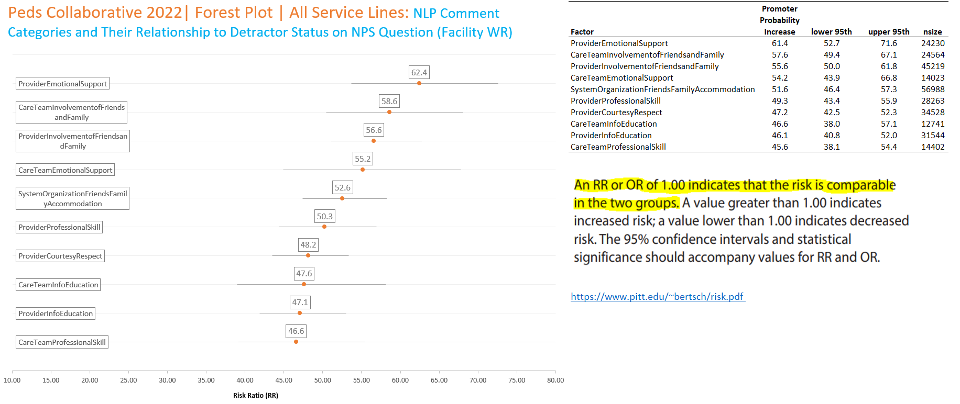

Slide 38
