Slide 1
2023 PEDIATRIC COLLABORATIVE
I.M.P.A.C.T.
Ignite and never lose your IMPACT!
Tim Olaore

Slide 2
I.M.P.A.C.T
Ignite and never lose your IMPACT!
Notes:
Time: 5 minutes
Quick intro

Slide 3
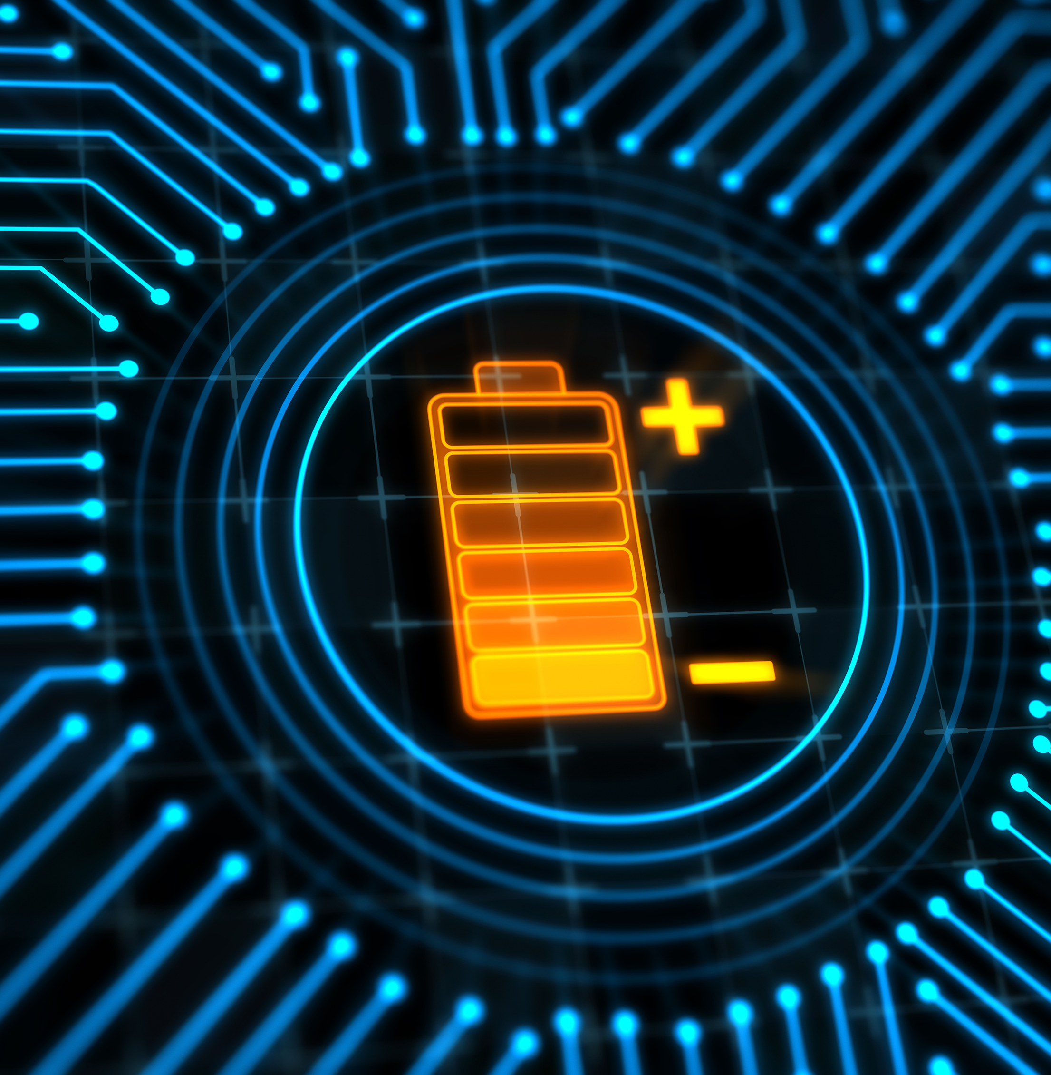
Objective
Gain a methodology to consistently manage your energy and bring the best to your patients and care team.
Notes:
Time: 3 minutes
While I am thrilled to be here with you today, I am even more thrilled in thinking of what you will do with what we cover today…
Let’s review our Objective!

Slide 4
Today’s Agenda
1. So, What?
2. Now What?
3. Wait, What?
Notes:
Time: 4 minutes – Revise Script
Agenda (Today):
This is our agenda – It follows the questions and experiences you will have to help you achieve the outcome we just reviewed.
Soon we will dig into SO WHAT …why is any of this important? The goal of that section is to ensure you literally have no questions about how important this is for you individually.
Then we will move onto NOW WHAT. This is how we activate this in real life
After we focus on how you will proactively consider what can get in the way. Yes, we will anticipate challenges so we can go in with a plan to overcome those obstacles before they even happen. – We call this…”Wait What?”

Slide 5
I
M
P
A
C
T
K
I IT STARTS WITH ME identify and own personal strengths
E
MOVE align tasks and engagements with identified strengths
E
PEOPLE build trust and enlist the right connections
P
ADVANCE/LEVEL UP upskill areas of strength and energy)
R
CUT THE FAT prioritize and set boundaries with discipline
TRUST believe in the process
Notes:
Time: 2 minutes
This is the IMPACT methodology.
The IMPACT Methodology is a set of actions that you will do as a pathway to ignite your inner source of energy.
It creates accountability for yourself, your career, learning, growth, contributions and success!
Here’s a catchy way to remember it….but I need your help to make a beat!

Slide 6
“burnout starts when energy turns to exhaustion, involvement turns into cynicism, and efficacy turns into ineffectiveness”.
– Maslach
Maslach CJS, Leiter MP. Maslach Burnout Inventory, 3rd ed. Mountainview, CA: Consulting Psychologists Press; 1996X
Notes:
Time: 1 minute
Read quote
Factors that contribute to that energy/exhaustion equation personal and environmental, but research suggests, should not be demarcated as they are often integrated
Also key to note is the rejection of the perception that burnout is solely equated with weakness or insufficient resilience. This outdated mindset risks shaming and blaming and has hindered solution-focused problem solving

Slide 7
So What?
Why is this important? what’s at stake?
46%
17%
7
Notes:
46% pf pediatric providers report experiencing burnout based on a 2014 study which was a 10% increase from 2011. It has been relatively unchanged since then, which mean its not getting worse but its not getting better
Cross-sectional studies have linked physician burnout with suboptimal patient care practices as well as with a doubled risk of medical error and a 17% increased odds of being named in a medical malpractice suit
each 1-point increase in emotional exhaustion or 1-point decrease in job satisfaction between 2011 and 2013 was associated with a 28% and 67% greater likelihood, respectively, of reduction in professional effort and work hours over the ensuing year according to payroll records 53. If extrapolated to the national level in the United States alone, the effective result on lost productivity annually is estimated to equate to the loss of the graduating classes of seven medical schools
Nov 2022 American Academy of Pediatrics: Physician Health and Wellness
https://publications.aap.org/pediatrics/article/150/5/e2022059665/189767/Physician-Health-and-Wellness?autologincheck=redirected%3fnfToken%3d00000000-0000-0000-0000-000000000000
2018 Journal of Internal Medicine: Physician burnout: contributors, consequences and solutions
https://onlinelibrary.wiley.com/doi/full/10.1111/joim.12752

Slide 8
Now What?
how do I activate this in real life?
Notes:
At the highest levels…energy comes in two forms…Kinetic energy which involves movent or action…or Potential (stored) energy. In addition, science suggests that there is a finite amount of energy in the universe, and it can only be transferred or transformed
The Impact framework is the pathway to discovering or igniting internal energy. But one of the factors in the methodology is particularly important to sustain and have a continuous resource of it.

Slide 9
People
the #1 energy resource
Notes:
Of all the elements of IMPACT, the P, or people are the only animate objects on the list. It is the only factor that has kinetic energy to transfer to you to keep you moving…or to be transformed into stored or potential energy
As your kinetic energy runs out you either need to build up your store of potential energy or get a transfer of kinetic energy from another source
The way to make sure you are getting it from the right source is to TRUST
You don’t want to store the wrong kind of energy or get energy transferred that moves you in the wrong direction.

Slide 10
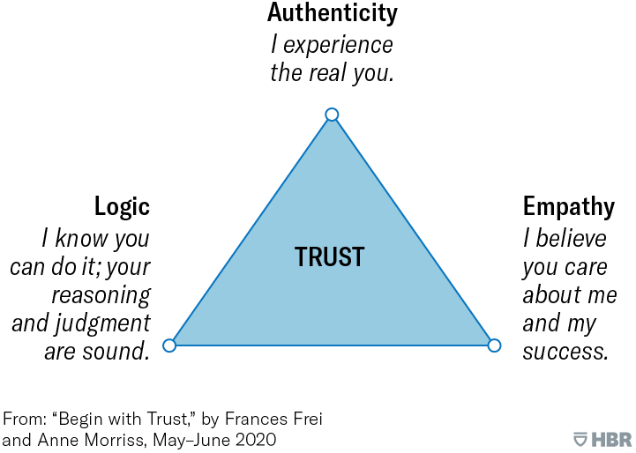
Building a reservoir of TRUST
Individual Exercise
Rank your trust corners to identify your pillars and wobbles
Identify 3 people who are strong in all 3 corners or in an area where you wobble
Time: 10 minutes
Notes:
Building a reservoir of trust involves know your trust pillars and trust wobbles, which allows you to show up as trustworthy and recognize aspects of others that draws you to trust them.
This ensures that you are getting the right type of energy to replace what is being deployed

Slide 11
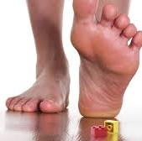
Wait, What?
Know what gets in the way & what to do about it!
Notes:
Time: 2 min
Our Wait What section focuses on things that get in the way.
This can be different for each person and each topic…
For THIS week…we have a common HIGH LEVEL focus: Derailers.
Picture a train – and something on the tracks that makes it come off the tracks.
If we are performing at our best – we can be like that train…moving along…with our strengths, however, if we have a DERAILER…it can interfere with our strengths and the KEEPR leadership model is at RISK!
So, let’s take a few minutes to consider DERAILERS and how to overcome them!

Slide 12
Objective
Gain a methodology to consistently manage your energy and bring the best to your patients and care team.
Notes:
Time: 3 minutes
While I am thrilled to be here with you today, I am even more thrilled in thinking of what you will do with what we cover today…
Let’s review our Objective!

Slide 13
I
M
P
A
C
T
K
I IT STARTS WITH ME
E
MOVE
E
PEOPLE
P
ADVANCE/LEVEL UP
R
CUT THE FAT
TRUST
Notes:
Lets end with our IMPACT JAM

Slide 14
Tim “Mr. Meaningful Work” Olaore
“Executive Producer of energetic Meaningful Work content and tools that help leaders develop teams that are inspired to stay”

