Slide 1

NRC PEDIATRIC COLLABORATIVE
Leveraging Patient Feedback &
High-Reliable Interventions for Inpatient Communication
Sam Hanke MD, MS, MBA │Pediatric Cardiologist │Chief Patient Experience Officer
Cincinnati Children’s Hospital
Co-Lead Pediatric Experience Collaborative

Slide 2
Disclosure
I have no financial disclosures

Slide 3


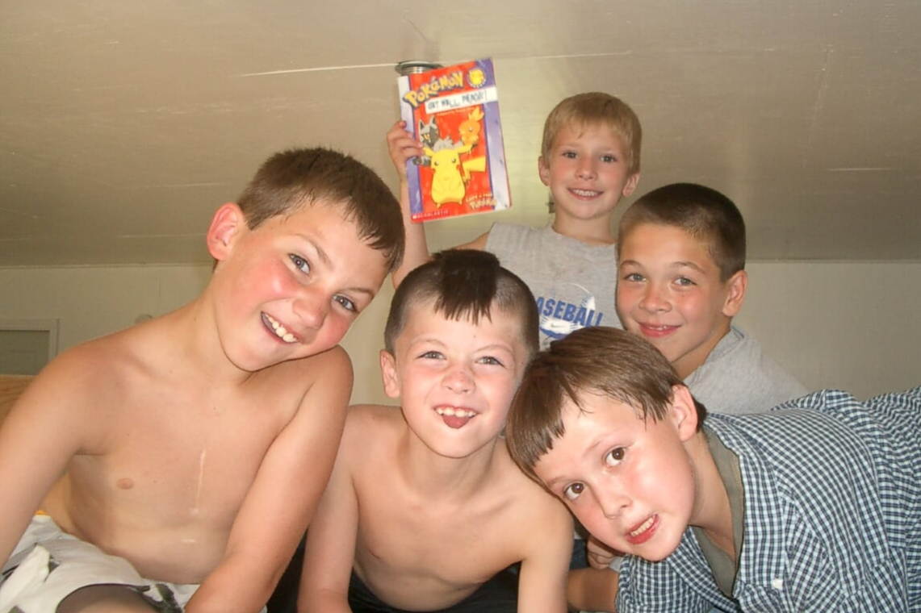

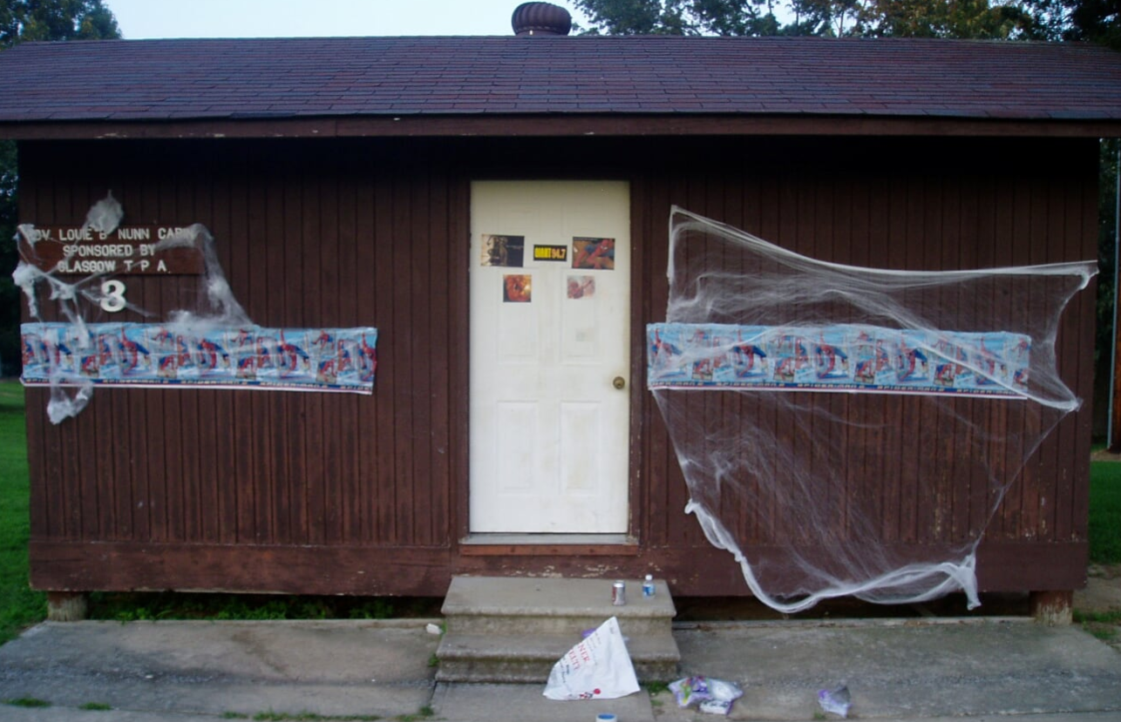

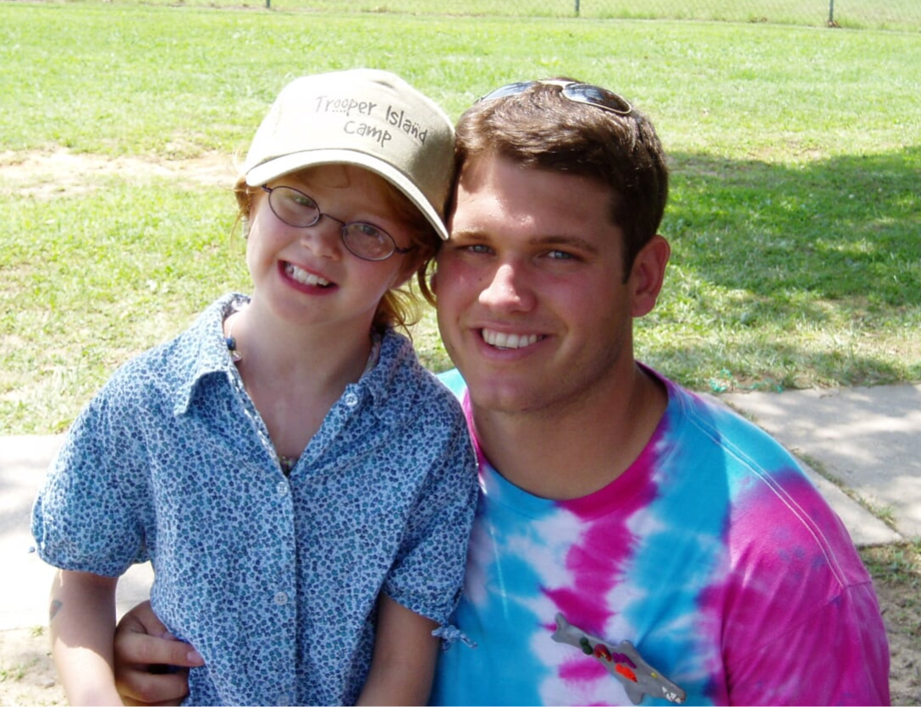
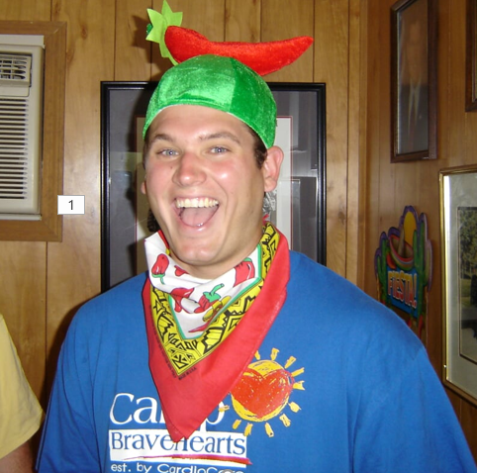

Slide 4
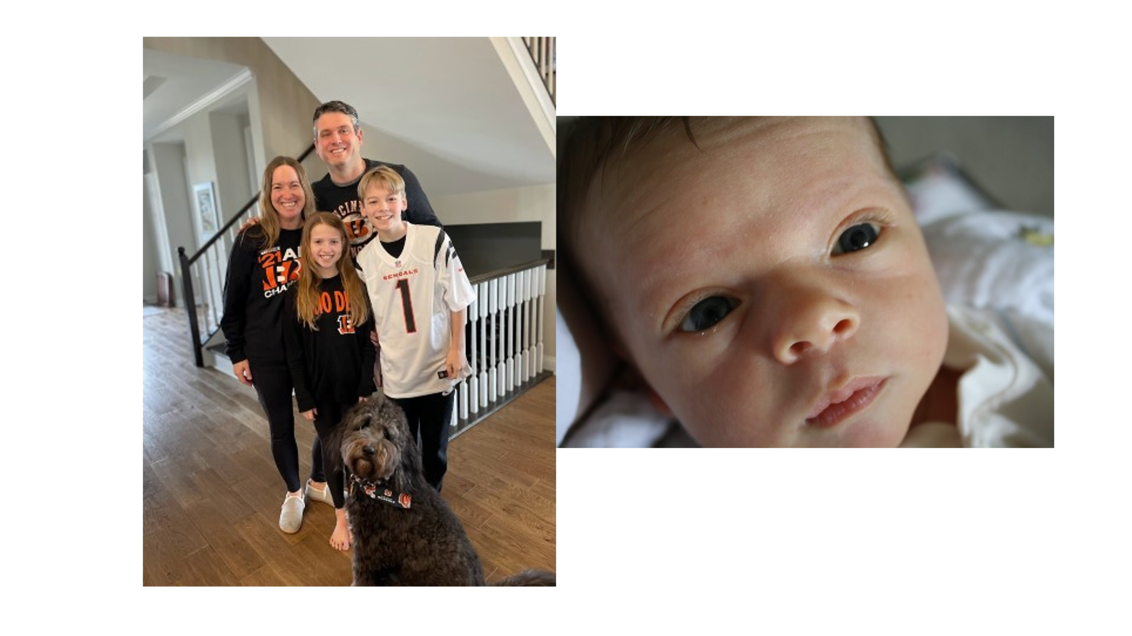

Slide 5
There are 515,000 kids in the Greater Cincinnati region.
Every day we care for more than 4,000
of them
along with children from around the nation and the world.
77
87
343
3,662
are admitted to the hospital for inpatient care.
undergo surgery.
visit one of our Emergency Departments or Urgent Cares.
visit an outpatient setting to support their physical and mental health.
FY21 data; Source: https://www.cincinnatichildrens.org/about/corporate/facts-figures

Slide 6
There are 515,000 kids in the Greater Cincinnati region.
Every day, more than
250
of their families
tell us the story
of their experience here.

Slide 7







Building a GREAT Experience
A Hierarchy of Experience
When families tell us the story of their experience, they speak to us about different elements that build upon each other. It starts with their ability to access our care, after which they expect to be kept safe and to receive the world-class care we are known for. Communication and respect are often at the heart of what families ask of us. When we are at our best, the experience we provide feels personalized, often like a definitive moment for that family.
When families tell us the story of their experience, they speak to us about different elements that build upon each other. It starts with their ability to access our care after which they expect to be kept safe and to receive the world class care we are known for. Communication and respect are often at the heart of what families ask of us and, when we are at our best, the experience we provide feels personalized and frequently even like a definitive moment for that family
DEFINING
MOMENTS
PERSONALIZATION
COMMUNICATION
RESPECT
QUALITY
SAFETY
ACCESS
DEFINING MOMENTS
Was I offered moments of insight, connection, pride or elevation?
PERSONALIZATION
Was I treated like a unique individual? Were my emotional needs met?
COMMUNICATION
Did I clearly understand what was said? Do I trust the information? Did the staff communicate with each other?
RESPECT
Did I feel listened to and respected? Was my family included in the care? Did I get enough time with the provider?
QUALITY
Did I get what I came for? Was the quality of the care good?
SAFETY
Was my family safe?
ACCESS
Was the experience available to me in the first place? Was it efficient?

Slide 8
Center for Patient and Family Experience
We are advocates, directly guided by the voices of patients and families, who champion a culture that strives for “the best” patient and family experience across the continuum of care.
We do so by:
Listening
Translating
Constantly Communicating
to the patient and family voice at scale for the purpose of learning and informing improvement.
that voice into accurate, relevant, actionable and real-time insights.
those insights to the front lines of care in clear ways that point toward action.
Collaborating
Sharing Learning
with diverse teams to implement human-centered solutions by championing, coaching and connecting.
with a national community of practice by building platforms to communicate research, expertise and data.

Slide 9
Building a GREAT Experience
A Hierarchy of Experience
When families tell us the story of their experience, they speak to us about different elements that build upon each other. It starts with their ability to access our care, after which they expect to be kept safe and to receive the world-class care we are known for. Communication and respect are often at the heart of what families ask of us. When we are at our best, the experience we provide feels personalized, often like a definitive moment for that family.
When families tell us the story of their experience, they speak to us about different elements that build upon each other. It starts with their ability to access our care after which they expect to be kept safe and to receive the world class care we are known for. Communication and respect are often at the heart of what families ask of us and, when we are at our best, the experience we provide feels personalized and frequently even like a definitive moment for that family
DEFINING
MOMENTS
PERSONALIZATION
COMMUNICATION
RESPECT
QUALITY
SAFETY
ACCESS
DEFINING MOMENTS
Was I offered moments of insight, connection, pride or elevation?
PERSONALIZATION
Was I treated like a unique individual? Were my emotional needs met?
COMMUNICATION
Did I clearly understand what was said? Do I trust the information? Did the staff communicate with each other?
RESPECT
Did I feel listened to and respected? Was my family included in the care? Did I get enough time with the provider?
QUALITY
Did I get what I came for? Was the quality of the care good?
SAFETY
Was my family safe?
ACCESS
Was the experience available to me in the first place? Was it efficient?

Slide 10
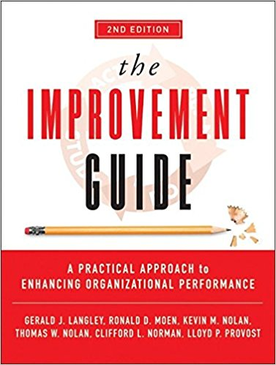
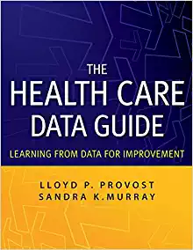

Slide 11
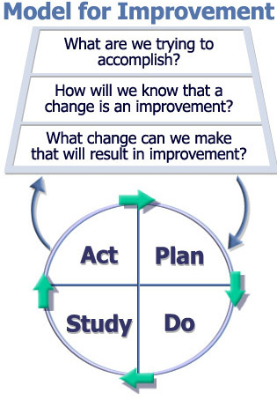

Slide 12
Inpatient Communication

Slide 13
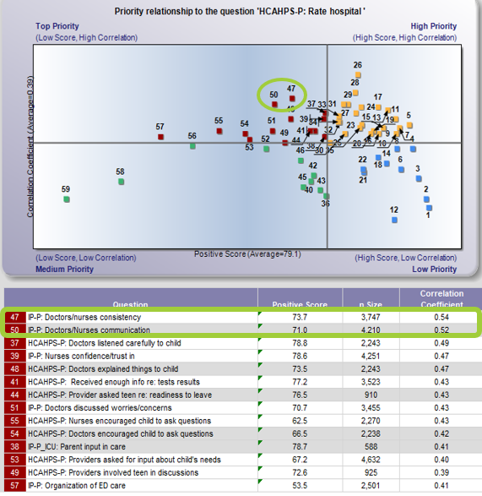
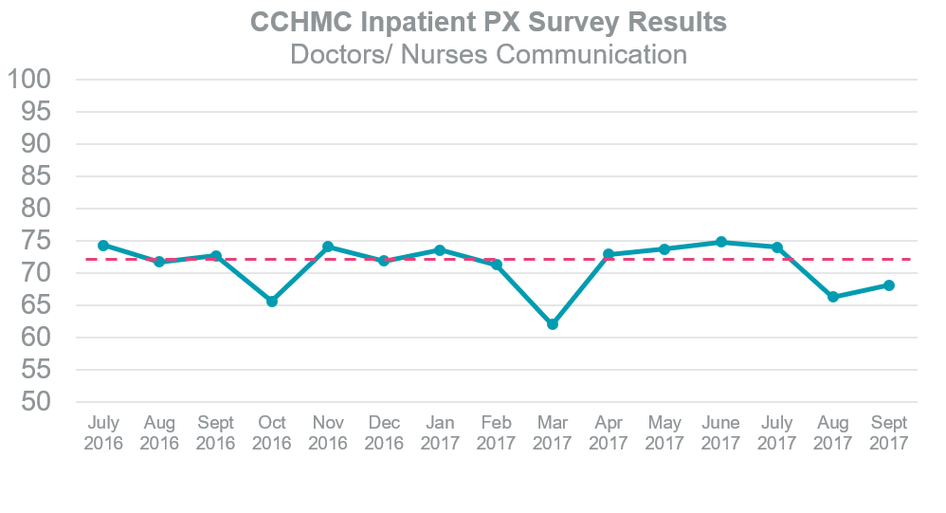
What Our Patients and Data
Told Us

Slide 14
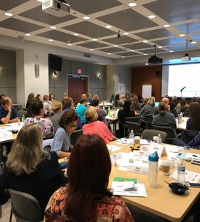

Held five 3 hour interactive focus group sessions
CCHMC Experience Collaborative
Approximately 75 people attended each session
Multidisciplinary team approach for rich, diverse insights
Included Physicians, Nurses, NPA’s, PCA’s, Unit Coordinators, Registration Staff, & Social Workers
Patients and/or Family members also involved with teams
Inpatient Journey to
Improve Communication

Slide 15
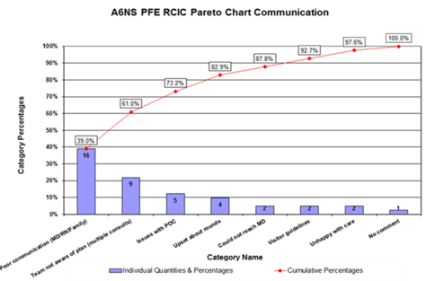
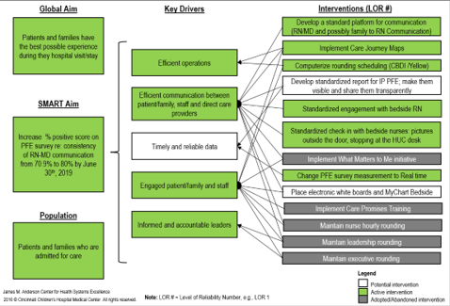
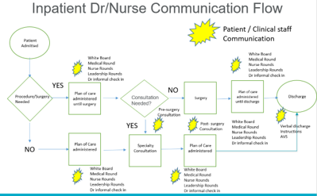
Human
Centered
Design

Slide 16
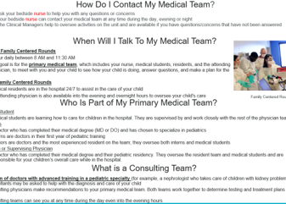
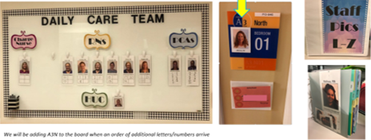
Small Quick
Wins
Communication
Pamphlets
Enhanced coordination
process with consulting providers and improved communication tools
HUC Coordination With Consulting MD or RN
Nurse Picture and Assignments Visuals
Developed tools to easily establish recognize and identify members of daily care team
Nurse Led Rounds
(rounds align with nurse assignment)

Slide 17
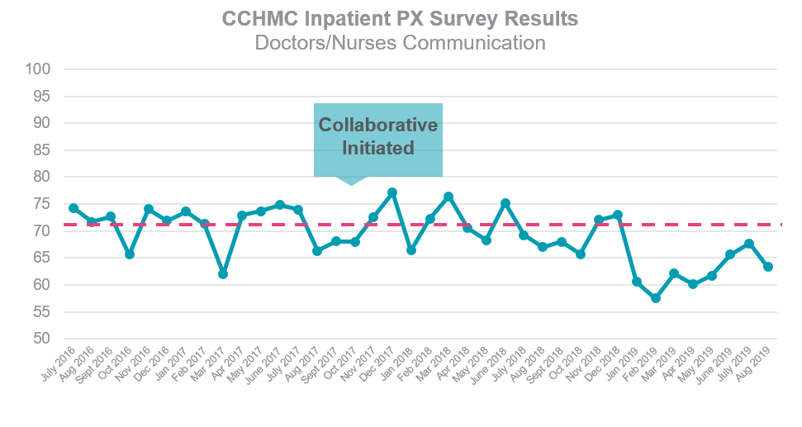
Transitioned to NRC Real Time Surveys
Communication outcome measures did not meet project goal targets
Results consistent with trends prior to collaboration initiative
Unintended Project Success:
Collaboration
Project
Outcomes
Enhanced collaboration across inpatient teams
Improved stakeholder engagement with PX initiatives
Leveraged case study to gain approvals on innovative technology advance provider-patient communication

Slide 18
Need for higher Reliability!
Reliability =Number of actions that achieve the intended result
Total number of actions taken
Level 1 Reliability: 10⁻¹ 1-2 failures out of 10
Level 1. Intent, vigilance and hard work
Notes:
Health reliability definition-The capability of a process, procedure or health service to perform its intended function in the required time under existing conditions.

Slide 19
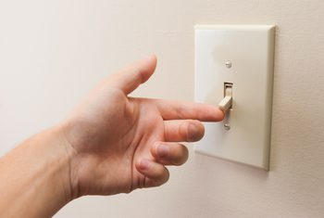
Need for higher Reliability!
Level 2. Design informed by reliability science and research in human factors
Level 2 Reliability: 10⁻² 1-2 failures out of 100

Slide 20
MyChart Bedside

Slide 21
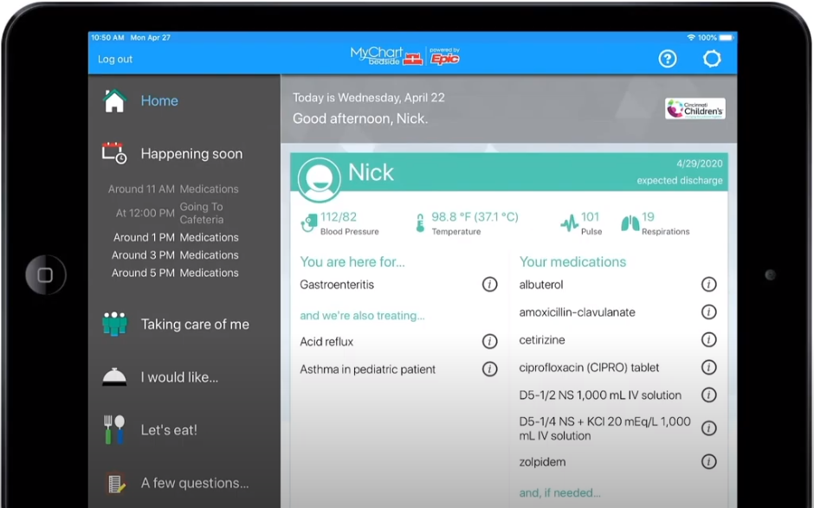
MyChart Bedside
The use of MyChart Bedside provides:
  A platform for disseminating medical information and education
  Clarity of caregiver roles
  Patient schedules/ Medications/ Vital signs
  Flexibility for patients and families to communicate
Integration with Epic
  Less non-value work on front-line staff
Lower cost to CCHMC
INCREASED PATIENT AND FAMILY
ENGAGEMENT!

Slide 22
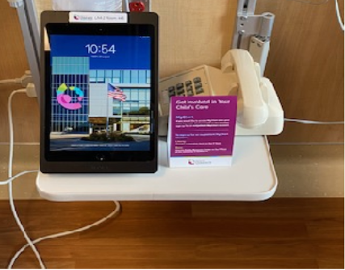
MyChart Bedside
iPad and MyChart Bedside in all inpatient rooms!

Slide 23
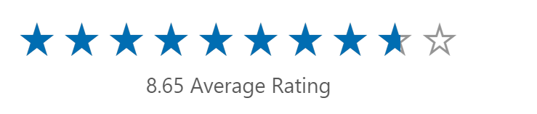
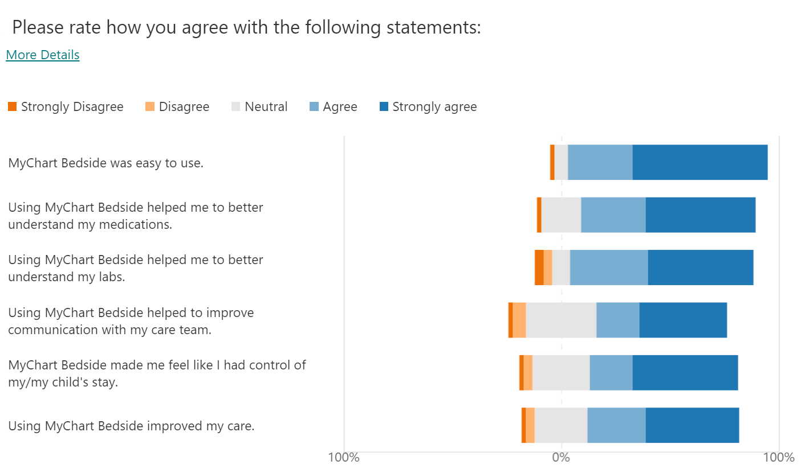
Family Feedback

Slide 24
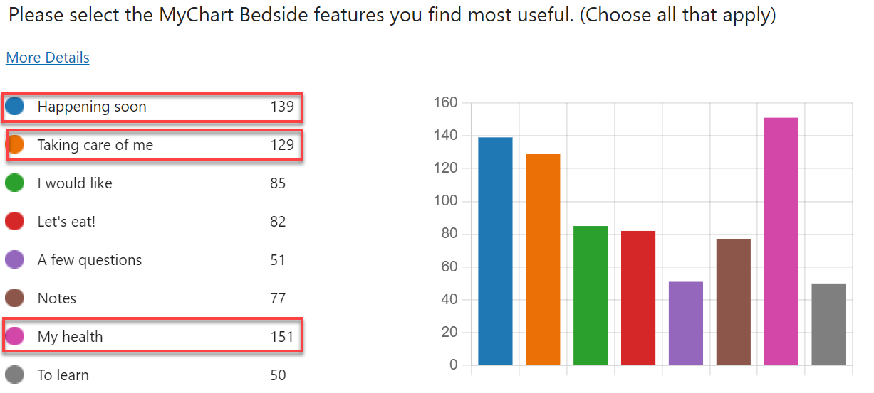
Features Most Useful in MyChart Bedside

Slide 25
Family Testimonials
"I like seeing who is working this shift. Around 7:15 I go to the iPad to see who is coming on next. I like to know who will be coming in our room. If it is someone we've had before, and if it's someone my daughter likes, it makes it easier to decide if I will take a little break or leave the room for a little bit“
“…I can just see everything on the iPad and I don't have to wait to see anything. I can see what's happening and think about things to know what questions to ask."

Slide 26
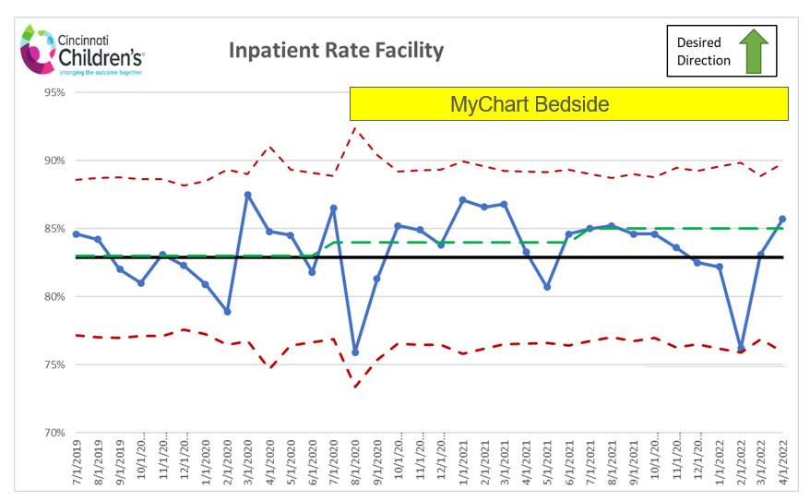
Inpatient Patient and Family Experience
FY20: 82.9%
FY21: 84.3%
FY22: 83.5%

Slide 27
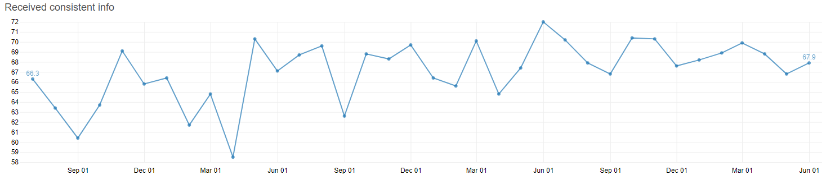
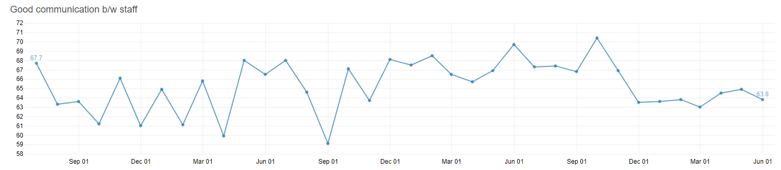
Communication Experience Improved
MyChart Bedside

Slide 28
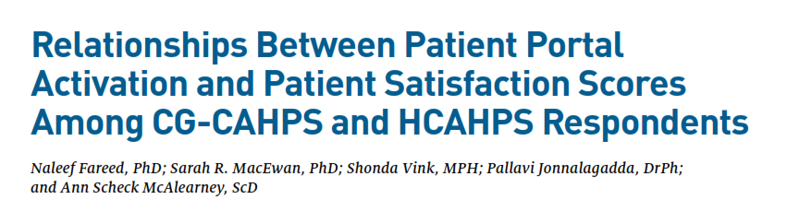
Doctor Communication- 1.24x higher with MyChart use
Care Coordination- 1.20x higher with MyChart use
American Journal of Managed Care 28.1 (2022).

Slide 29
Open Notes

Slide 30
21st Century Cures Act- information blocking
“… any practice likely to interfere with a patient’s access to and exchange of their own electronic health information.”
  Patients own their health information
  Patients control when and how they access and share that information
  Providers cannot reasonably delay or block patients’ access to their information

Slide 31
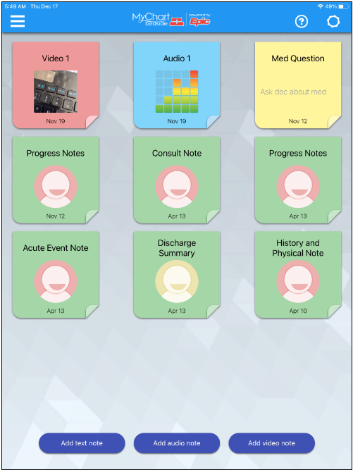
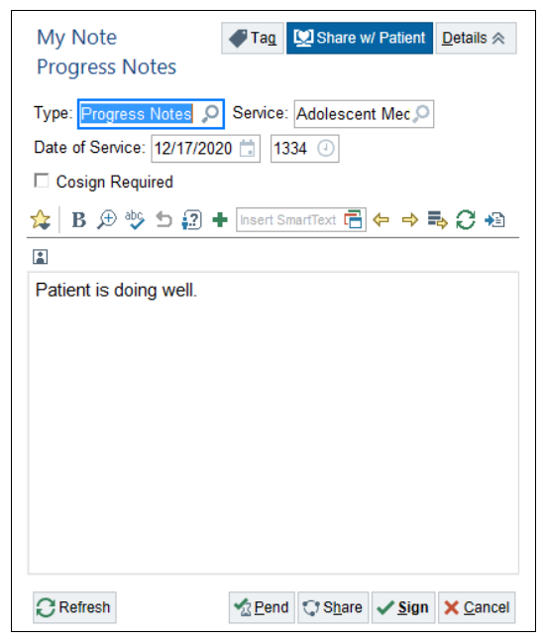

Slide 32
Family Testimonials
“I really like notes. I look to see what his vent settings were overnight. I know they tell me lots of things during rounds, but sometimes they don’t say everything, or I can’t remember everything they said. So, I like the notes. “
“Really like notes. When they come talk to us, they don’t always say everything they put in the notes. I know they don’t have to tell us every little thing, so it’s really nice to read up on anything they didn’t say when they were here.”

Slide 33
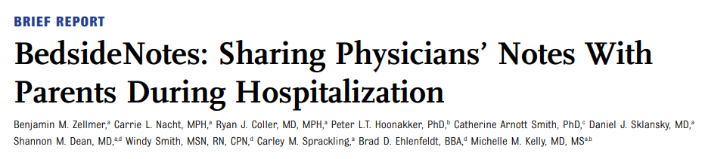
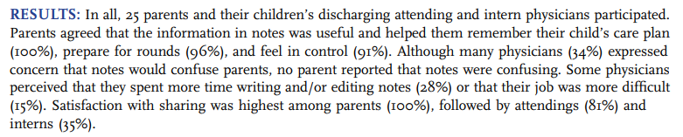
Hosp Pediatr. 2021 May;11

Slide 34
Family Feedback

Slide 35
MyRounds &
Family-Centered Rounding

Slide 36
Family-Centered Rounds
Goal is to include ALL members of the patient’s care team in rounds including the family.
  Frontline staff (RNs and RTs) are critical partners given their 24-hour presence at the bedside
  Interdisciplinary team members (social workers, dieticians, pharmacy, care managers, consultants) are essential in finalizing the plan for the day

Slide 37
Benefits of Family-Centered Rounds
Safety
Situation Awareness
Improve and more efficient Communication
BETTER PATIENT CARE and ENGAGEMENT

Slide 38
Barriers to RN and Family Presence at Rounds
Competing Priorities- Caring for other patients/ family
Staffing
Value of attending rounds isn’t recognized
Coffee, Bathing, Sleeping, etc.
Employment

Slide 39
What is MyRounds?
MyRounds is an application that:
  Creates a daily rounding schedule
  Communicates this schedule to
    Bedside RNs of their patients anticipated rounding time
  Notifies parents/guardians of their child’s anticipated rounding time so they can plan their day

Slide 40
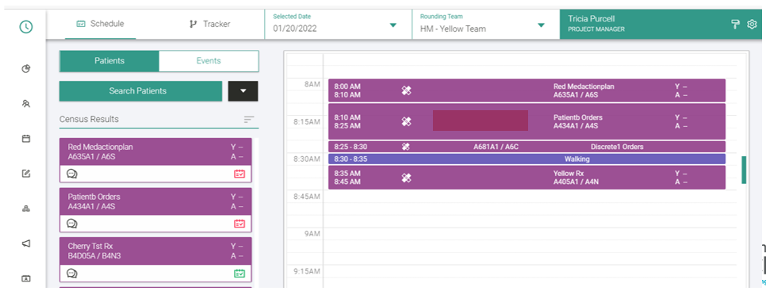
Workflow
Providers create schedules
Voalte alerts nurses automatically of scheduled rounding times for their patients
Parents/guardians who have signed up for MyRounds receive a text message of the scheduled rounding time

Slide 41
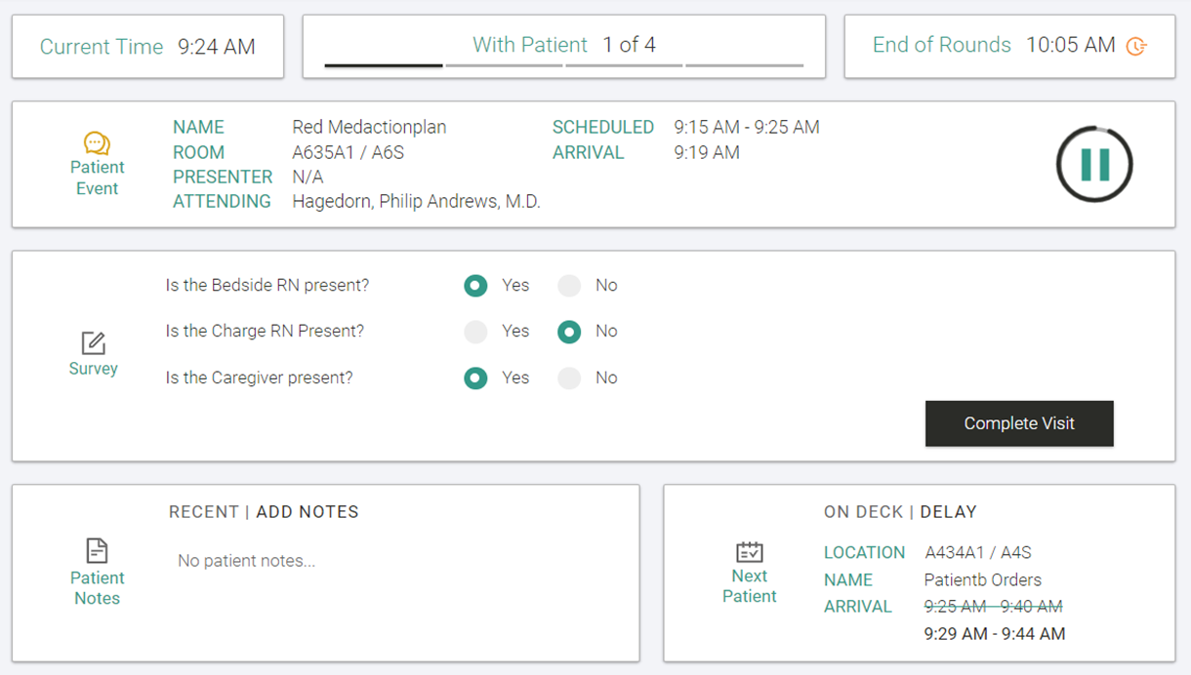
Workflow
During rounds, the rounding team tracks the schedule answering questions on RN and caregiver presence

Slide 42
Current Goals
Increase arrival time accuracy of the originally communicated rounding window to families and rounding team from 81% to 90%
Increase RN presence in rounds with teams using MyRounds from 69% to 80%
Improved Patient and Family Experience communication questions by 4%

Slide 43
“Any sufficiently advanced technology is indistinguishable from magic.”
~1965
Arthur C. Clarke- scientist, science writer, and science fiction stories and novels.

Slide 44
Thank you!

