Slide 1
Exploring the partnership between clinical access and experience
Dr. Ahmed Abdelmoity, MD, FAAP, FAES, Vice President of Clinical Access
Mandy Riemer, MSW, Manager, Patient Experience
Notes:
Mandy:

Slide 2
Dr. Ahmed Abdelmoity, MD, FAAP, FAES, Vice President of Clinical Access
Mandy Riemer, MSW
Manager, Patient Experience
Notes:
Mandy:

Slide 3
Objectives
Define the value of asking the ‘seen in a timely manner’ question and how to use patient feedback from the question to improve care delivery.
Discuss insights into how timely healthcare services lead to better health outcomes and a positive patient experience.
Identify how to integrate the concept of a human-centered design approach into clinical access and patient experience to foster a collaborative partnership.
Notes:
Mandy

Slide 4
The Problem
Decreased patient and family satisfaction
Multiple phone calls to schedule an appointment
Prolonged time from referral to appointment scheduled
Notes:
Mandy

Slide 5
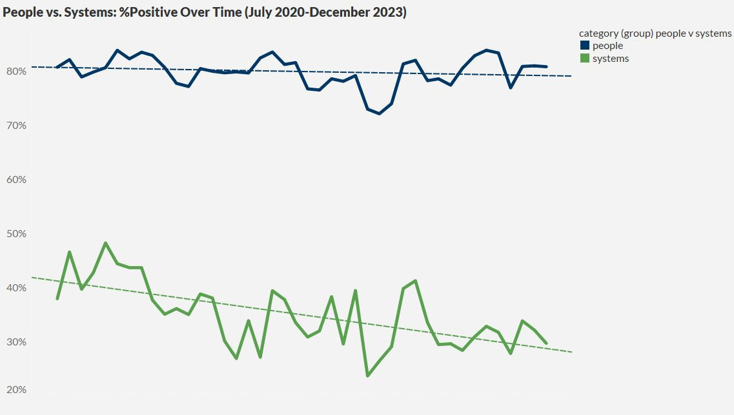
People vs. Systems*: July 2020-Dec 2023
*People = Doctors, Nurses, Staﬀ
Systems= Wait, CC, Hospital, Admission, Scheduling, Pain
Notes:
Mandy

Slide 6
Access-Initiative Goals
Improve patient access and experience, therefore improving access metrics
Improve staff productivity and experience
Ensure staff are working to top-of-scope
Ensure patients are seen by the right provider, in the right time frame, at the right location
Increase scheduling accuracy
Notes:
Ahmed

Slide 7
Workshop Strategies
Conduct thorough reviews of current templates for all providers at all clinic locations
Analyze key metrics, data, and trends related to all facets of scheduling and patient access
Employ lean strategies such as waste reduction, process mapping, level-loading, and standard work
Engage Patient and Family Advisory members, Provider Relations, Contact Center, and more
Administer pre- and post-improvement staff satisfaction surveys
Align all referral and scheduling components, including the referral webform, referral to clinic orders, external webpages, and power plans
Notes:
Ahmed

Slide 8
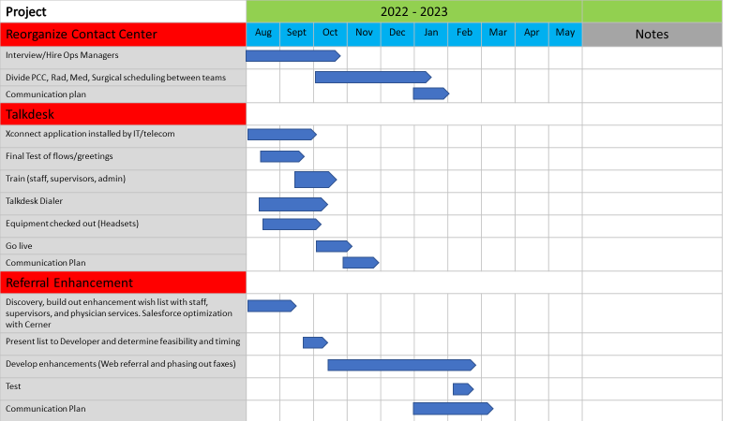
Contact Center Optimization
Notes:
Ahmed

Slide 9
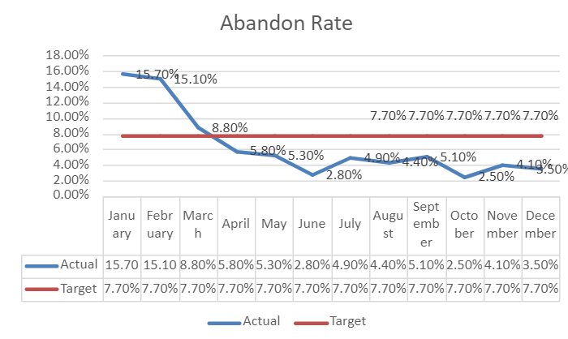
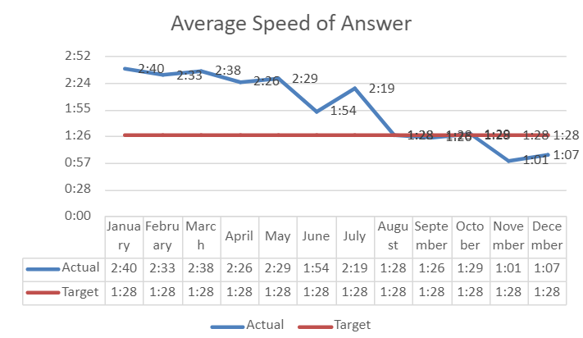
Implementation of New Technology
Implemented Talkdesk
Implemented Talkdesk
*2023 CHAC 75th Percentile: 4.9%
*2023 CHAC 75th Percentile: 2min
Notes:
Ahmed

Slide 10
DNKA MITIGATION STRATEGIES (Improve DNKA by 10% by end of FY 25)
OVERBOOK
For surgical clinics and appointments less than 30 minutes
Jeopardy backup provider for clinic (if all patients showed up)
AUTOMATED REMINDERS
48 and 24 hour reminders/confirmation
Rescheduling/cancelling if no returned confirmation
CARE COORDINATION
Facilitating social work consults, financial counseling, and care coordination when/if needed
Notes:
Ahmed

Slide 11
Integrating DNKA rates in the model: all patients
missed ≤ 14% of appts. scheduled in the past 6 months
Likelihood of attending is 95%
Appt. is ≤ 27 days from when scheduled: likelihood of attending is 83%
Appt. is > 27 days from when scheduled: likelihood of attending is 75%
missed 14%-30% of appts. scheduled in the past 6 months
missed 30%-47% of appts. scheduled in the past 6 months
Appt. is ≤ 20 days from when scheduled: likelihood of attending is 72%
Appt. is > 20 days from when scheduled: likelihood of attending is 59%
missed > 47% of appts. scheduled in the past 6 months
Likelihood of attending is 44%
Notes:
Ahmed
Node 1 (<=14%): n =262,402 patients
Node 3 (14-30%, <= 27 days): n = 14,892 patients
Node 4 (14-30%, > 27 days): n = 18,368 patients
Node 5 (30-47%, <= 20 days): n = 7,247 patients
Node 6 (30-47%, > 20 days): n = 12,429 patients
Node 7 (>47%): n = 21,315 patients

Slide 12
Patient-based data points examined
Race
Ethnicity
Sex
Age
Language
Payor Types
New/Follow-Up
Distance Traveled
Based on data from 1/1/22 - 6/30/22
Notes:
Ahmed
Race and Ethnicity are combined into one factor
Language – grouped into English, Spanish, and Other (some languages did not occur enough to be able to determine impact)
Financial Class – grouped into Commercial and Medicaid/Self-Pay
Distance Traveled – distance between patient zip code and hospital zip code
In the analysis, the most recent patient information provided is used as variables such as distance traveled, financial class, and new/follow-up status may change over time

Slide 13
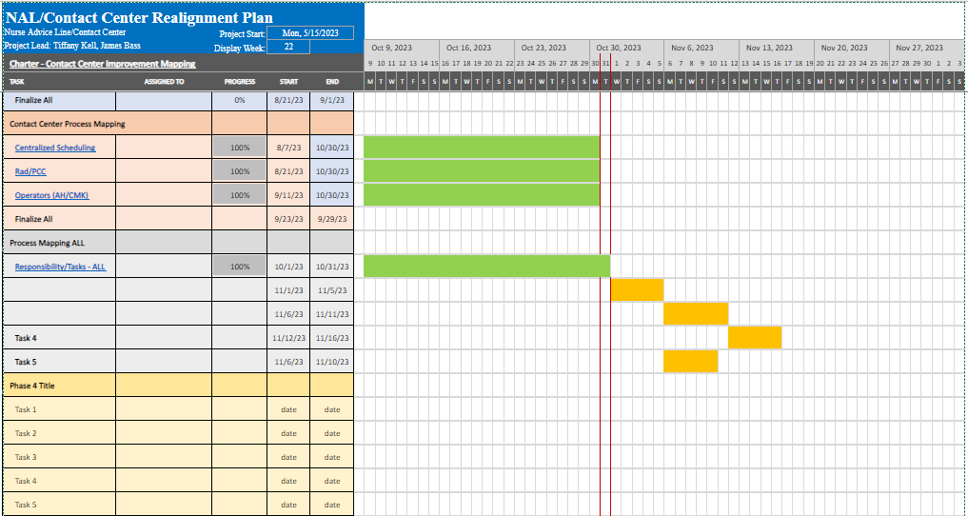
Reducing clinic escalation by 42%
Notes:
Ahmed

Slide 14
The Results
Reduced wait times for call back
# of patients on request list for RN call back:
August – Avg. 130 per day;
average 2-3 day call back
Avg # of callers now left in queue at end of day: 3
Metrics to monitor
# of appts scheduled, # of appts scheduled within 14 days
Request list for outbound calls
Calls left in queue; avg time in call back queue
# of patients scheduled on 1st call
# of RL events/patient advocate grievances
Scheduler/Nurse satisfaction
Notes:
Ahmed

Slide 15
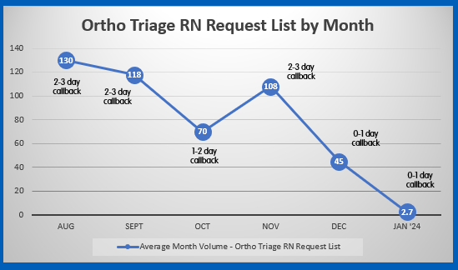
Request List Volumes
Notes:
Ahmed

Slide 16
Slot Utilization | Unfilled Rate
CHA Median:
22%
Routine, data-driven template maintenance will help ensure available slots align with appointment demand
Desired Direction
Data surrounding why appointments have been rescheduled or cancelled has been optimized, which will allow for more targeted process improvement
Notes:
Ahmed

Slide 17
The Results
Reduced wait times for call back
# of patients on request list for RN call back:
August – Avg. 130 per day;
average 2-3 day call back
Avg # of callers now left in queue at end of day: 3
Metrics to monitor
# of appts scheduled, # of appts scheduled within 14 days
Request list for outbound calls
Calls left in queue; avg time in call back queue
# of patients scheduled on 1st call
# of RL events/patient advocate grievances
Scheduler/Nurse satisfaction
Notes:
Ahmed

Slide 18
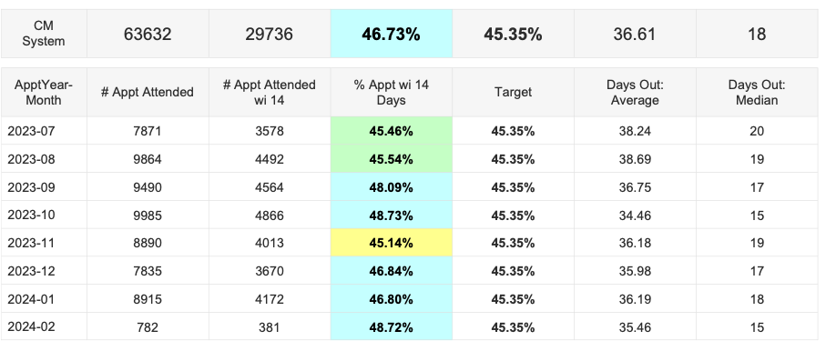
FY to Date Access Trends
CHA 75%:
47.2
CHA 75%:
24
Notes:
Ahmed

Slide 19
Targeted pilot (where, why, how)
Help move the needle on NPS with purposeful action
1
Provide action items to the entire medical team
2
Improve staff experience with families
3
Notes:
Mandy

Slide 20
“Was your child seen by a care provider in a timely manner?”
The experience from door to discharge
waiting room AND idle time in the exam room AND idle time between care providers
Patients expect to wait in a waiting room and to be examined in an exam room
Too much idle time in an exam room is confusing and often leaves families feeling like they have been forgotten.
National data tells us families are OK to wait less than 30 minutes for a scheduled visit, and less than 20 minutes for a telehealth visit
Data shows families most value:
receiving updates on wait time from the front desk staff
the amount of meaningful time spent with staff during the visit
comfortable waiting areas.
Notes:
Mandy

Slide 21
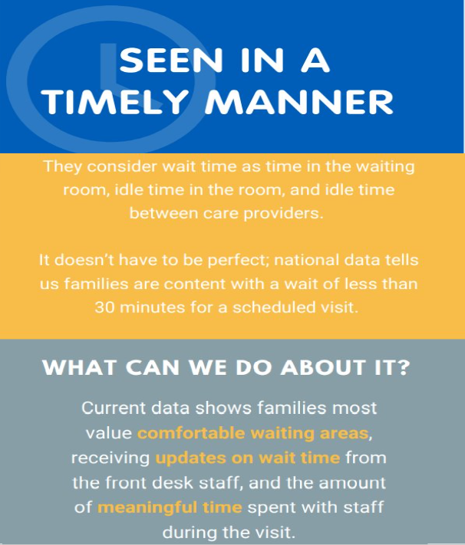
Notes:
Mandy: Focusing on a metric, identifying countermeasures, and using the patient voice to show importance

Slide 22
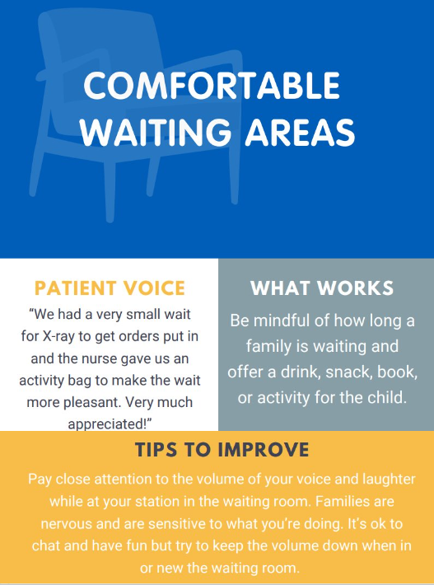
Notes:
Mandy

Slide 23
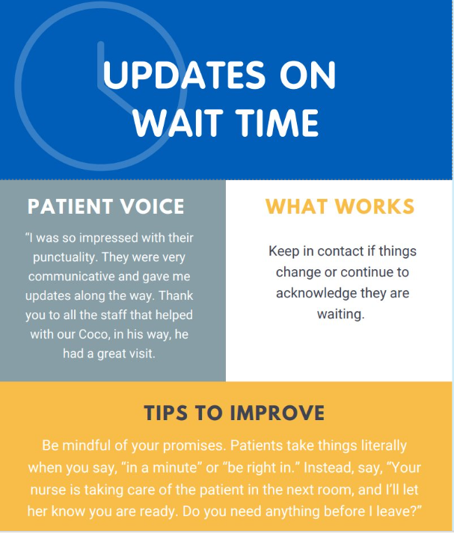
Notes:
Mandy

Slide 24
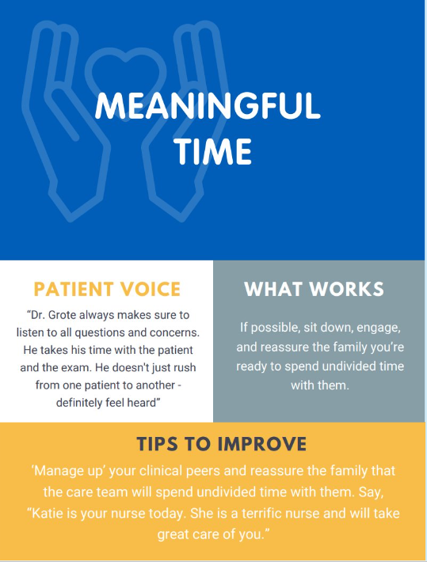
Notes:
Mandy

Slide 25
Upside Opportunities: Specialty
Single biggest opportunity:
Wait | Time (3% expected ▲T2B)
Other areas to target for max impact:
 | Upside Opportunity | #Negative
wait, time | 3% | 445
staﬀ, communication | 2% | 257
doctors, communication | 2% | 143
doctors, availability | 1% | 159
clinical care, coordination | 1% | 119
scheduling, initial | 1% | 166
Staﬀ | Communication
Doctors | Communication
Dividing #Negative by 12 gives a target projection for
monthly improvement goals in 2024
E.g., Getting the upside opportunity for Staﬀ | Communication would mean converting 24 complaints about this per month (or about 1/day)
Notes:
Mandy

Slide 26
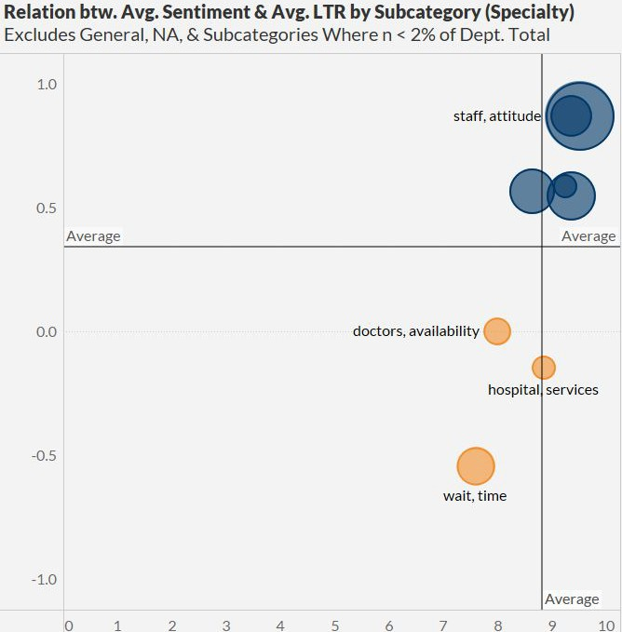
Subcategory Performance: Ambulatory
Which subcategories have the greatest
impact on sentiment & LTR?
Biggest positive impact
doctors, attitude
doctors, communication
nurses, attitude
Staﬀ | Attitude (20% of comments in Specialty)
Staﬀ | Communication (10%)
Doctors | Communication (8%)
staﬀ, communication
Biggest negative impact
Wait | Time (6%)
Doctors | Availability (3%)
Hospital | Services [e.g. patient portal] (2%)
Notes:
Mandy

Slide 27
Ambulatory: What’s (Not) Working?
Staﬀ | Attitude
Staﬀ | Communication
Doctors | Communication
“That nurse and doctor were so sweet and caring to my son!! Great service, very kind! I would recommend them 100%! Thank you for being so good to my baby!!”
“I really appreciate how much they take the time to explain things and interact with my child. They have been around for 2 years now, and I couldn't be happier with their service. THANK YOU!”
Dr. XXXX is a wonderful provider and person. She answers all our questions thoroughly and makes my daughter feel very comfortable at appts when she is anxious with medical appts. And she and her team are always very quick to respond to all our portal messages.
Wait | Time & Doctors | Availability
“I get very frustrated with making appointments at CM and not being seen in a timely manner. The doctor was 40 past our appointment time and I had to go ask when we were going to be seen. If I was 40 minutes late for an appointment it would get canceled and I would be charged. People have lives and things they need to do and the patients time should be respected as well."
Hospital | Services
“I was not able to log into the Patient Portal and I still cannot.”
Notes:
Mandy

Slide 28
Ambulatory: Wait | Time & Appointments
Appointment was at 8…
My appointment was for 1 : 1 5…
My daughters apt was a 8:45am…
Our appointment time was 1045…
Our appointment was at 9:15…
Our appointment was at 9:45…
Our appointment was on the portal for 810…
Our appt was at 2:30…
Our appointment was at 915…
We had a 245 appointment…
We had a morning appointment for 0840am…
Notes:
Mandy

Slide 29
Qualitative Summary
Strengths to reinforce:
Staﬀ/Doctors/Nurses | Attitude: Families really respond to genuine kindness, empathy, and compassion. People have the power to make or break the experience (even when systems issues go wrong), so the impact of attitude cannot be understated.
Weaknesses to address:
Wait | Time: Families feel helpless when waiting is paired with unknowing. Reducing length of visit in ED and seeing people closer to appointment time in Specialty are crucial. But, even providing meaningful communication while a family waits mitigates negative impact.
Clinical Care | Coordination: Ensure that the may people involved across touchpoints are all on
the same page. For ED, don’t just assert that there is a triage process; help families understand it and how it relates to their visit (and their wait).
Clinical Care | Tests: Families want to trust that everything is being done to get answers they
need, including getting appropriate tests (or communicating why a test isn't necessary)
Notes:
Mandy:

Slide 30
Notes:
Ahmed
Goal of NAL:
Decrease resource utilization: How many unnecessary ED or UCC visits are we saving by families calling the NAL?
Increase patient safety: How many callers would have opted for doing nothing, or waiting, when they REALLY did need to be seen in the ED?
Next Steps:
Analyze cost savings comparison - Capitated (PCN) vs. other Medicaid vs commercial

Slide 31
Summary
True North Metrics
Percent of new patient appointments scheduled and seen within 14 days continues to increase each month
Unfilled slot rate hovers at the CM Target of 15%, continuing to put us in the top 1-2 children’s hospitals in the CHAC for slot utilization
Finances
Contribution Margin improved by $12.6M between FY22 and FY23 and is continuing to improve in FY24
Stretch Goal reached
Contact Center
Centralized Scheduling has made remarkable improvements in call handling since implementing Talk Desk
Nurse Advice Line is asking an additional NRC question to ascertain the value of the service beyond the tangibles of after-hours contracts
Delivery Index at Target end of Quarter 1
Notes:
Ahmed

Slide 32
THANK YOU!
aabdelmoity@cmh.edu
mariemer@cmh.edu

Slide 33
Ambulatory Data Definitions and Sources
Slot Utilization
Source | Data is sourced from Cerner tables and displayed in HealtheAnalytics under the “Slot Utilization Summary” Dashboard
Link | Slot Utilization Summary
Definition | % of patient-facing slots that are ‘active’ and ‘open’ at the time of the appointment; excludes all blocks
Did Not Keep Appointment (DNKA)
Source | Data is sourced from Cerner scheduling tables and displayed in multiple reports; end-users are directed to the HealtheAnalytics “Ambulatory Appointment Analytics” Dashboard
Link | No-Shows and Cancellations
Definition | Percentage of all scheduled appointments that result in a ‘no-show’
% of New Patients Seen Within 14 days
Source | Data is sourced from Cerner scheduling tables and displayed in a Business Objects report that is pushed to all leaders weekly, built by Mike Sayer
Link | Business Objects Report
Definition | Percentage of all new patients seen within 14 days of having scheduled their appointment
% of New Appointments
Source | Data is sourced from scheduling tables and displayed the HealtheAnalytics “Ambulatory Appointment Analytics” Dashboard
Link | Clinic Appointment Analysis
Definition | Percentage of all attended appointments that have an appointment type of “New”
Appointment Lag
Source | Data is sourced from Cerner scheduling tables and displayed in a Business Objects report that is pushed to all leaders weekly, built by Mike Sayer
Link | Business Objects Report
Definition | Average and median days from scheduled to seen
Notes:
Ahmed

