Slide 1

A.I. and Tech: Friend or foe of the healthcare experience?
Peggy Greco, Ph.D.
Chief Patient Experience Officer
Nemours Children’s Health

Slide 2








Nemours - A Leading Pediatric Health System
2 Hospitals
72 Care Locations in
4 States
1,130 Employed
Physicians
23 Collaborating Hospitals
8,600 Associates
$1.7 Billion in Annual Revenue
35,000
SDoH Patient-Family Screenings
1.6 Million Patient
Encounters Annually
Notes:
Only multi-state, multi-site children’s health system
Operating in Florida, Delaware, Georgia, New Jersey and Pennsylvania
Enduring legacy of Alfred I. duPont
Commitment to all aspects of children’s health
Enthusiastic adopter of digital technology, in the tradition of our innovative founder – from our award-winning KidsHealth website established in the 90s to our integrated HER
KidsHealth receives XXX million visits annually
National Office in D.C.
P2P, D2C,24/7 online doctor visits
Recently Nemours VBSO MCO..?

Slide 5
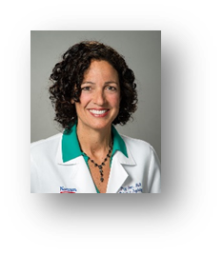








Department of Patient Experience
Nemours Children’s Health
Part-time Clinician Liaisons:
Cheyenne Hughes-Reid, Ph.D.
Patient Experience Clinician Liaison, Delaware Valley
Sahar Barfchin, M.D.
Patient Experience Clinician Liaison, Delaware Valley
Nicole Kahhan, Ph.D.
Patient Experience Clinician Liaison, Florida
Carlos Araya, M.D.
Patient Experience Clinician Liaison, Florida
Peggy Greco, PhD, Chief Patient Experience Officer
Cynthia Lewis, MBA, CPXP, Patient
Experience Operations Manager
Daria Young, CPXP, Patient Experience
Clinical Partner, Delaware Valley
Tyler Pieters, MHA, Patient Experience
Partner, Florida
Kaitlin Danzig, Patient Experience
Clinical Partner, Florida

Slide 6

What is “Patient Experience”?
Everything we are and do, in partnership with children and families throughout the healthcare continuum.
Todo lo que somos y hacemos, en colaboración con los niños y las familias en todo el proceso de atención médica

Slide 7

Improving the Patient Experience
The most important aspect of the patient experience is safe and high-quality care.
Health outcomes are primary and need to be equitable –safe and beneficial outcomes for all humans.
Notes:
The most important thing we can change is health outcome. We want to improve the degree to which we provide safe and high-quality care. We want o make sure that the impact is equitable…

Slide 8
Learning Objectives
Identify variations in effectiveness of AI solutions for improving the healthcare experience.
Integrate assessment of impact across multiple areas of experience such as physician and staff well-being as well as patient experience.
Design a plan to utilize technological advances in a way that optimizes human understanding and the broader health care experience within the constraints of your particular setting.

Slide 9


Slide 10
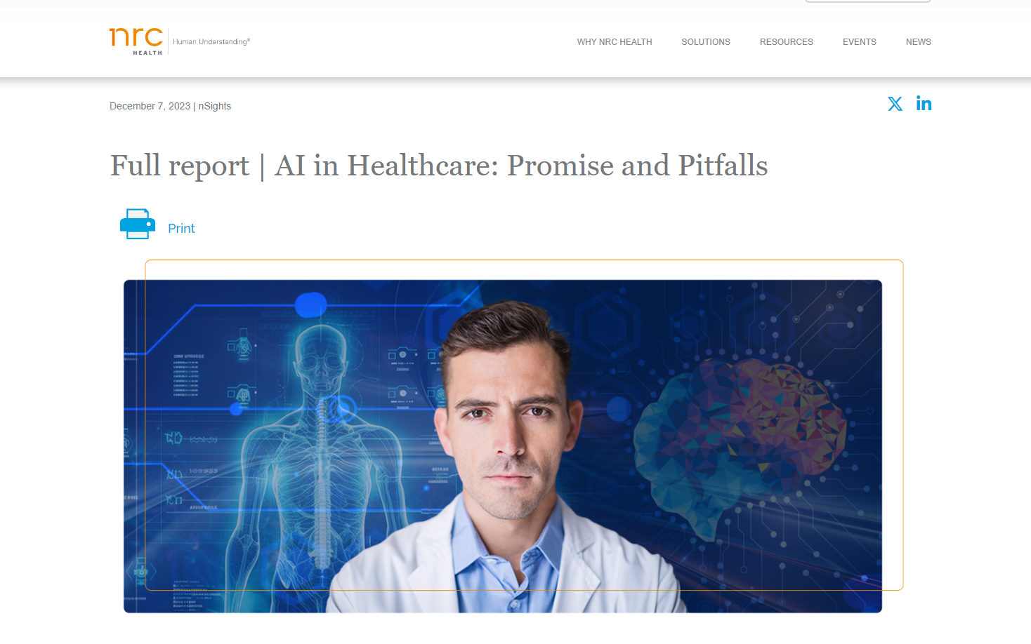
England W, Makoul G. 2023. AI in Healthcare: Promise and Pitfalls. Human Understanding Institute – NRC Health. https://go.nrchealth.com/ai-in-healthcare-promise-and-pitfalls-citation

Slide 11
Artificial Intelligence in Healthcare

Slide 12


CHANGE

Slide 13
Friend
Foe
Impactful
Terminator
INNOVATIVE
Revolutionary
Cold
Tool
Risky
Flexible
ROBOTIC
Research
HOPEFUL
Non-humanistic
Trending
Scary
Advancement
HAZARDOUS
Efficient
Mistakes

Slide 14
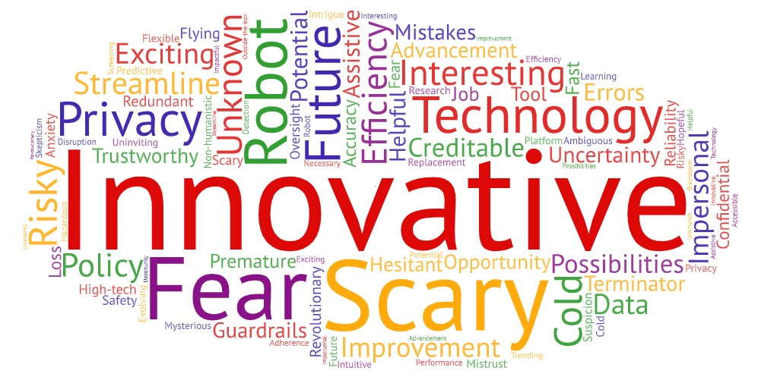

Slide 15


Slide 16

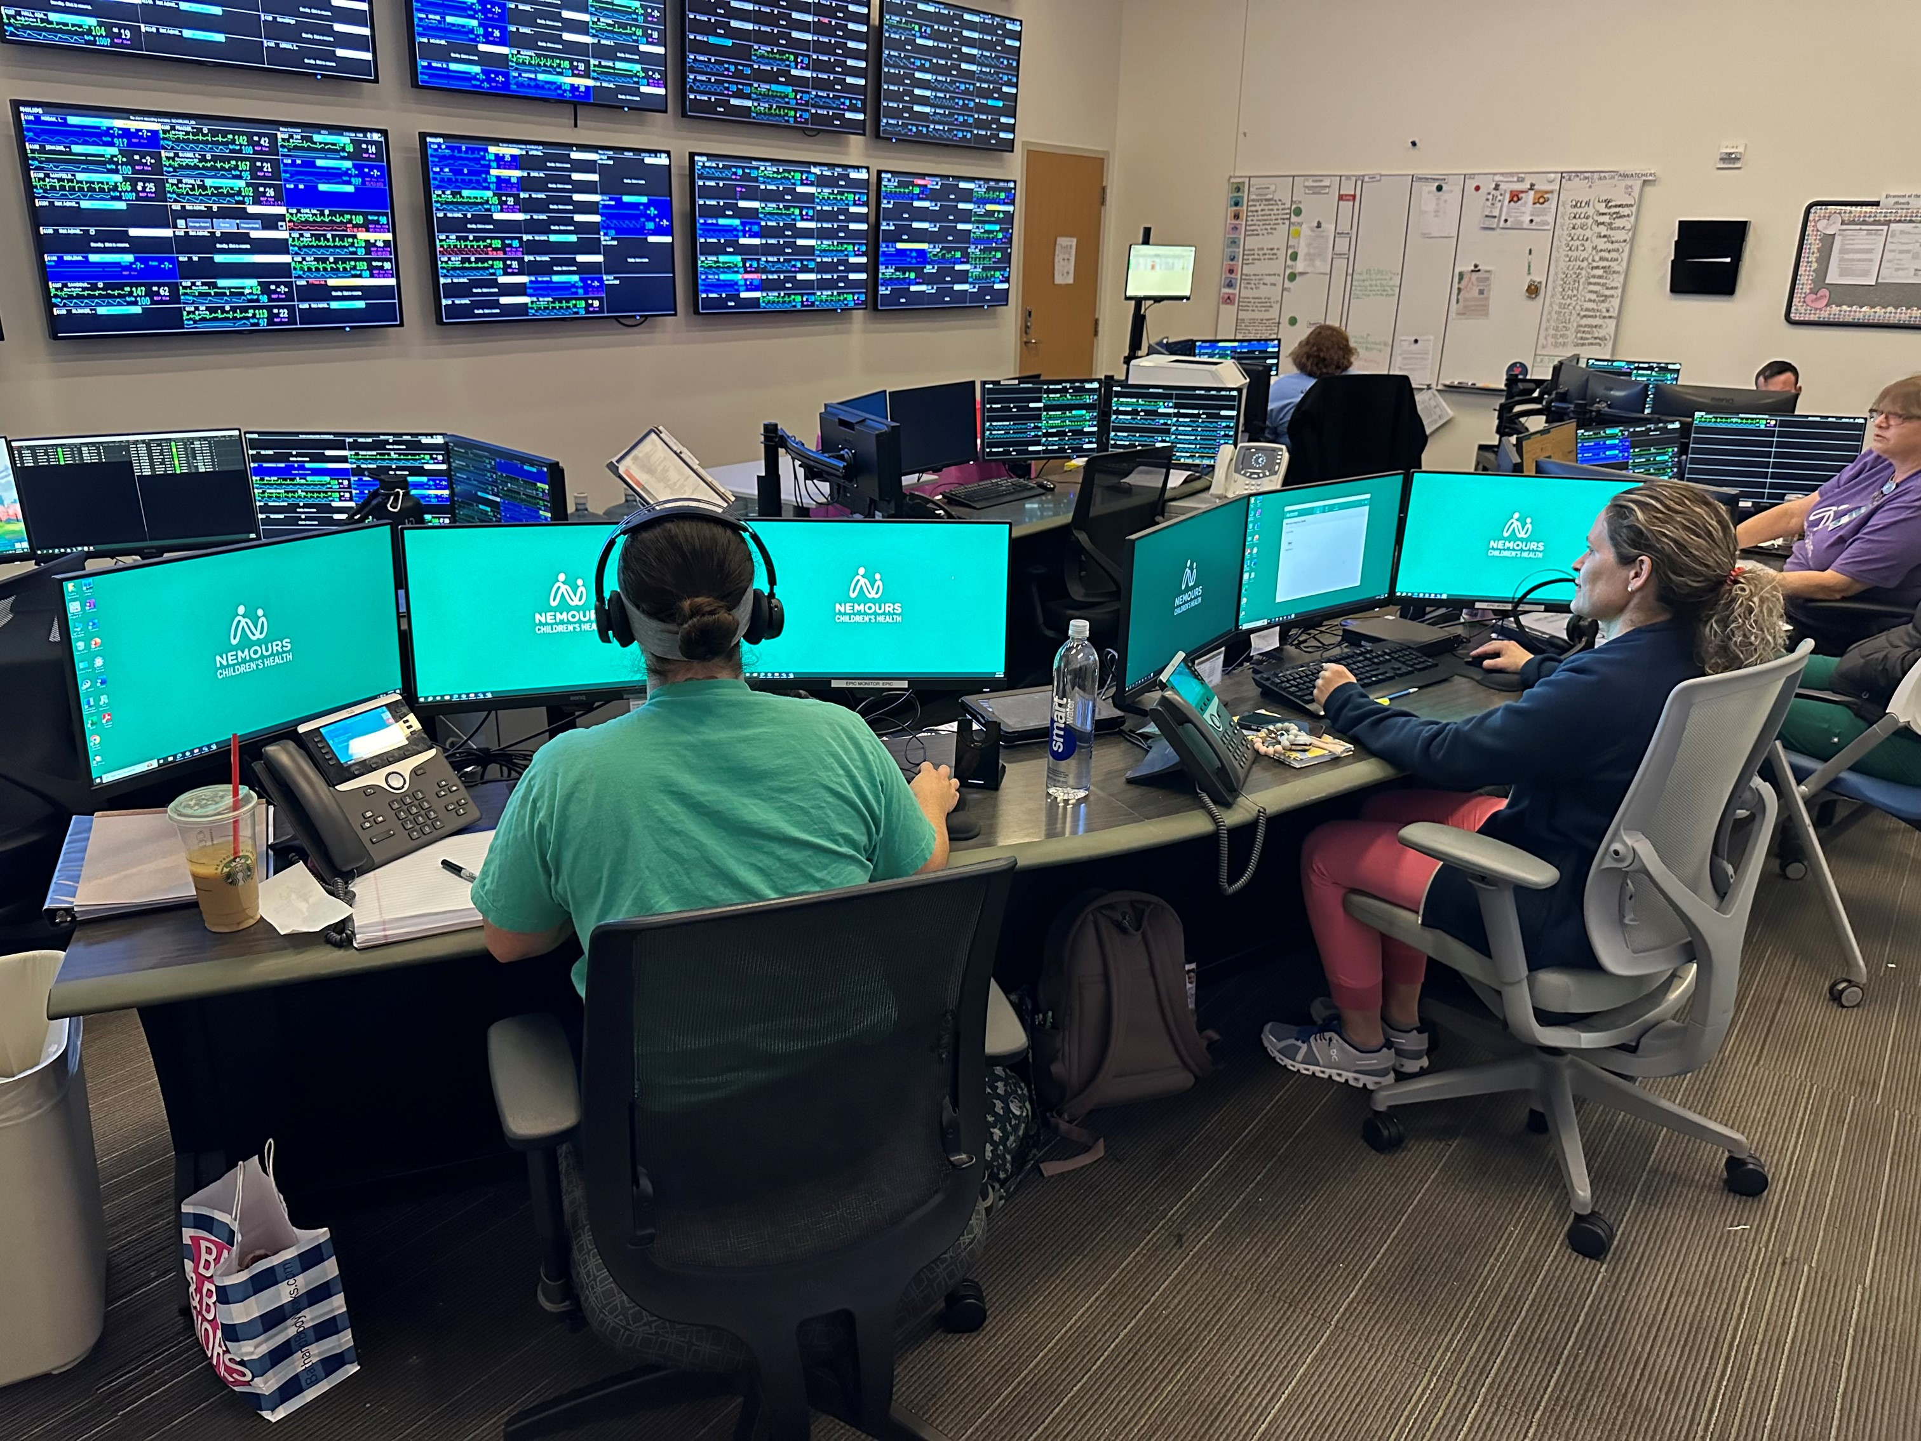

Slide 17





Is it effective?

Slide 18

EQUITY
QUALITY/
SAFETY

Slide 19
Virtual Nursing

Slide 20
A “virtual nurse” is a nurse who is on site but not at your bedside. This nurse may connect to your room virtually and may help you and your child through your admission and discharge or other care-related tasks, such as reviewing medications.

Slide 22
Monitoring Impact
Survey Question
Comfort talking with nurses
Nurses courtesy/respect
Nurses explained things
Nurses listened carefully

Slide 23
Monitoring Impact
Survey Question | Baseline
Comfort talking with nurses | 82.4
Nurses courtesy/respect | 85.4
Nurses explained things | 82.6
Nurses listened carefully | 80.1

Slide 24
Monitoring Impact
Survey Question | Baseline | 1-Month
Comfort talking with nurses | 82.4 | 77.5
Nurses courtesy/respect | 85.4 | 79.6
Nurses explained things | 82.6 | 78.1
Nurses listened carefully | 80.1 | 73.9

Slide 25
Monitoring Impact
Survey Question | Baseline | 1-Month | 3-Month
Comfort talking with nurses | 82.4 | 77.5 | 85.0
Nurses courtesy/respect | 85.4 | 79.6 | 88.5
Nurses explained things | 82.6 | 78.1 | 87.3
Nurses listened carefully | 80.1 | 73.9 | 80.5

Slide 26
Monitoring Impact
Survey Question | Baseline | 1-Month | 3-Month | 6-Month
Comfort talking with nurses | 82.4 | 77.5 | 85.0 | 90.9
Nurses courtesy/respect | 85.4 | 79.6 | 88.5 | 92.0
Nurses explained things | 82.6 | 78.1 | 87.3 | 90.7
Nurses listened carefully | 80.1 | 73.9 | 80.5 | 89.0

Slide 27
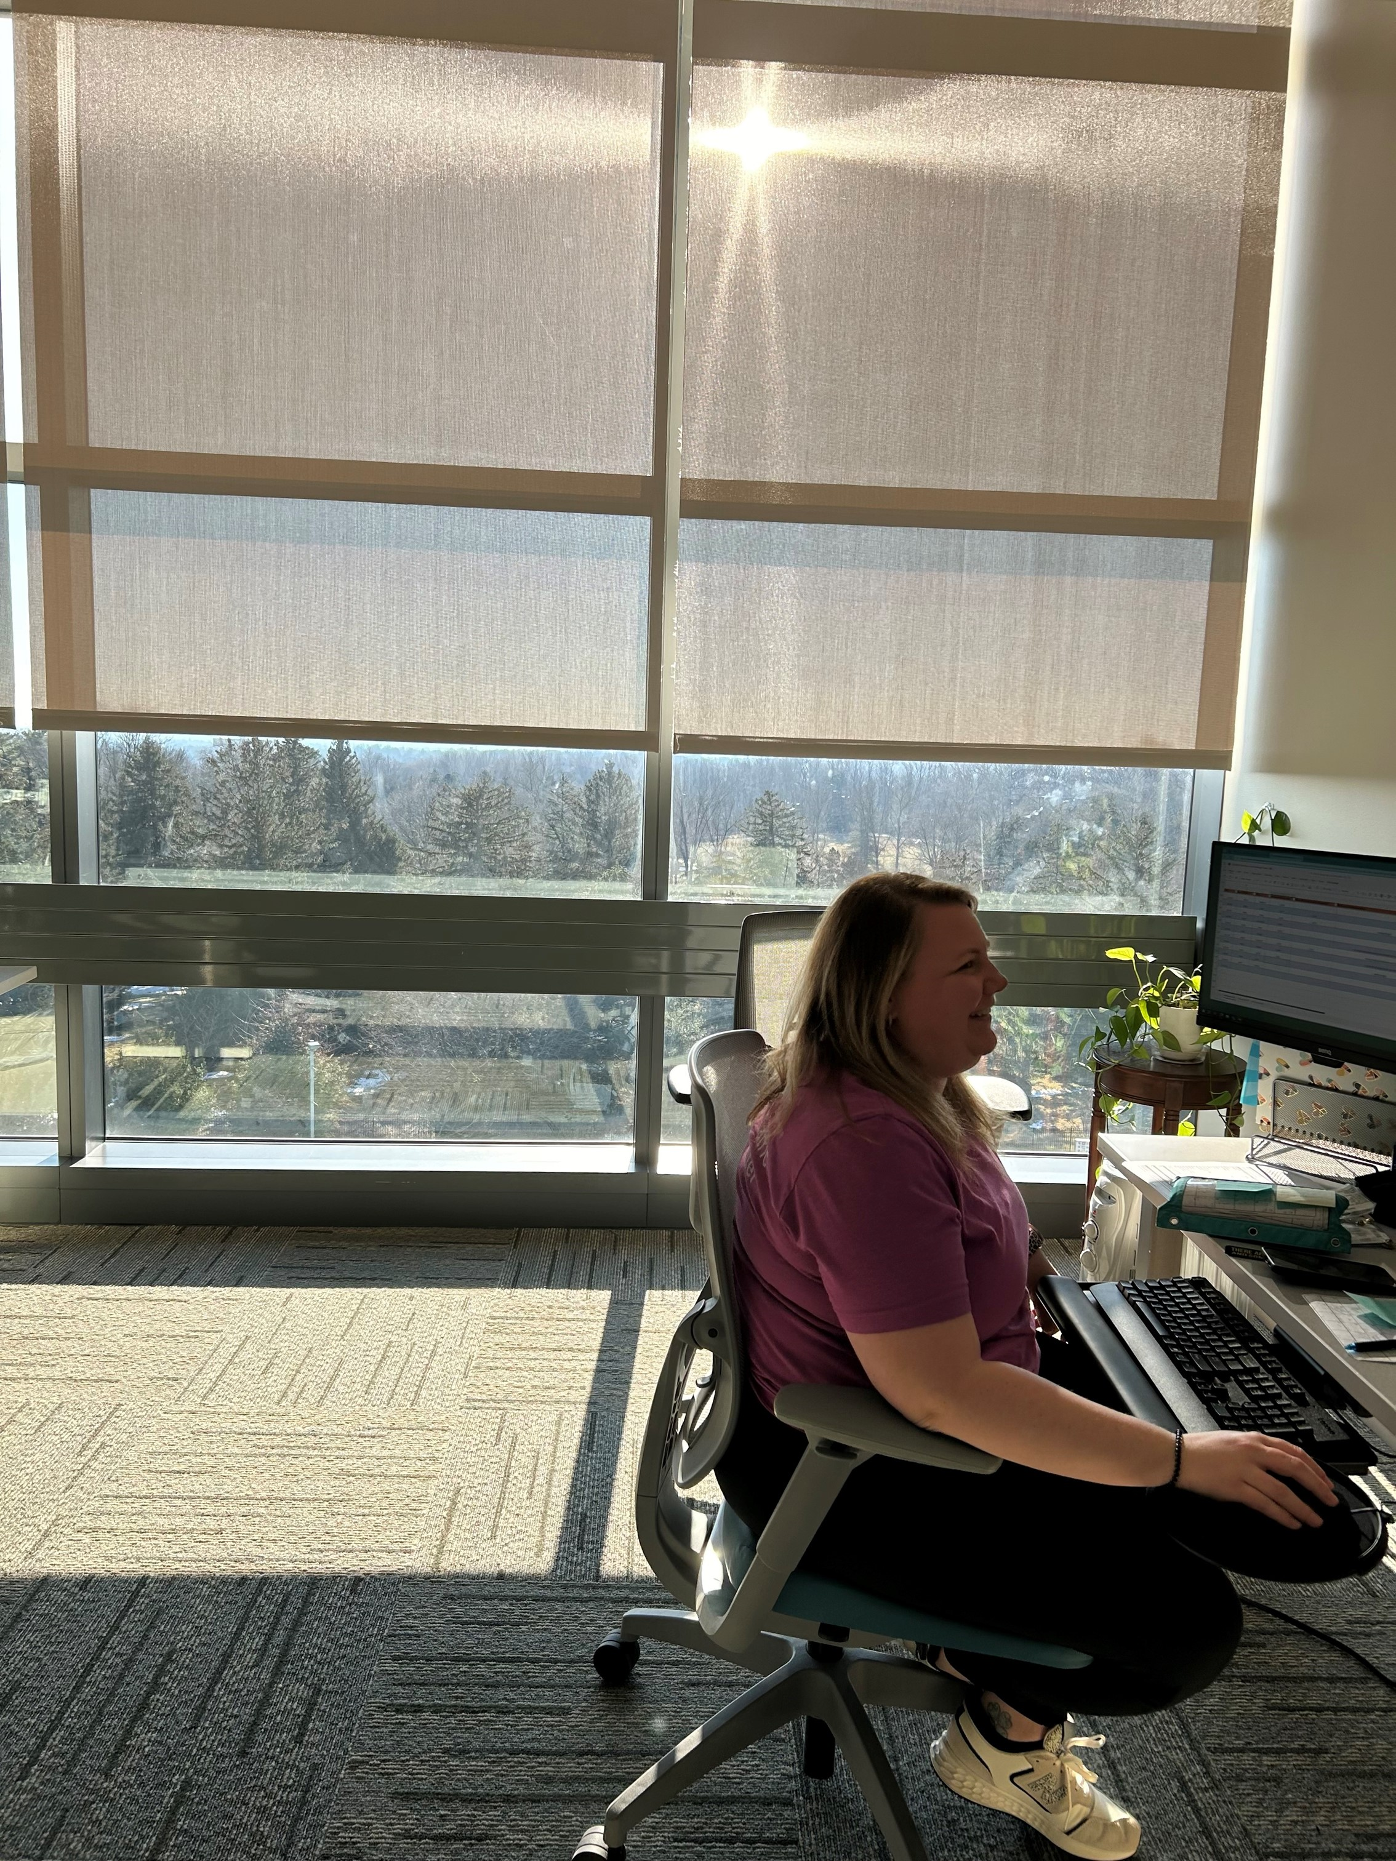
Two different staffing models:
Delaware - Identified two nurses from the specific Unit, who are serving as full-time virtual nurses.
Florida - Cross-trained nurses so that they have one or two shifts of virtual nursing per week.
“Everyone loves their virtual nursing shift, and it has increased their satisfaction in their current role as well.”

Slide 28
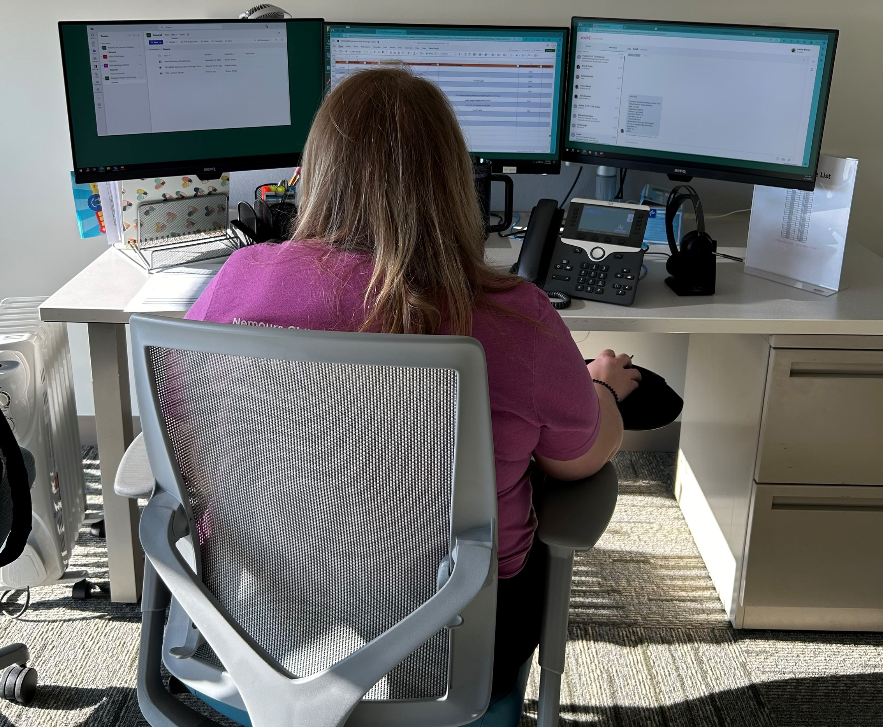
It is great to hear from families in the moment how helpful, calming, and appreciated our role is. They find it comforting when we call and take the time to explain everything to them after hearing a lot of information about their care from MDs and other nurses that they may not have fully understood.

Slide 29
EQUITY
QUALITY/
SAFETY

Slide 30
Virtual Nurse Experience – by Language
Survey Question
Comfort talking with nurses
Nurses courtesy/respect
Nurses explained things
Nurses listened carefully

Slide 31
Virtual Nurse Experience – by Language
Survey Question | English
Comfort talking with nurses | 84.9 (n=504)
Nurses courtesy/respect | 88.3 (n=495)
Nurses explained things | 85.5 (n=498)
Nurses listened carefully | 82.1 (n=504)

Slide 32
Virtual Nurse Experience – by Language
Survey Question | English | Spanish
Comfort talking with nurses | 84.9 (n=504) | 84.2 (n=114)
Nurses courtesy/respect | 88.3 (n=495) | 90.3 (n=113)
Nurses explained things | 85.5 (n=498) | 85.8 (n=113)
Nurses listened carefully | 82.1 (n=504) | 85.0 (n=113)

Slide 33
Virtual Nurse Experience – by Race/Ethnicity
Survey Question
Comfort talking with nurses
Nurses courtesy/respect
Nurses explained things
Nurses listened carefully

Slide 34
Virtual Nurse Experience – by Race/Ethnicity
Survey Question | Black (n=100) | Hispanic (n=214) | White (n=230)
Comfort talking with nurses | 81.0 | 86.9 | 85.2
Nurses courtesy/respect | 87.9 | 91.1 | 86.2
Nurses explained things | 84.0 | 87.4 | 84.9
Nurses listened carefully | 78.0 | 85.5 | 81.8

Slide 35
Virtual Nurse Experience – by Race/Ethnicity
Survey Question | Black (n=100) | Hispanic (n=214) | White (n=230)
Comfort talking with nurses | 81.0 | 86.9 | 85.2
Nurses courtesy/respect | 87.9 | 91.1 | 86.2
Nurses explained things | 84.0 | 87.4 | 84.9
Nurses listened carefully | 78.0 | 85.5 | 81.8

Slide 36
Impact on Quality and Safety
Improving preventable harm
  Medication errors
  Medication duplications
  Enhancing patient/caregiver understanding

Slide 37
Artificial Intelligence Documentation Tool (AIDT)

Slide 38

Artificial Intelligence Documentation Tool (AIDT)
Natural
conversation

Slide 39

Artificial Intelligence Documentation Tool (AIDT)
AIDT
Natural
conversation

Slide 40

Artificial Intelligence Documentation Tool (AIDT)
AIDT
Natural
conversation
Complete
clinical note

Slide 42
 | Care Provider Listened | Care Provider Explained | Received Clear Information | Had Input in Care
N = 6

Slide 43
 | Care Provider Listened | Care Provider Explained | Received Clear Information | Had Input in Care
PRE-AIDT | 81.2 | 88.4 | 88.7 | 86.1

Slide 44
 | Care Provider Listened | Care Provider Explained | Received Clear Information | Had Input in Care
PRE-AIDT | 81.2 | 88.4 | 88.7 | 86.1
POST-AIDT | 92.0 | 93.2 | 93.8 | 90.7

Slide 45
 | Care Provider Listened | Care Provider Explained | Received Clear Information | Had Input in Care
PRE-AIDT | 81.2 | 88.4 | 88.7 | 86.1
POST-AIDT | 92.0 | 93.2 | 93.8 | 90.7
Improvement from baseline | +10.8 | +4.8 | +5.1 | +4.6

Slide 46
 | Care Provider Listened | Care Provider Explained | Received Clear Information | Had Input in Care
PRE-AIDT | 81.2 | 88.4 | 88.7 | 86.1
POST-AIDT | 92.0 | 93.2 | 93.8 | 90.7
Improvement from baseline | +10.8 | +4.8 | +5.1 | +4.6
Maintenance | 91.6 | 93.7 | 90.6 | 90.2
Improvement from baseline | +10.4 | +5.3 | +1.9 | +4.1

Slide 47
 | Care Provider Listened | Care Provider Explained | Received Clear Information | Had Input in Care
N = 23

Slide 48
 | Care Provider Listened | Care Provider Explained | Received Clear Information | Had Input in Care
PRE-AIDT Training (n = 1337) | 85.8 | 89.4 | 89.2 | 86.1

Slide 49
 | Care Provider Listened | Care Provider Explained | Received Clear Information | Had Input in Care
PRE-AIDT Training (n = 1337) | 85.8 | 89.4 | 89.2 | 86.1
POST-AIDT (n=1109) | 92.4 | 92.6 | 92.0 | 87.9
Improvement from baseline | +6.6 | +3.2 | +2.8 | +1.8

Slide 50
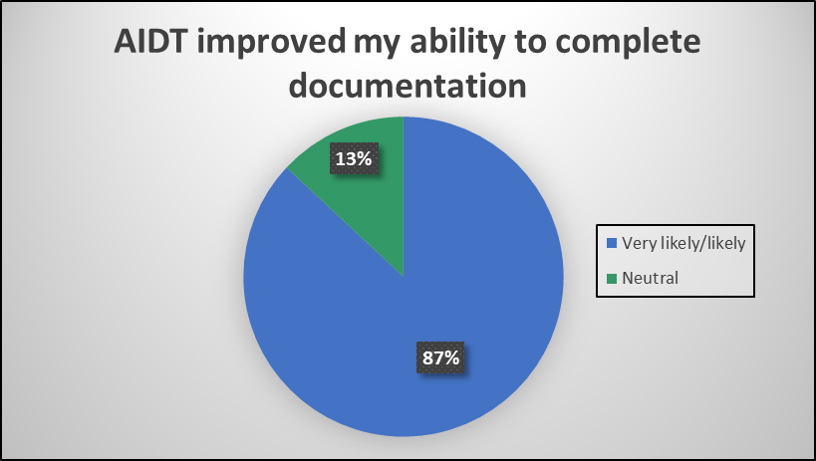
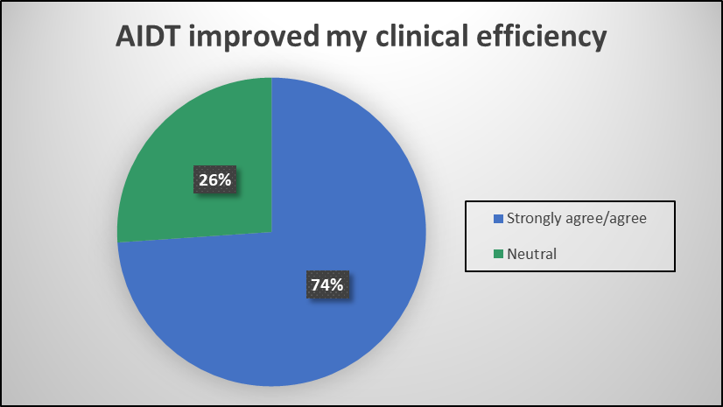
Improvement in Provider Experience

Slide 51
Physician Thoughts on Patient Impact
“I find myself enjoying my time in the room with patients and families more - as I can have a conversation and not feel burdened to document as I go or feel that I need to hold all the information in my brain until I can 'download' it at the end of the clinic session or day.”
“It has allowed me to focus more on my patients during my time with them but not at the expense of leaving more documentation for me later.”
“I enjoy not being on the computer as much during the visits and enjoy my interactions with patients more during the time in the room.”

Slide 53
EQUITY
QUALITY/
SAFETY

Slide 54
Friend
Foe
Impactful
Terminator
INNOVATIVE
Revolutionary
Cold
Tool
Risky
Flexible
ROBOTIC
Research
HOPEFUL
Non-humanistic
Trending
Scary
Advancement
HAZARDOUS
Efficient
Mistakes

Slide 55


Slide 58
EQUITY
QUALITY/
SAFETY

Slide 59


