Slide 1
Creating Safe Environments for Employees and Patients Alike
Shelby Chapman, MA Shawna Grissom, MS, CCLS, CEIM, CPXP
Director of Patient- Family Experience Director of Family Services
Children’s Hospital Colorado Children’s Hospital Colorado

Slide 2
Objectives

Slide 3
Impact of Escalations on
Healthcare Workers

Slide 4
Violence Against Healthcare Workers
Occupational Safety and Health Administration (OSHA)
defines workplace violence as any act of threat of physical violence, harassment, intimidation, or other threatening disruptive behavior that occurs at work
US Bureau of Labor Statistics
Healthcare and social service industries experience the highest rates of injuries caused by workplace violence
5 times more likely to suffer a workplace violence injury
25% of nurses report being physically assaulted by a patient or family member
50% report exposure to verbal abuse or bullying
73%
73%

Slide 5
Verbal Escalations
Verbal/written escalations are more common than physical escalations
Often unreported or unrecognized
Impacts team member resiliency, morale, and retention
Can impact team members’ ability to respond empathetically

Slide 6
Connecting the Drivers of
TMX and PFX

Slide 7
Higher levels of engagement = higher PFX scores
Pride
Intent to stay
Intrinsic motivation

Slide 8
Employee Experience Elements
Leadership
Culture of safety
Valuing employees

Slide 9
Our Journey with
De-escalation Support

Slide 10
Safe and Healing Environments Flyer
Provided to families to create an environment where the entire care team can work together to care for the child
Included as part of inpatient admission packet
Visible in most exam rooms and inpatient rooms across the system

Slide 11
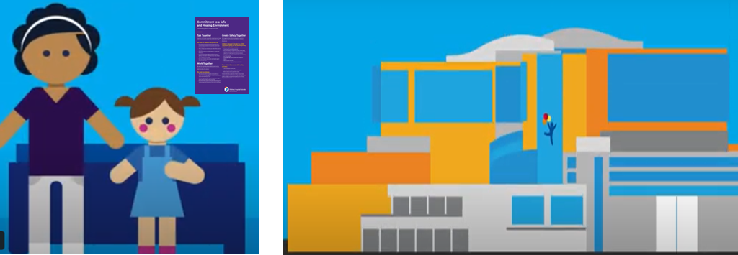
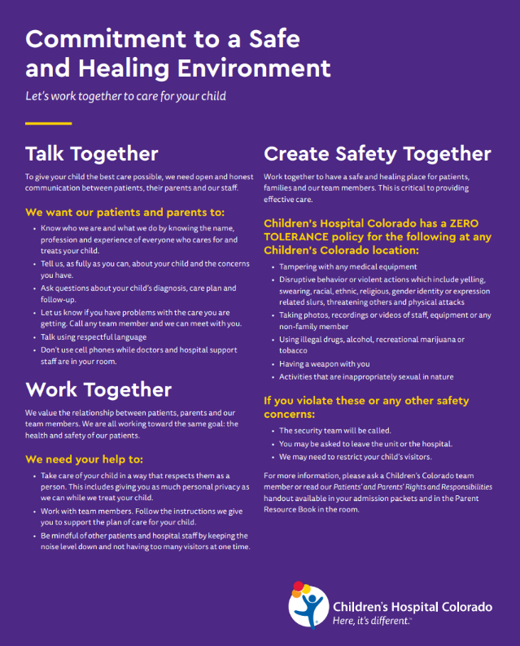
Flyer: Serving a Purpose, Not Fully Meeting Needs

Slide 12
New Documentation Tools
De-escalation Navigator Tool

Slide 13
Computer Based Training

Slide 14
New Approaches and Pilots

Slide 15
Verbal / Over-the-Phone Escalations Taking a Toll
Many resources focused on in-person scenarios
Teams working on the phone were experiencing increased verbal escalations
Impacts to team member resiliency and retention
Response:
Moral Distress Rounds
Identified ideas from the team that would be meaningful/helpful

Slide 16
Tip Sheet
Easily accessible
Helpful phrasing
Reinforces the computer-based training

Slide 17
Phone Recording Pilot
Record a message, in the voice of a patient, to be played on the call recording/hold message for certain call centers/lines.
Intention: Remind caller that we’re humans caring for humans, which hopefully “turns down the temperature” and reduces the number of verbal escalations.
Call recording plays at the beginning of the call (even if the caller is not put on hold)
Hold music and hold messages have also been updated

Slide 18
Measurement
Collecting pre- and post-intervention data
Nurses and schedulers are asked to fill out a survey at the end of their shift documenting any call escalations

Slide 19
Emergency Department
& Urgent Care

Slide 20
Supporting Safe &
Healing Environments
The ED/UC is a stressful environment to patients, families, and team members
Our goal is to create experiences that mitigate escalation and provide a physically and psychological safe environment to decrease the stress of a chaotic environment for families, patients, and team members.

Slide 21
Physical Safety
Evolv Weapons Detection System installed at select entrances across our System of Care

Slide 22
GetWell Network Screensavers

Slide 23
Safe & Healthy Environment Videos
Content has been generated based on team members experiences, stories, and hopes for a safe and healthy environment.
Videos:
2–3-minute video (in English and Spanish) to be played in the ED/UC waiting rooms. Videos will explain:
Processes (i.e. triage)
Resources & comfort items
Ways to partner with care team
2-3-minute video for ED/UC team members

Slide 24
Team Member Response

Slide 25
“Seeing the name of the patient in the in-basket brings butterflies to my stomach. I have to take a deep breath before I start dialing the phone number. The interactions always leave me with anxiety, and a desire to vent about trying to help families who seem ungrateful.”
“Other conversations leave me feeling so proud of my role and my job. Proud to be a nurse, and proud to have learned how to de-escalate a family member in order to get to the root of the problem.”

Slide 26
Team Member Resilience

Slide 27
Team Member Resources
Post Assault Respite and Recovery Leave (PARR)
Resiliency, Education, Support and Training (REST)
CODE 4 Counseling

Slide 28
Key Takeaways
Solutions will need to be multi-faceted and iterative
Consider debrief/moral distress rounds to support the emotional well-being of staff
Involve the teams directly impacted in designing the solutions
Multi prong solutions that support both patient-families and team members

Slide 29
Thank you
Shelby.Chapman@childrenscolorado.org
Shawna.Grissom@childrenscolorado.org

