Slide 1



2024
Pediatric Experience Perspective TM
Toya Gorley, Improvement Advisor, NRC Health

Slide 2
Thank you!
Mandy Riemer, Patient Experience Manager, Children’s Mercy Kansas City
Peggy Greco, PhD, CPXO, Nemours Children’s Health
Evelyn Ferrer, Senior Director, Organizational Development & Patient Relations, Driscoll Health System
Dante Griffin, MA, CPXP, LSSBB, Vice President of Patient Experience, Arkansas Children’s Hospital
Sam Hanke, MD, MS, MBA, Chief Patient and Family Experience Officer, Cincinnati Children’s
Notes:
The Pediatric Experience Perspective combines data and perspectives from healthcare executives that allows us to reflect on lessons learned from last year and offer a point of view for the year ahead.

Slide 3
Overview
SECTION ONE:
INNOVATION STARTS WITH THE FUNDAMENTALS
SECTION TWO:
UNDERSTANDING DETRACTORS
SECTION THREE:
EMERGING TRENDS

Slide 4
Section 1
Innovation starts with fundamentals
It’s all about follow through.
Hard to push for innovation if we can’t or don’t execute on the fundamentals.
FUNDAMENTALS = basics + execution
INNOVATION = new ideas + execution

Slide 5

01 Alignment / Buy-In: Taking a ‘One Big Dot’ Approach
Quality, safety, experience, equity and brand should not be treated in isolation, nor are they in competition with each other.
Evolve thinking from connecting the dots to ‘One Big Dot’
‘One Big Dot’ can re-energize improvement efforts and strengthen buy-in

Slide 6
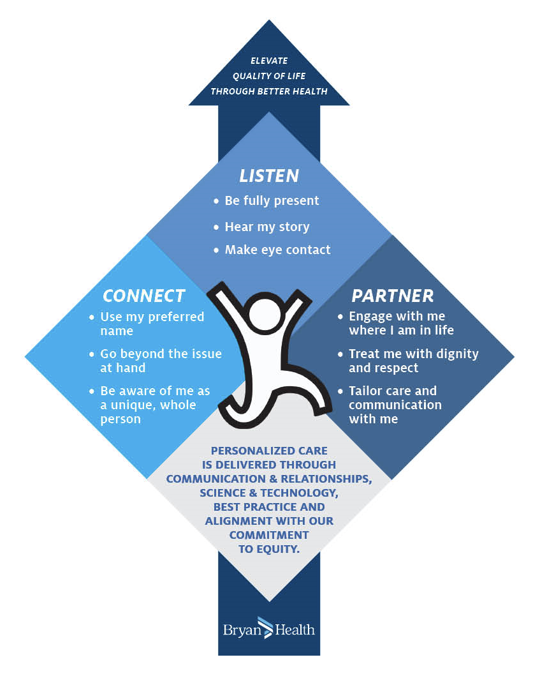
02 Human Connection: Advancing Human Understanding
Bryan Health: Making the effort to make it real
Changing all orientation materials to reflect the model
Creating a video to illustrate the model for all employees
Presenting at organizational leadership meetings, systemwide
Working to bring the model into a physician-led DEI team
Incorporating the model into our monthly presentation of quality metrics related to patient experience
Highlighting the model on computer screen-savers
Incorporating the model into our staff recognition program
Integrating the model into our Leadership Development topic about ‘how work with and lead others’
Exploring integration of the model into job descriptions and annual appraisal process

Slide 7

03 Frontline First: Getting Strategic about Accountability
Accountability Begins with Clarity
What does experience mean to the organization?
What does it mean to the people we serve?
Who is responsible for experience?
How is success measured?
What behaviors and practices are expected?
Does everyone know how to do what’s expected?
Does everyone feel safe asking for help?
What happens if we meet or exceed goals?
What happens if we don’t meet goals?

Slide 8
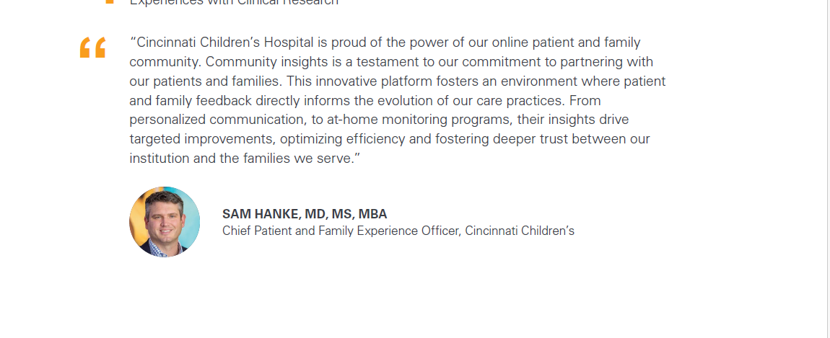
04 Co-Design: Amplifying Consumer + Community Voices
Notes:
NRC Health’s Community Insights tool provides a more contemporary approach that makes it easy for
health organizations to run reliable custom studies at scale.

Slide 9
Section 2
Understanding detractors
Detractors are healthcare’s misunderstood stakeholders

Slide 10
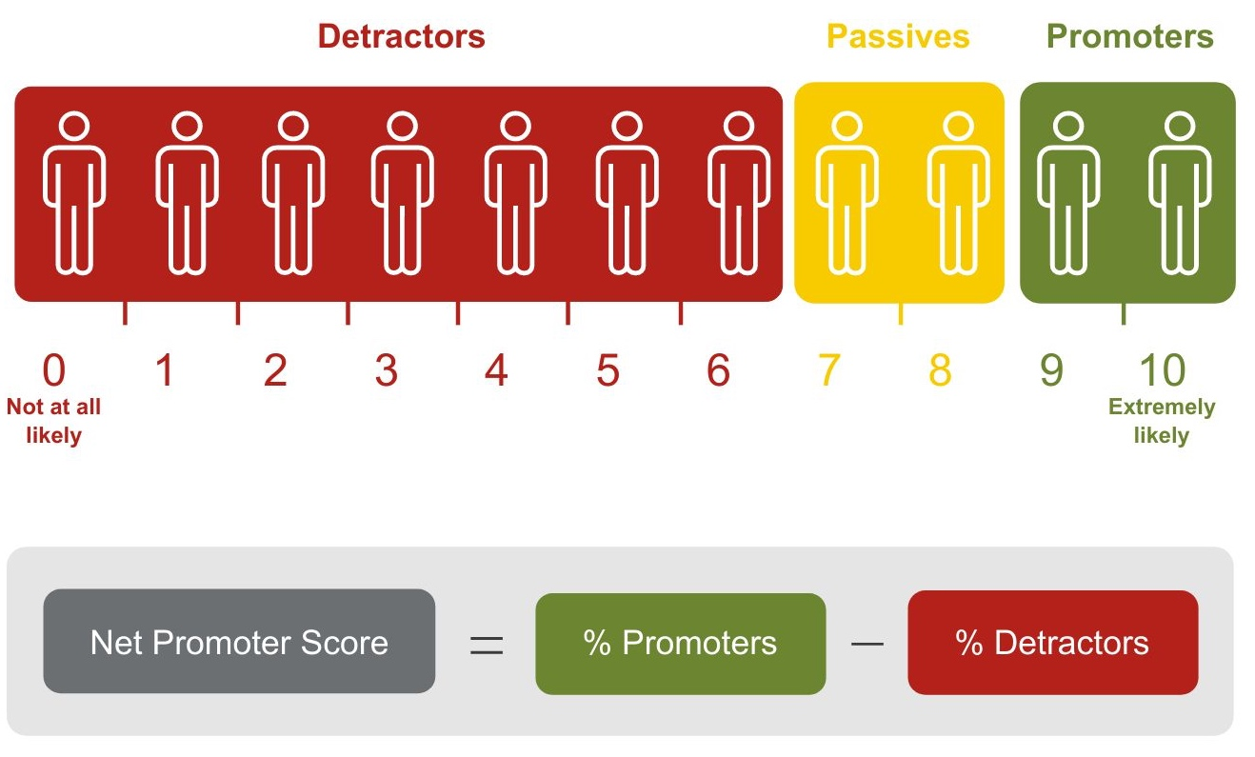
NPS Components

Slide 11
Good News
Healthcare Detractors are forgiving, which reinforces the importance of understanding what makes them tick.
Make every effort to mind gaps in care.

Slide 12
Section 3
Emerging trends
Paying close attention to what matters helps anticipate real-world needs.

Slide 13
2023 Trends
Retail clinic usage
Preference for health systems
NPS for healthcare facilities
Loyal to hospital or health systems
Future mobile device usage
Visiting hospital websites

Slide 14
Bottom Line
Elevating experience requires thinking differently and taking decisive action.
The idea that innovation starts with the fundamentals is a great place to start, and the One Big Dot approach is a game-changer.
Better understanding Detractors – minding the gap – should help us miss the mark less often and change the trajectory when we do.
And the trends all reinforce the need to pay close attention to what matters so we can anticipate and meet real-world needs.
Human Understanding is the line of continuity that runs through every aspect of experience for all involved. Because healthcare is human care.

Slide 15
Final Thoughts, Questions, Pushback

Slide 16
Reflection and Wrap-up
What can you do to meet/exceed expectations related to access in your organization?
What is 1 takeaway that stands out for you?
What’s the first step you will take to advance 1 new idea in your organization?

Slide 17
Thank you.

